Slide 1
A Service Based Approach to Connect Seismological Infrastructures: Current Efforts at the IRIS DMC
By Tim Ahern and Chad Trabant

Slide 2
Key points in this talk
Federated Services in Seismology (COOPEUS)
Standardized access to seismological Data Centers resulting in federated services within seismology
Vertical Integration in seismology
Horizontal Integration Across Earth Sciences
Initial funding from NSF EarthCube
GeoWS
Deploying “somewhat” standard web services across geosciences
Brokering – B-Cube
Registation Services - CINERGI

Slide 3
Vertical Integration of Seismological Data Centers
FDSN federated web services
dataselect – for time series observations
station – for metadata describing the recording station
event – info related to earth2uakes and events
Fully adopted by the FDSN working groups
Description of the payload (XML, text, etc)
Calling convention ( parameter specifications)

Slide 4
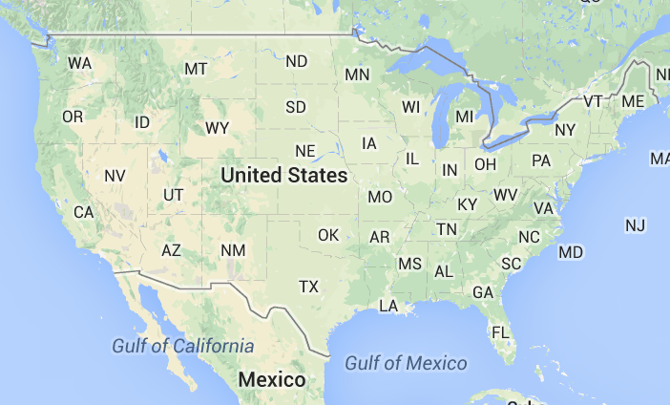
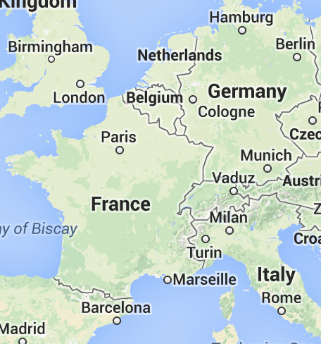
Participants in Federation

Slide 5
Standardization of web services
Root URL: unique for each data center
IRIS http://service.iris.edu/fdsnws/station/1/
ORFEUS http://www.orfeus-eu.org/fdsnws/station/1/
NCEDC http://ncedc.org/fdsnws/station/1/
RESIF http://ws.resif.fr/fdsnws/station/1/
GEOFON http://geofon-open2.gfz-potsdam.de/fdsnws/station/1/
INGV http://webservices.rm.ingv.it/fdsnws/station/1/
ETH http://eida.ethz.ch/fdsnws/station/1/
query?net=IU&sta=ANMO&loc=00&cha=BHZ&starttime=2010-02-27T06:30:00&endtime=2010-02-27T10:30:00&nodata=404
Query Parameters: standardized

Slide 6
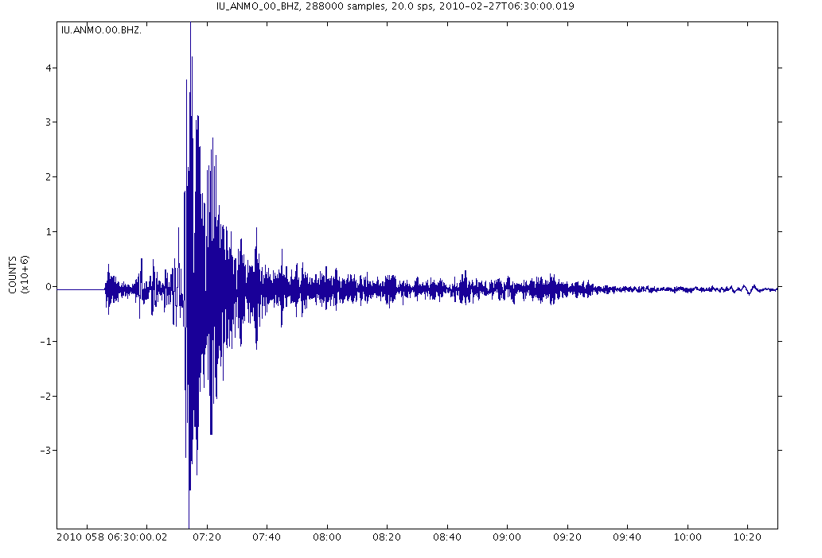
Output from an FDSN service - dataselect

Slide 7
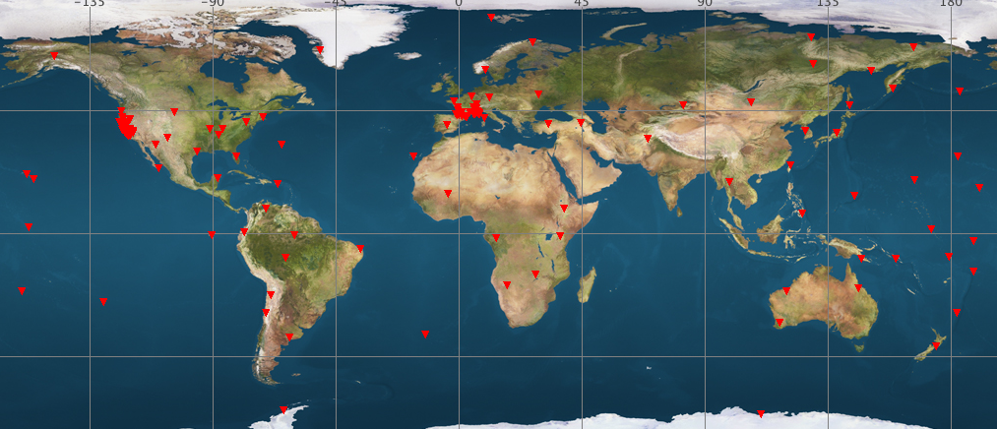
Accessing Information from NCEDC (BK), RESIF (FR), and IRIS (IU)

Slide 8
IRIS Federator
IRIS is developing a federating web service that will allow a user to make a request to a web service at IRIS. This service will return a set of URLs that will allow the software running on a user’s computer to directly access the appropriate data center to service their request
IRIS
Federator
USER

Slide 9
EarthCube: GeoWS Overall Goals
To simplify
Data discovery
Standard and simplified web services supporting space-time (and more) queries
Data access
Simplified services also mean simple clients
PERL, MatLab, R, wget, etc
Data Usability
When possible standard widely used formats will be supported and when reasonable text output formats will be available to aid in interdisciplinary access

Slide 10
EarthCube GeoWS Partners
RAMADDA
Long Tail Data
GGP
NEON
IRIS
UNAVCO
UTEP
Gravity
NGDC
GeoWS
CUAHSI
SDSC
Caltech
GPlates
Inter
Magnet
OOI
Columbia
IEDA
Unidata
Structural
Geology
WOVODAT
B-Cube
CINERGY

Slide 11
Contributing Data Centers
GGP
UTEP
Gravity
Inter
Mag
Struc
Geol
WOVODAT
NEON
NGDC
OOI
RAMADDA
IRIS WS Shell
These 8 data collections plus the datasets from our funded centers address 14 of the 15 identified needs in a user scenario in geodynamics identified at the EarthCube-EarthScope End User workshop

Slide 12
Key milestones
Standardized space-time queries for 14 geosciences data types/centers
Data discovery client
Standardized documentation
URL builders
GUI to URL builders to provide proper URL construction
Development of Simple clients
Standard and Simple cross-domain formats developed

Slide 13
Thank You!

