Slide 1
Broadband Array in Taiwan for Seismology (BATS) http://bats.earth.sinica.edu.tw Institute of Earth Sciences Academia Sinica
Yifan Yin*, Wen-Tzong Liang,
Chun-Chi Liu and Bor-Shouh Huang
Notes:
Hello everyoneThe highest ranking academic institute in Taiwan.
Our institute owns several different networks, BATS is our seismic networks

Slide 2
History of BATS
1992 Project initialized
1994 Start building the first station
1996 Operation start
1998 Data open to public
2001 CWB joined the project
Present
59 High quality broad-band stations
BATS data center
Our missions:
To better monitor the earthquake activity in the Taiwan region
Provide high-quality, continuous data to meet a variety of research demands
Notes:
The plan of building a broadband seismic network started under way in mid-1992.
It later got its name and enter test operation in 1994. There were 15 permanent stations at that time.
In 1996, BATS started operating officially, and opened its data since 1998.
Our mission...
These two goals remain as our most important “??”

Slide 3
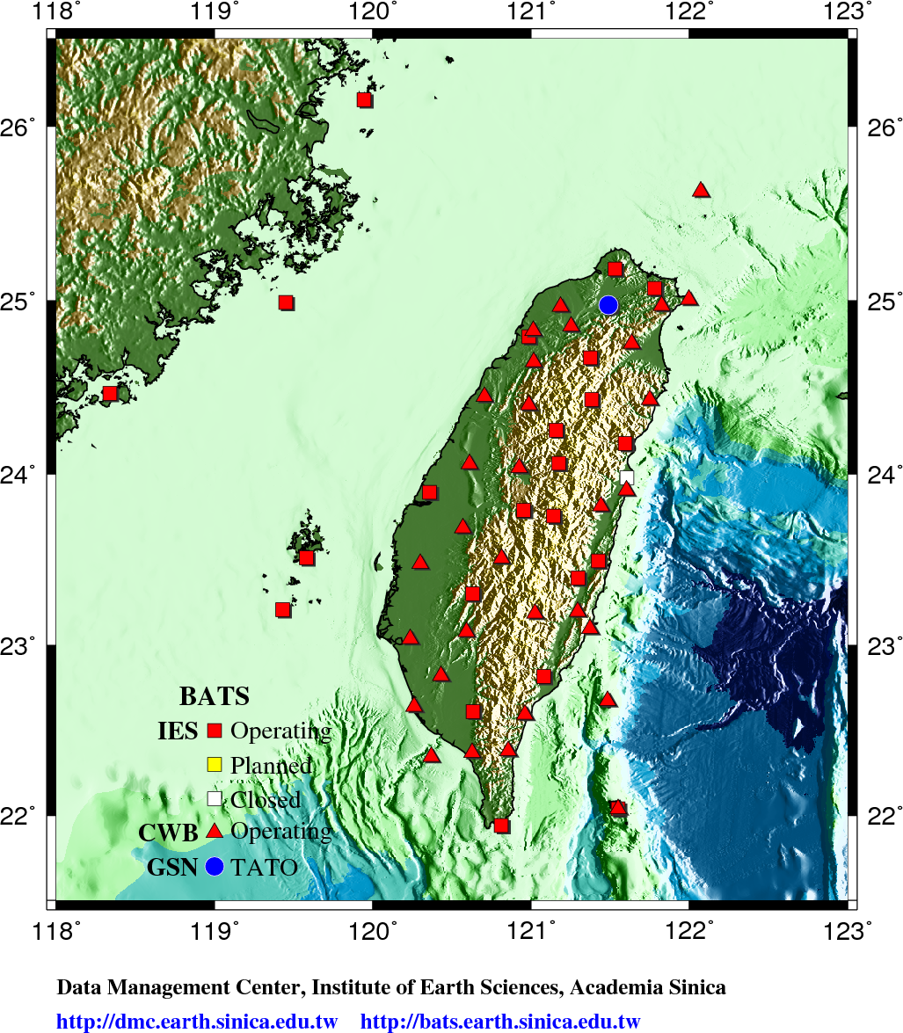
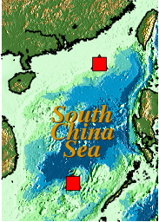
BATS Stations
BATS-IES:
25 stations
Realtime: 24
IRIS: 7
Satellite: 5
Instrument types
STS-1/STS-2
Trillium 120/ 240
CMG 3TB
EpiSensor
BATS-CWB:
34 stations
Instrument types
CMG 3T
CMG 3ESP
CMG 40T
EpiSensor
GSN station (TATO)
Notes:
This is the map of BATS stations.
We have 25 stations spread across the main island and other surrounded islands.
All stations except LYUB are real-time stations.
Seven of them contribute real-time data to IRIS DMC.
We also have 5 satellite stations on far reaching islands and mountainous area.
Such as the two islands in south china sea.
The instruments presently operating right now are listed here.

Slide 4
Station | Location | Lat. | Lon. | Elev. | Geology | Sensor | Recorder | Comm. | Operating | Network
ANPB | Anbu | 25.1828 | 121.5292 | 875 | Andesite | STS-2 | Q330 | - | 970618~ | TW
CHGB | Ching-ging | 24.0602 | 121.174 | 1850 | Slate | STS-2 | Q330HR | ADSL | 050802~ | TW
HGSD | Houtzshan | 23.4921 | 121.4239 | 132 | N.A. | CMG-3TB | Q330HR | FR | 040425~ | TW
KMNB | Kinmen | 24.4638 | 118.3882 | 54 | Granite | Trillium240 | Q330HR | ADSL | 980205~ | TW
LYUB | Lanyu | 22.0373 | 121.5581 | 324 | Andesite | Trillium120 | Q330 | - | 980716~ | TW
MASB | Mahsi | 22.6119 | 120.6328 | 139.4 | N.A. | STS-1 | Q330HR | ADSL | 071102~ | TW
MATB | Matsu | 26.14021 | 119.9291 | 30 | Granite | Trillium240 | Q330HR | ADSL | 090423~ | TW
NACB | Ninganchiao | 24.1738 | 121.5947 | 130 | Marble | STS-2 | Q330HR | FR | 950727~ | TW
NNSB | Nanshan | 24.4284 | 121.3828 | 1102 | Slate | Trillium240 | Q330HR | ADSL | 060323~ | TW
PHUB | Penghu | 23.5114 | 119.5801 | 15 | Basalt | STS-2 | Q330HR | ADSL | 020501~ | TW
RLNB | Erlin | 23.8911 | 120.3594 | 40 | Sediment | CMG-3TB | Q330 | ADSL | 040625~ | TW
SBCB | Shibagienshan | 24.7924 | 120.9854 | 125.7 | N.A. | Trillium240 | Q330HR | ADSL | 070717~ | TW
SSLB | Suanglung | 23.7875 | 120.954 | 450 | Sandstone | Trillium240 | Q330HR | ADSL | 960604~ | TW
TATO | Taipei | 24.9735 | 121.4971 | 157 | Siltstone | KS-54000 | Q330HR | - | 1992~ | IU
TDCB | Techi | 24.252 | 121.1583 | 1280 | Slate | STS-1 | Q330HR | FR | 960315~ | TW
TPUB | Dapu | 23.3005 | 120.6296 | 370 | Siltstone | Trillium240 | Q330HR | FR | 950323~ | TW
TWGB | Taitung | 22.8176 | 121.0799 | 195 | Meta-Sandstone | Trillium240 | Q330HR | ADSL | 941006~ | TW
TWKB | Kenting | 21.9406 | 120.8125 | 90 | Sandy Shale | Trillium240 | Q330HR | ADSL | 941108~ | TW
WFSB | Wufenshan | 25.0716 | 121.7806 | 751 | Siltstone | STS-2 | Q330 | FR | 971023~ | TW
WUSB | Wushe | 23.9919 | 121.1175 | 1552.4 | N.A. | STS-2 | Q330HR | ADSL | 110622~ | TW
YHNB | Yeheng | 24.6698 | 121.3748 | 785 | Slate | STS-2 | Q330HR | ADSL | 021003~ | TW
YULB | Yuli | 23.3924 | 121.2973 | 340 | Black Schist | Trillium240 | Q330HR | FR | 000215~ | TW
VCHM | Cimei Is. | 23.2087 | 119.4295 | 60 | Basalt | Trillium120 | TAURUS | VSAT | 100427~ | TW
VDOS | Dongsha Is. | 20.701 | 116.7306 | 38 | Coral reef | Trillium120 | TAURUS | VSAT | 090506~ | TW
VNAS | Nansha Is. | 10.3774 | 114.365 | 2 | Sedi. | Trillium120 | TAURUS | VSAT | 090720~ | TW
VWUC | Wuchiu | 24.9911 | 119.4492 | 5 | Rock | Trillium120 | TAURUS | VSAT | 090915~ | TW
VWDT | Danda | 23.75372 | 121.1412 | 2578 | Rock | Trillium120 | TAURUS | VSAT | 110426~ | TW

Slide 5
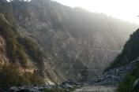
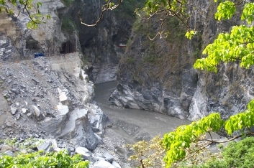
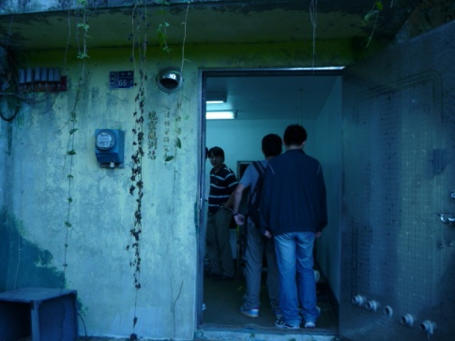
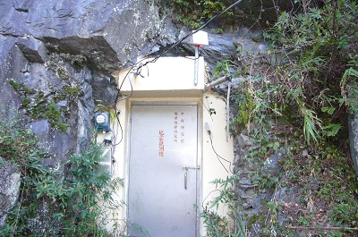
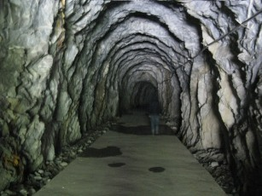
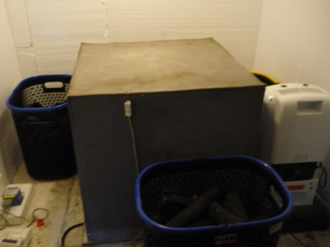
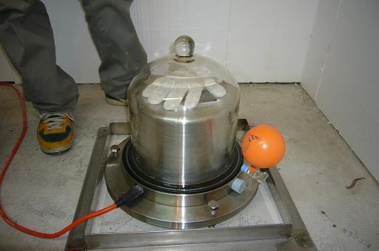
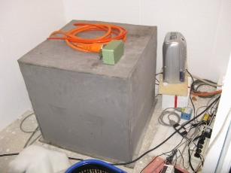
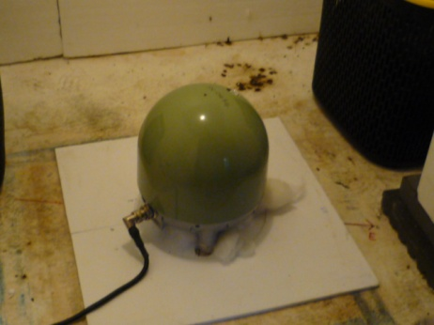
Site Condition
TDCB Techi
NACB Taroko
YULB Yuli
STS-1
Trillium 240
STS-2

Slide 6
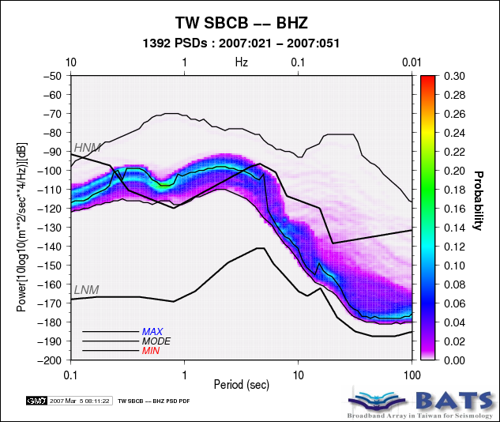
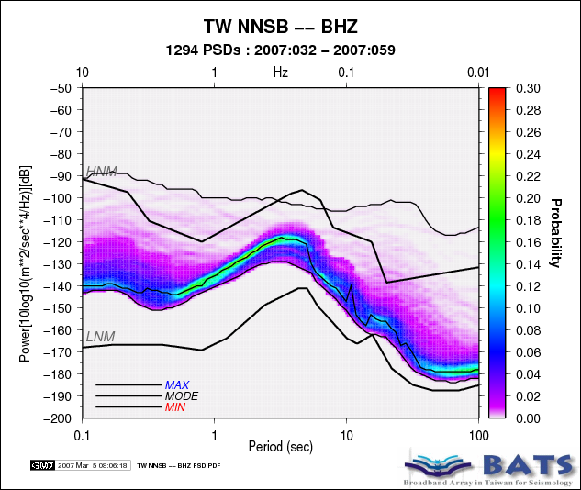
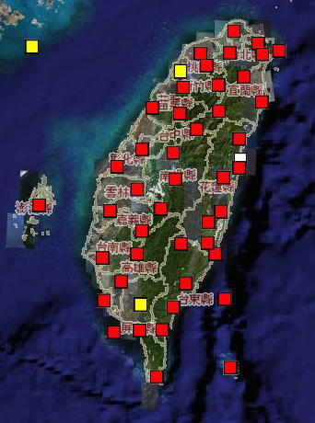
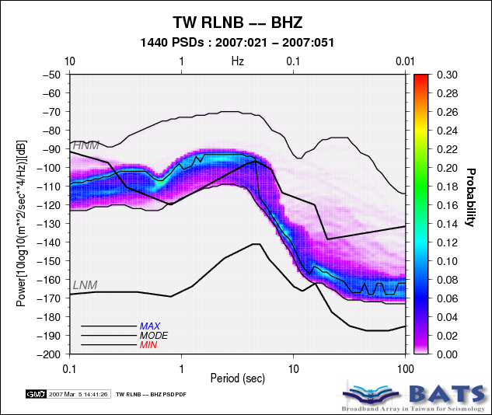
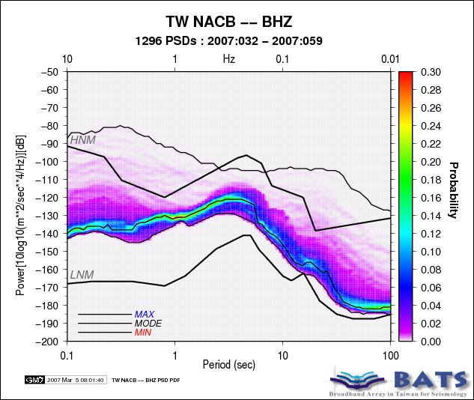
Stations -- Ambient Noise Level
Plain
Mountain

Slide 7
Routine Tasks
Waveform Data Processing
Quality Control
Data archiving
Data distribution
Metadata update
BATS CMT source inversion for felt regional earthquakes
Real-time Seismology
International collaboration
Japan, Malaysia, Philippine, Vietnam, Germany, Laos
On-going Projects

Slide 8
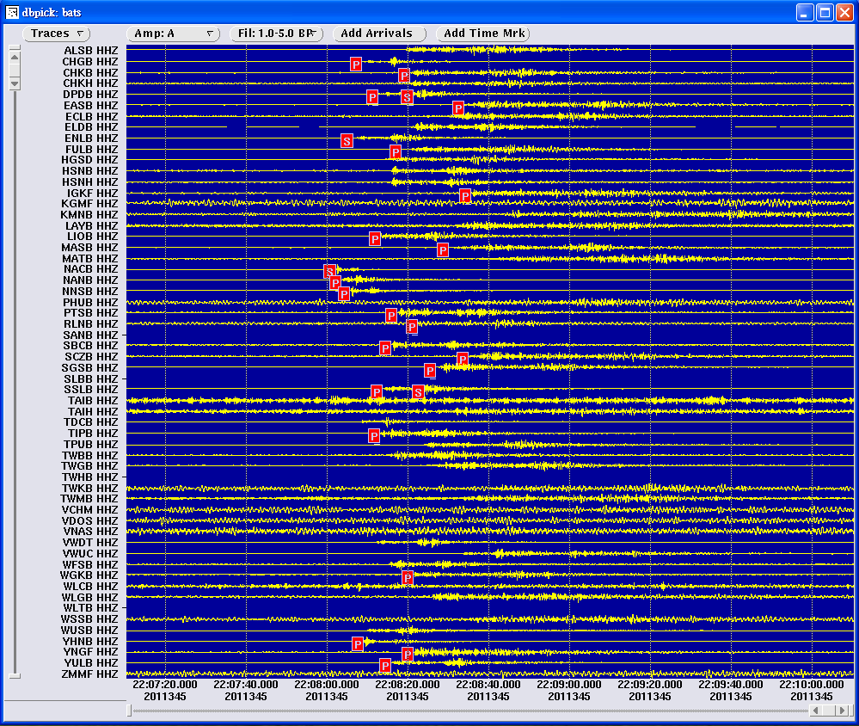
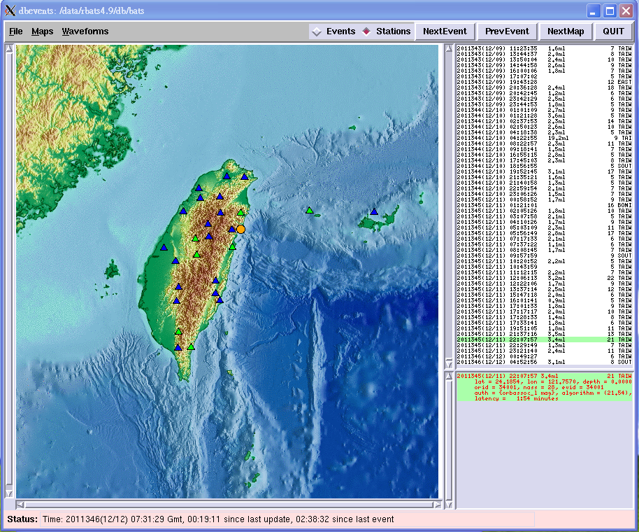
Data Acquisition Systems
Earthworm
Antelope – BATS / SCS / GSN
SeisComP

Slide 9
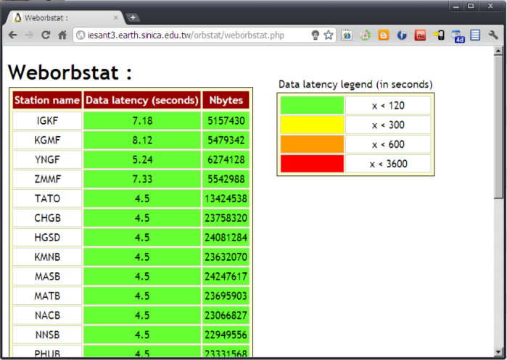
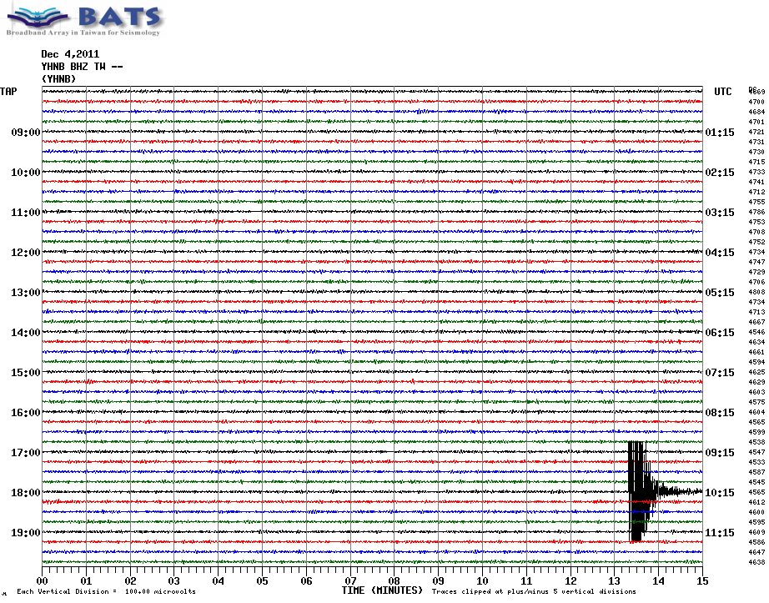
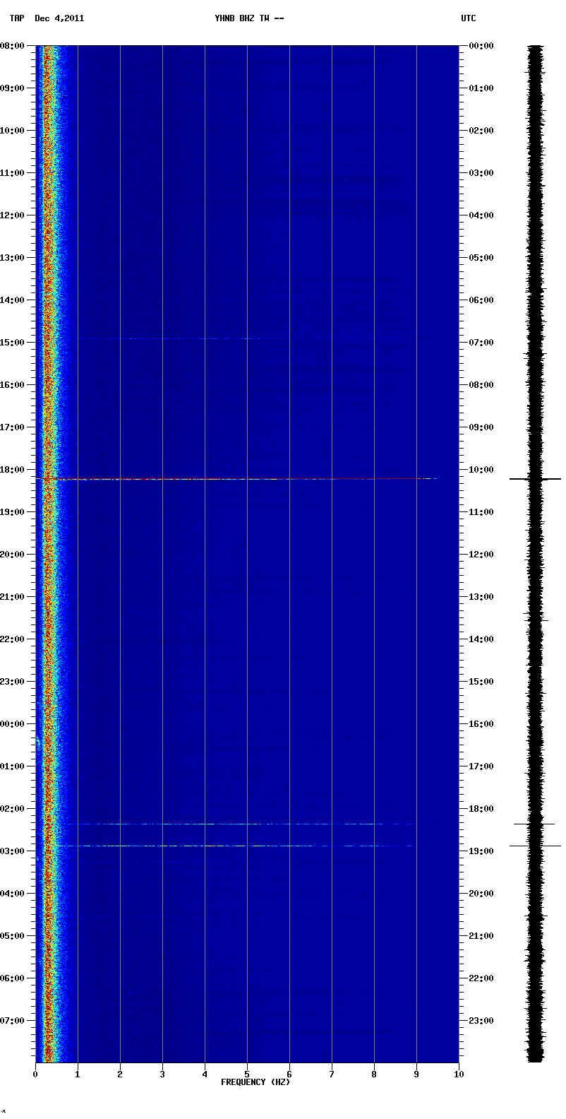
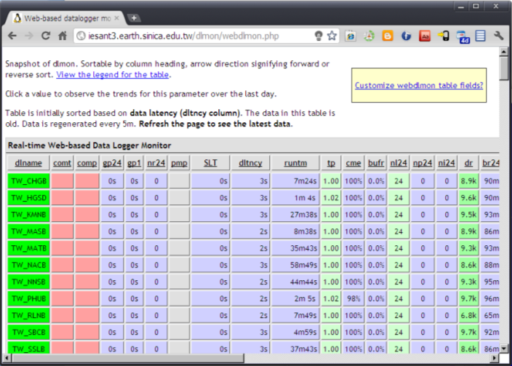
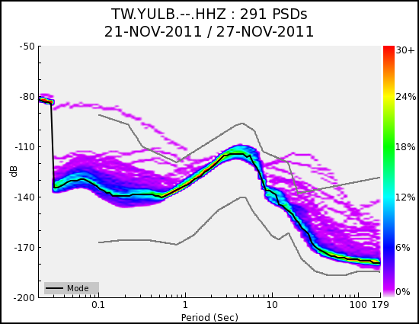
Routine Tasks -- Real-time Quality Control
Station Status
Data Status
Helicorder
Spectrogram
latency
Weekly PDF
Data logger

Slide 10
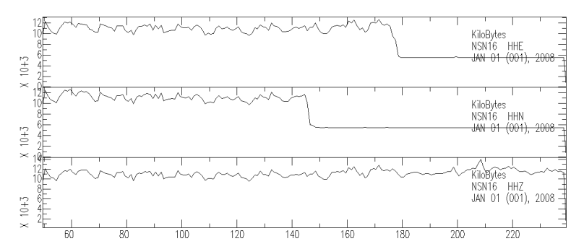
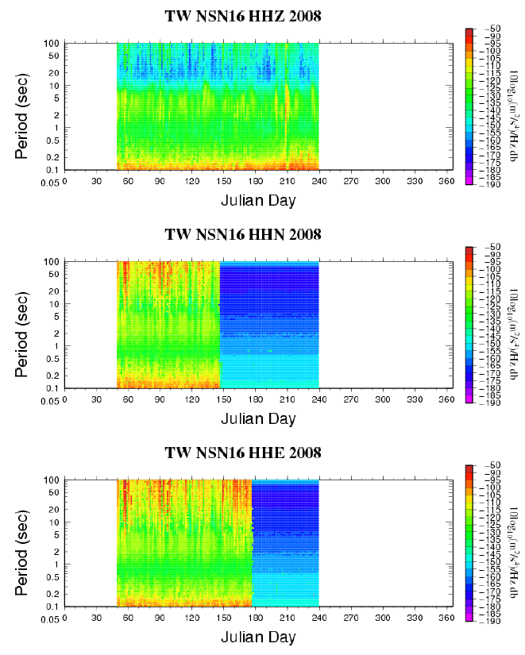
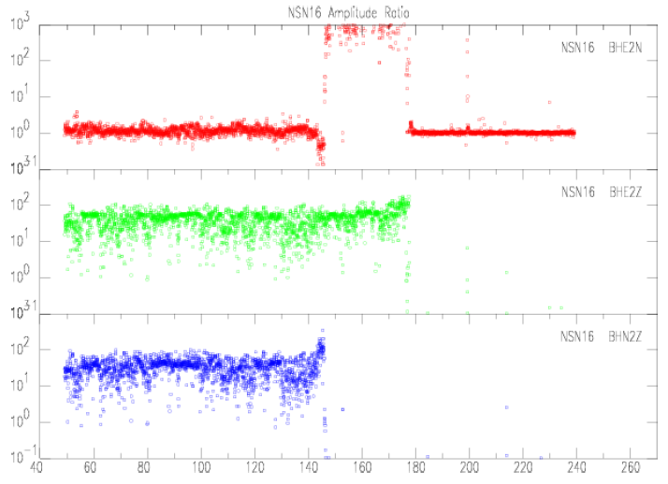
Routine Tasks -- Archive Quality Control
Daily seed availability
Daily seed size
E2N
E2Z
N2Z
Hourly RMS amplitude ratios between the three components
Daily PDF

Slide 11
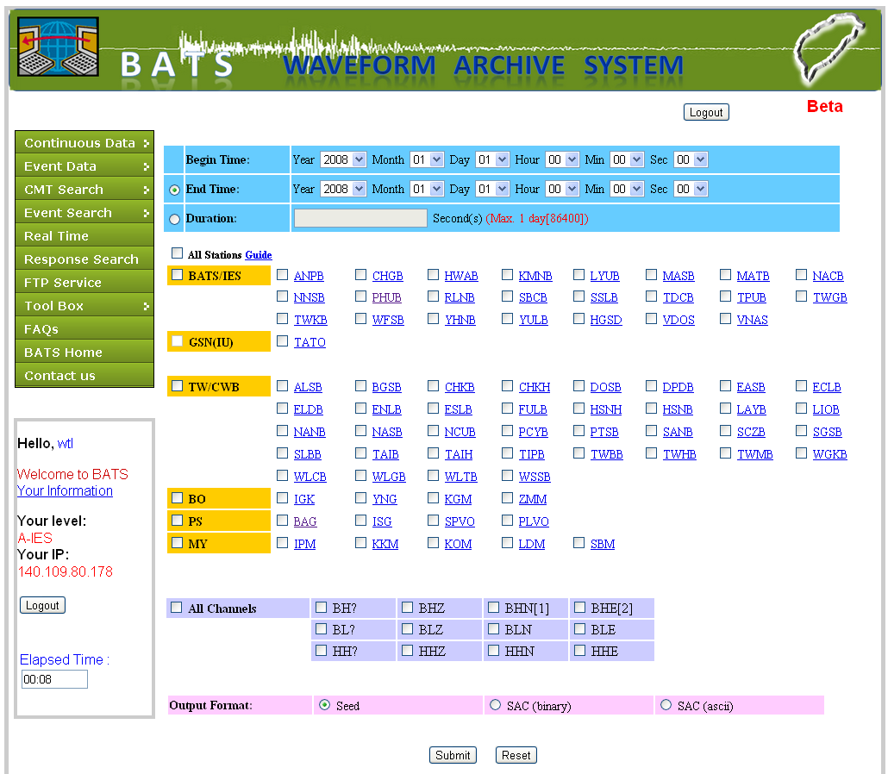
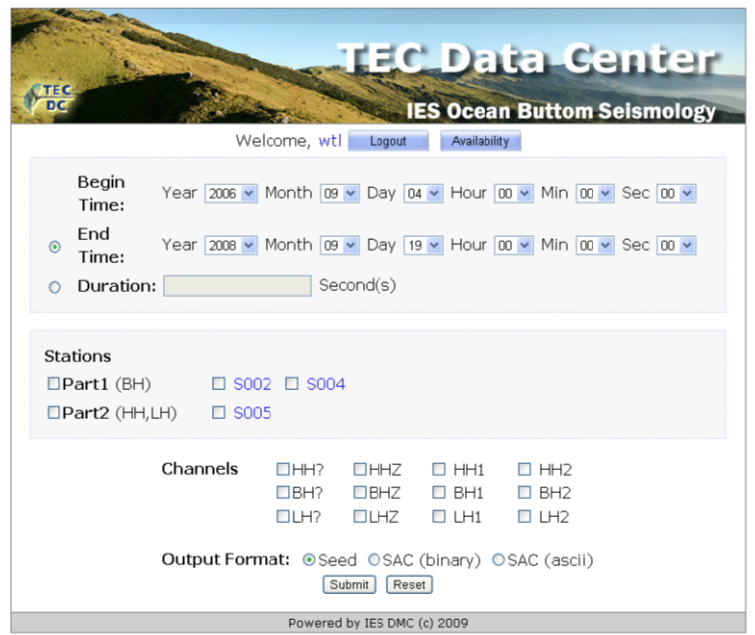
Routine Tasks
-- Data Archiving and Distribution
Standard database with metadata and miniseed volumes
Web-based data request system
Event/Data Query
Waveform Browsing
Data Download

Slide 12
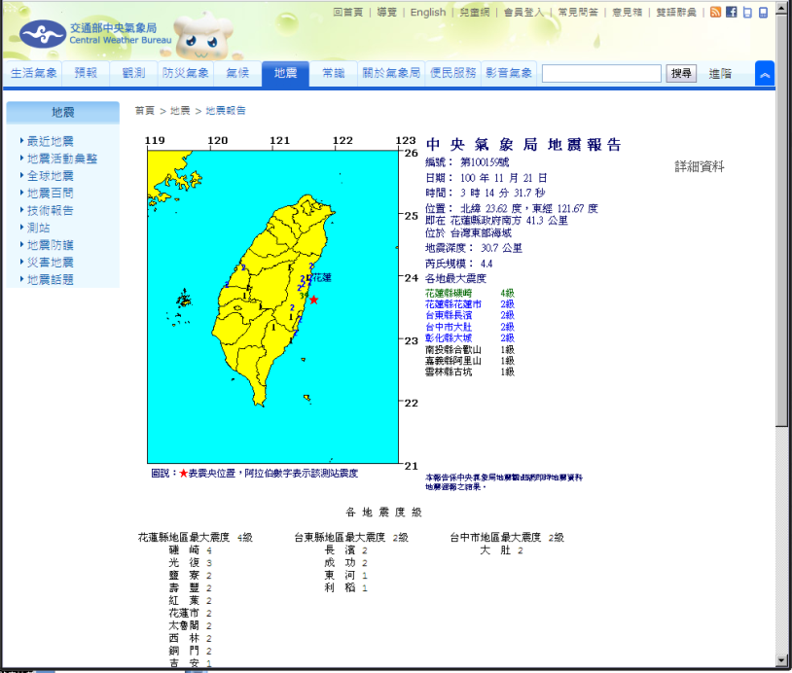
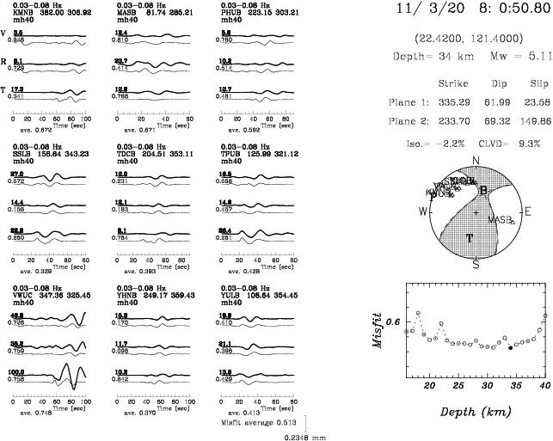
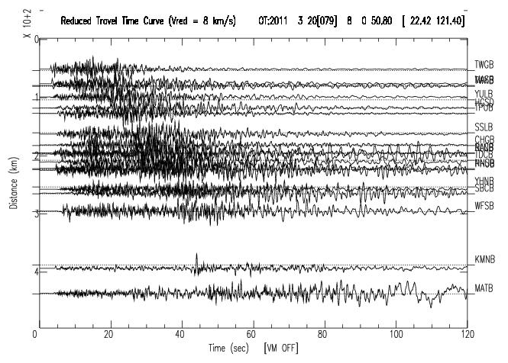
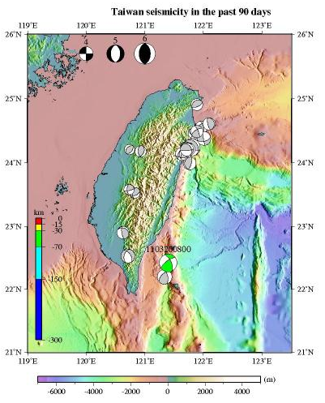
Routine Tasks -- Rapid Focal Mechanism Determination
Locations from CWB
BATS Real-time waveforms

Slide 13
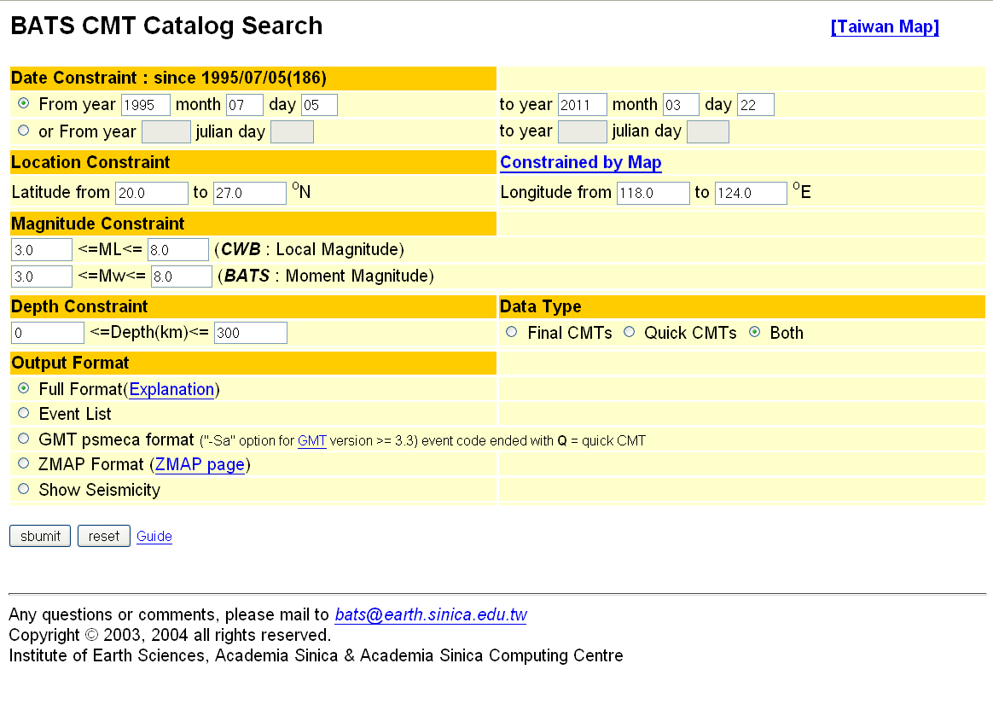
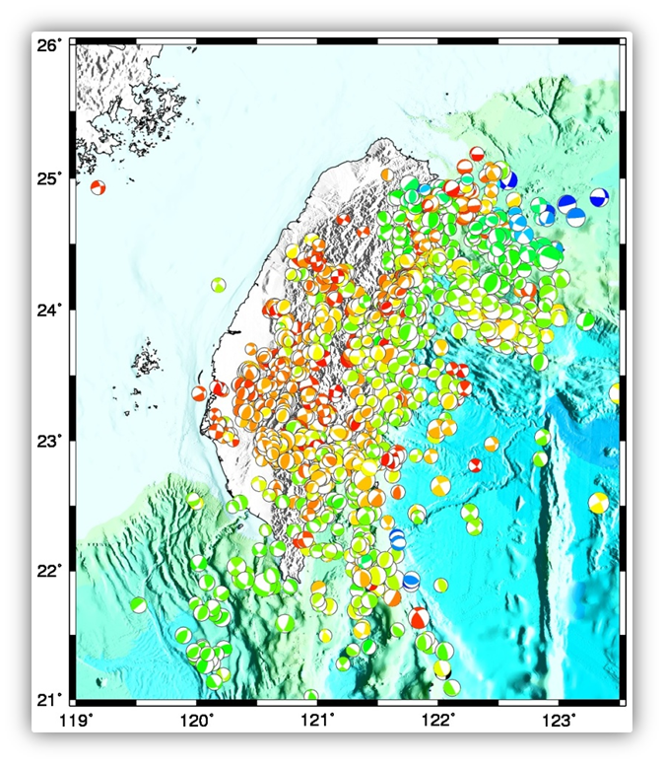
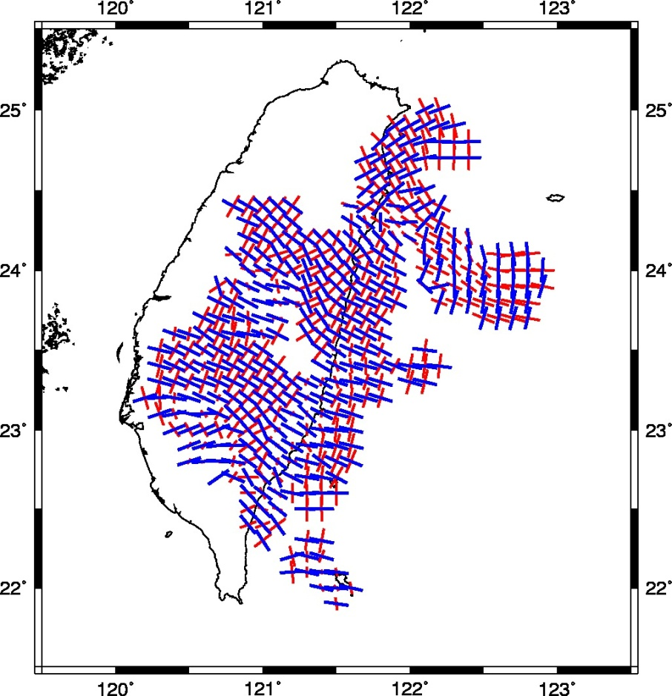
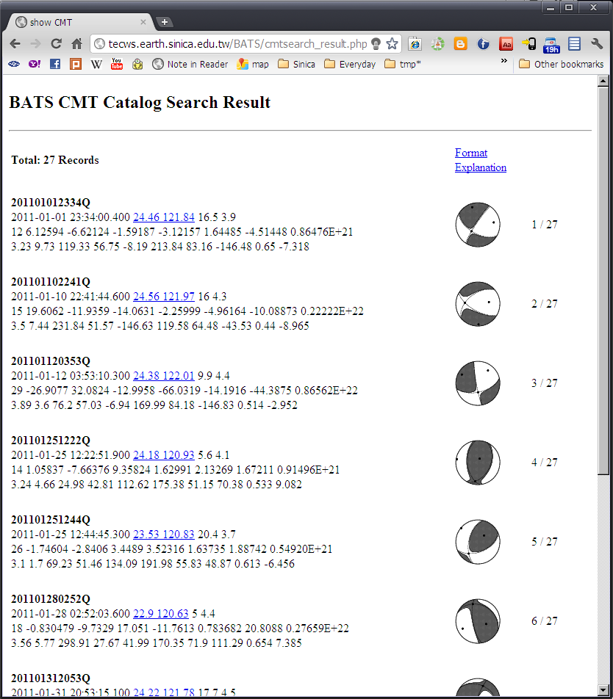
BATS CMT Solution Catalog

Slide 14
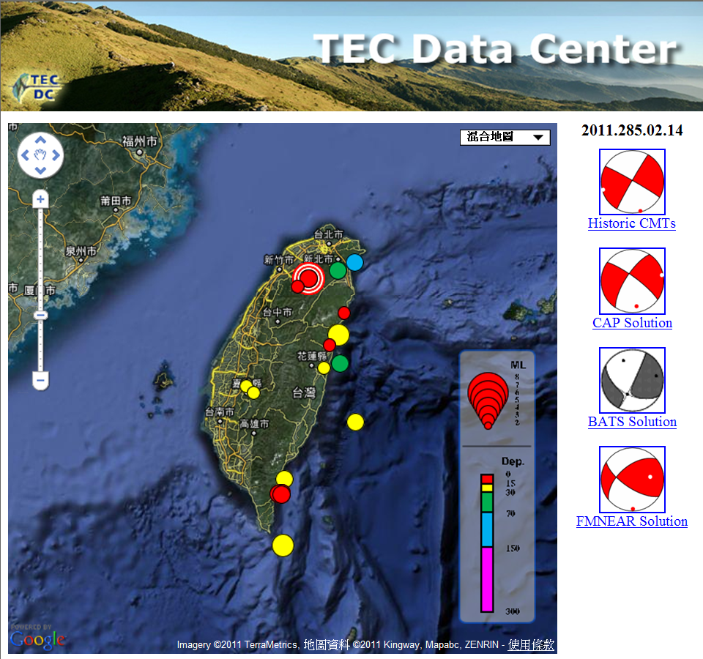
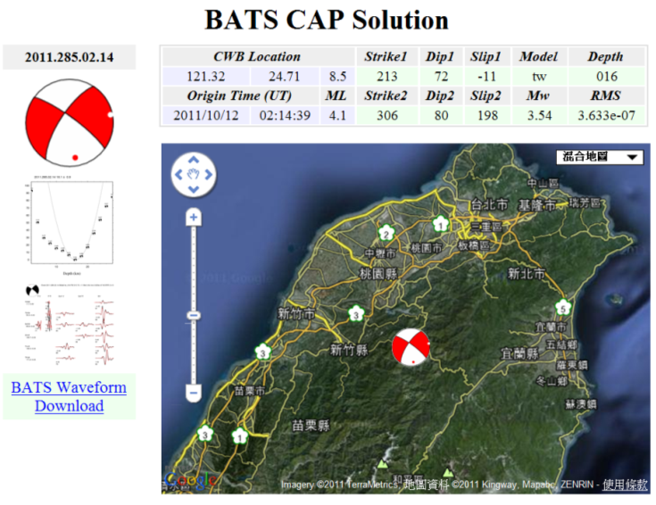
Automated Near Real-Time Source Inversion
Automated near real-time focal mechanism determination
Zhao et al, 2011

Slide 15
Real-time Moment Tensor Monitoring
Lee et al, 2011

Slide 16
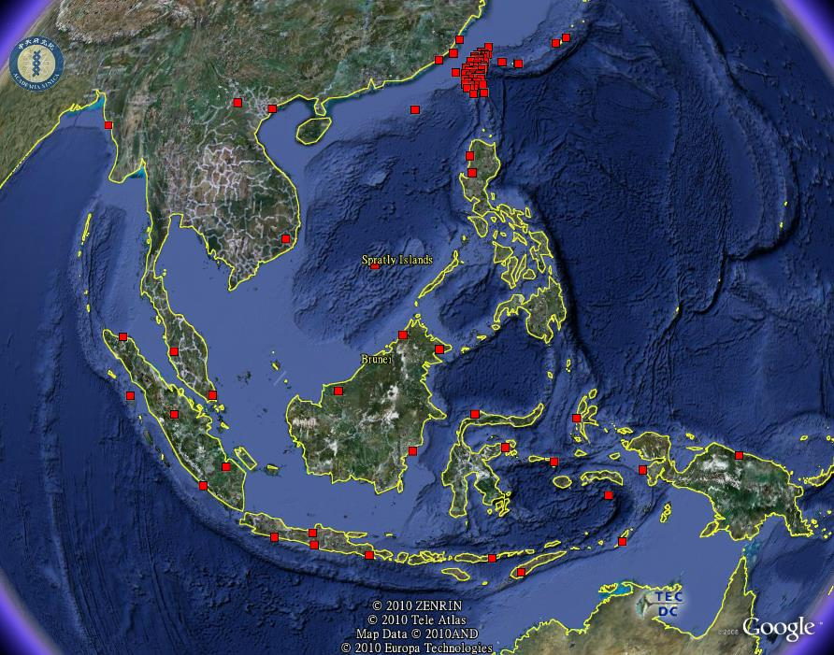
Real-time Data Exchange Among Data Centers
Virtual South China Sea Seismic Network
Manila Trench
GSN: 1 (IRIS)
F-Net: 4 (NIED)
OHP: 4 (JAMSTEC)
MMD: 5 (Malaysia)
GEOFON: 20 (GFZ)
RIMES: 4

Slide 17
Future Work
Automated quality control system
Promoting data standards to other research institutes in Taiwan
More advanced web services
Intensify the regional collaborations
Thank You!!

