Slide 1
Portable Data Collection Center (PDCC) and the Nominal Response Library (NRL)
Tim Ahern

Slide 2
PDCC – creation of dataless SEED
SEED
metadata contains both simple and complex informatio
format is difficult to build and edit correctly
PDCC
was designed to simplify the task of building metadata to describe your seismic stations/channels
can also be used to edit existing dataless SEED volumes
is a client application that runs in a terminal window
Java so runs on most operating systems

Slide 3
Hierarchical Structure of SEED components
Standard for Exchange of Earthquake Data (SEED) Volumes contain two parts
Dataless SEED volume
Networks
Two character network code
Stations
Five character station names
Location Identifiers
Two character without required convention
Channels
Three character channel codes
Data only SEED or miniSEED

Slide 4
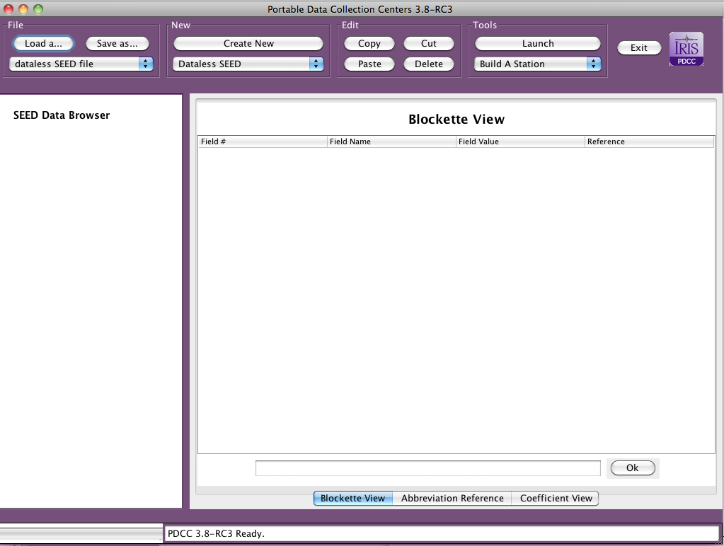
PDCC startup window

Slide 5
To get started
Create a new dataless SEED volume
Launch Build a Station
Enter Station Code and Network ID
Answer a variety of questions about network and station
Latitude, Longitude, and Elevation and Depth
Define Instrumentation
Using NRL tool
Specify Configuration of Sensor at Station
Manufacturer and configuration
The information must match configuration of actual station in the field

Slide 6
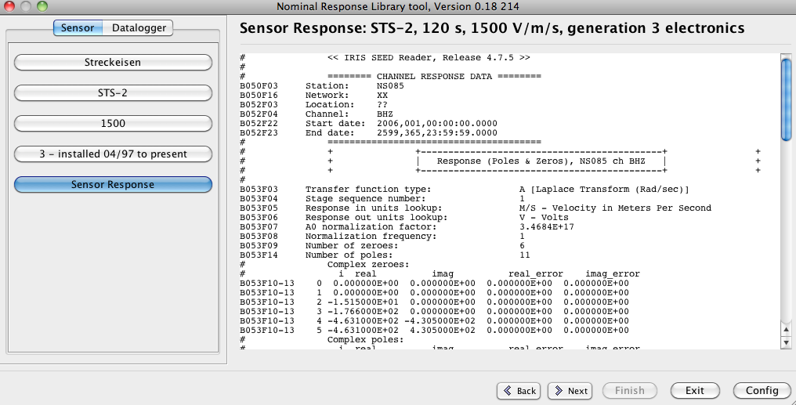
PDCC displays a RESP file after the sensor is fully specified identified

Slide 7
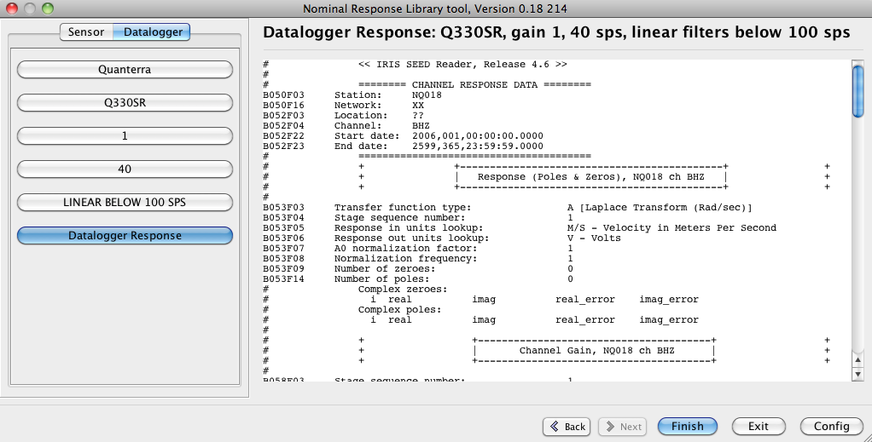
Next select and specify datalogger configuration PDCC will display the RESP file for the data logger

Slide 8
NRL (http://www.iris.edu/NRL)
Directories each have an index.txt file that enables logical navigation of the NRL
[Main]
question = "Select the hardware category”
[Sensor]
path = "sensors/index.txt”
[Datalogger]
path = "dataloggers/index.txt"

Slide 9
Selecting sensor
[Main]
question = "Select the sensor manufacturer”
[CEA-DASE]
path = "dase/index.txt”
[Eentec]
path = "eentec/index.txt”
[Geotech]
path = "geotech/index.txt”
[Guralp]
path = "guralp/index.txt”
[Kinemetrics]
path = "kinemetrics/index.txt”
[Lennartz]
path = "lennartz/index.txt"

Slide 10
Selecting Sensor Continued
[Nanometrics]
path = "nanometrics/index.txt”
[OYO Geospace]
path = "oyo_geospace/index.txt”
[REF TEK]
path = "reftek/index.txt”
[Sercel/Mark Products]
path = "sercel/index.txt”
[Streckeisen]
path = "streckeisen/index.txt”
[Generic]
path = "generic/index.txt"

Slide 11
If one selects Streckeisen for instance
[Main]
question = "Select the Streckeisen sensor model”
[STS-1]
path = "sts-1.txt”
[STS-2]
path = "sts-2.txt"

Slide 12
STS-2 specific configuration
[Main]
question = "Select the sensor sensitivity in V/m/s”
[1500]
path = "sts-2.1500.txt”
[20000]
path = "sts-2.20000.txt"
There can be many, many questions required to specify
The configuration at your seismic station

Slide 13
Sensor specification continued
[Main]
question = "Select the generation of electronics used in this STS-2"
detail = "streckeisen_sts2_sensors-details.html”
[1 - installed 01/90 to 09/94]
resp = "RESP.XX.NS081..BHZ.STS2_gen1.120.1500"
description = "STS-2, 120 s, 1500 V/m/s, generation 1 electronics”
[2 - installed 09/94 to 04/97]
resp = "RESP.XX.NS083..BHZ.STS2_gen2.120.1500"
description = "STS-2, 120 s, 1500 V/m/s, generation 2 electronics”
[3 - installed 04/97 to present]
resp = "RESP.XX.NS085..BHZ.STS2_gen3.120.1500"
description = "STS-2, 120 s, 1500 V/m/s, generation 3 electronics"

Slide 14
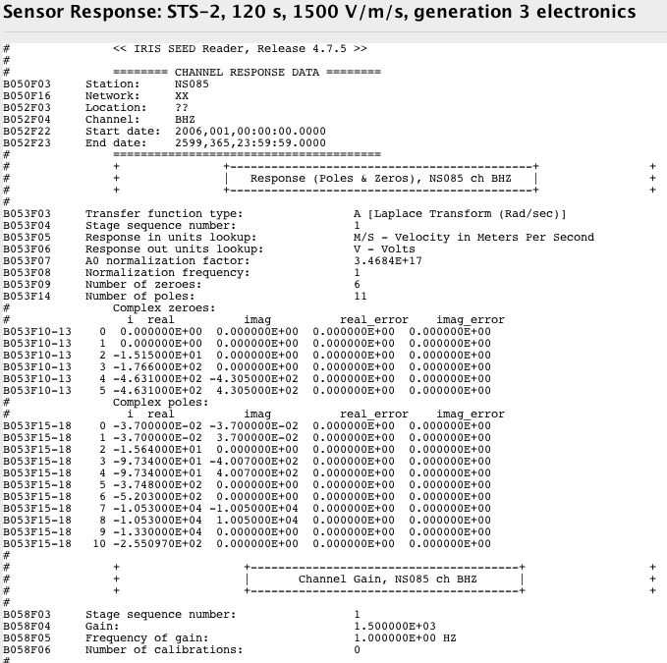
RESP File Produced
Stage 1
Poles & Zeroes
Gain

Slide 15
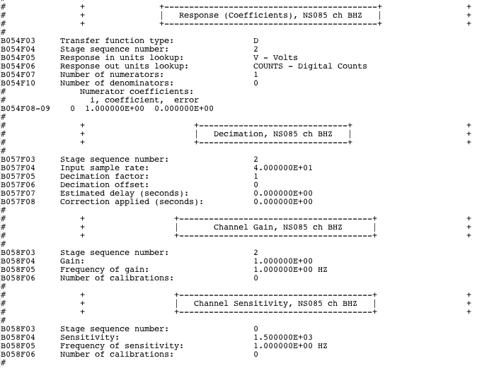
RESP file continued
Stage 2
Units
Sample Rate
Gain
Stage 0
Overall Gain

Slide 16
NRL could be used directly but
A utility called “NRL Tool” can be launched from within PDCC to make the navigation of the NRL directories simpler
This provides an easy to use GUI to help describe the seismic stations

Slide 17
Describe the first station completely
Then use Clone Station Tool to duplicate stations of similar configuration
Change things such as
Latitude, longitude, site name, elevation, depth, etc

Slide 18
The Goal
The goal at this workshop is for each of you to be able to produce the metadata that describes actual stations in your network
Focus will be on hands-on use of PDCC

