Slide 1
Measuring Seismic Noise
IRIS Metadata Workshop
January 12, 2012
Peter Davis
Project IDA
Scripps Institution of Oceanography
University of California, San Diego

Slide 2
Calculating background noise:
  Remove mean and trend of time series

Slide 5
Calculating background noise:
  Remove mean and trend of time series
  Apply a taper to reduce spectral leakage

Slide 6
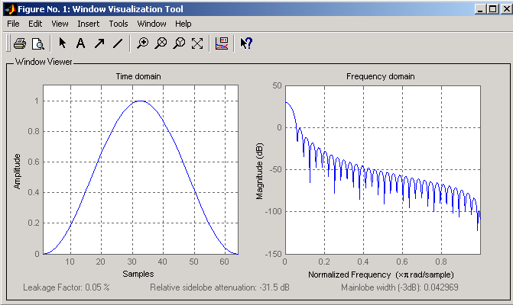

Slide 7
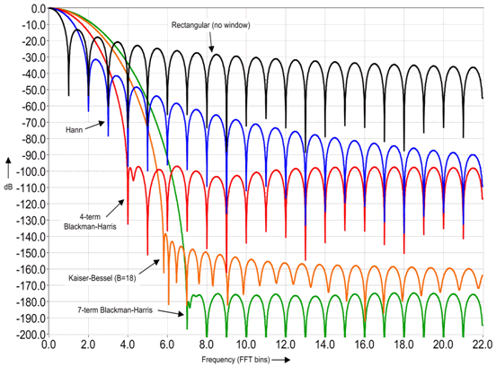
Types of data tapers (windows):
  Hanning
  Hamming
  Bartlett
  …

Slide 9
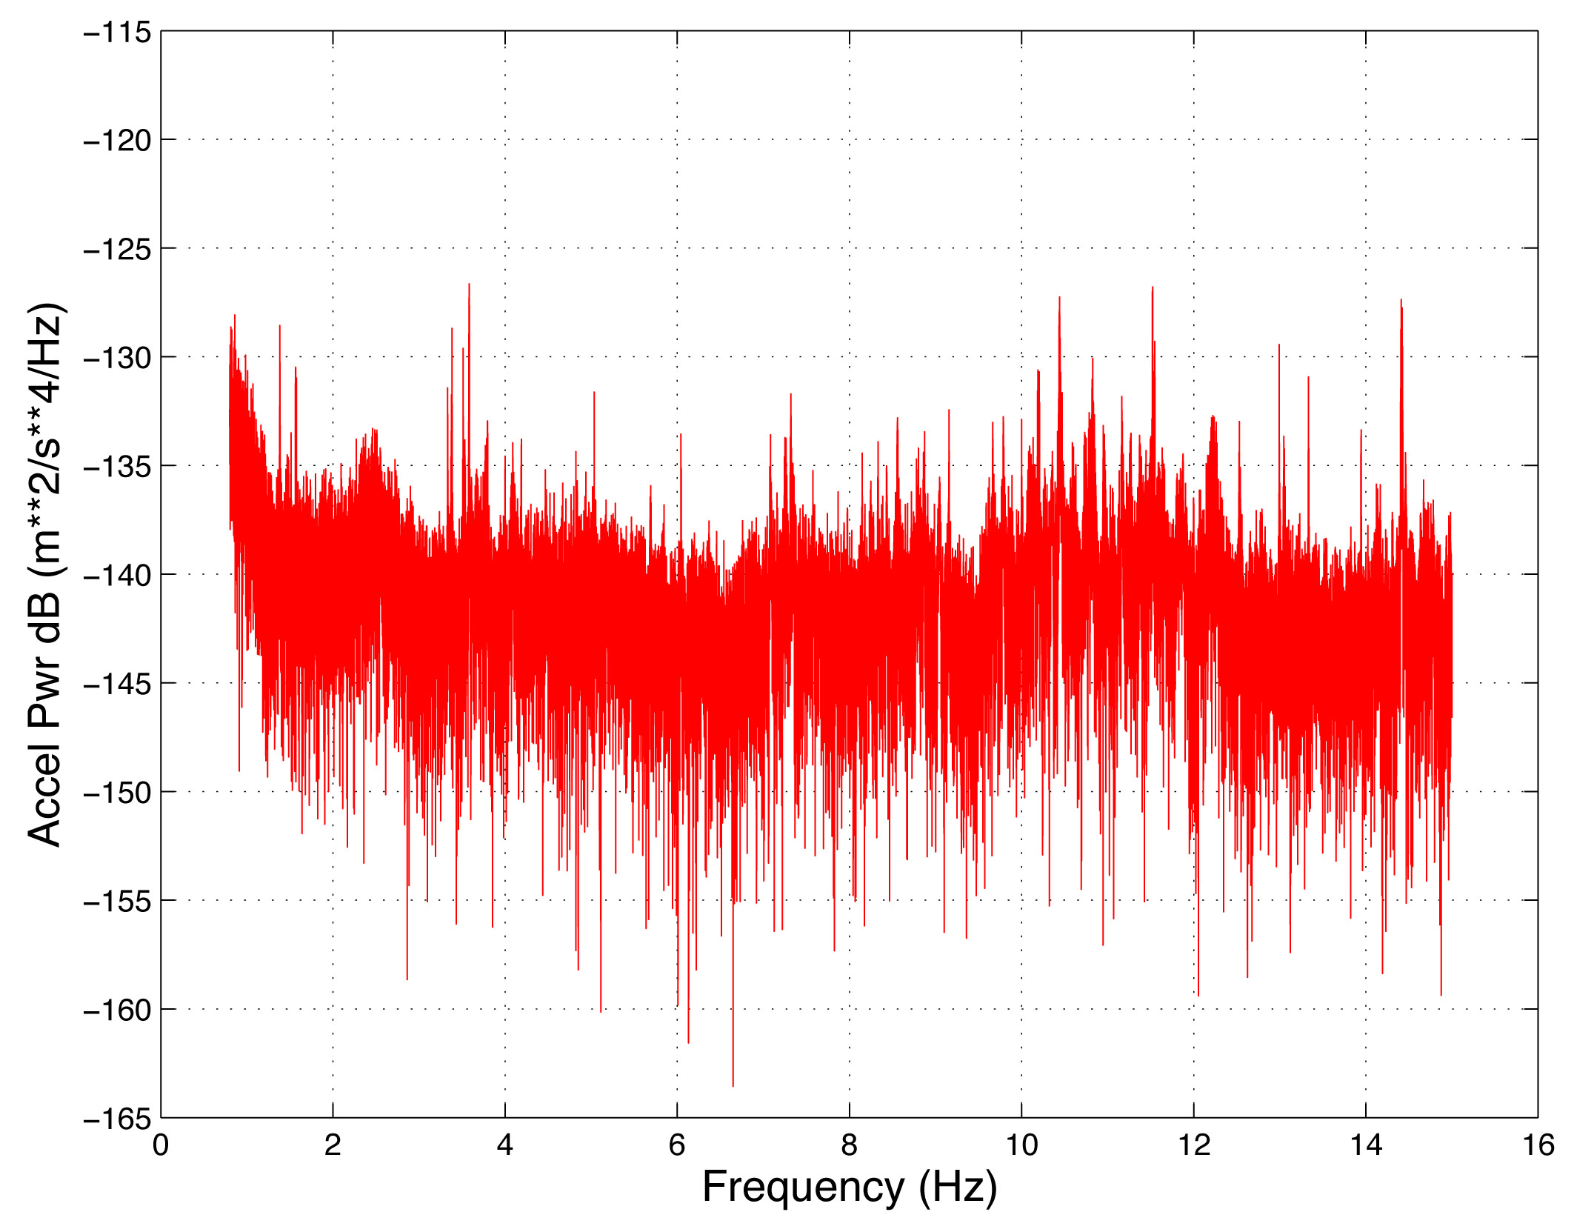

Slide 10
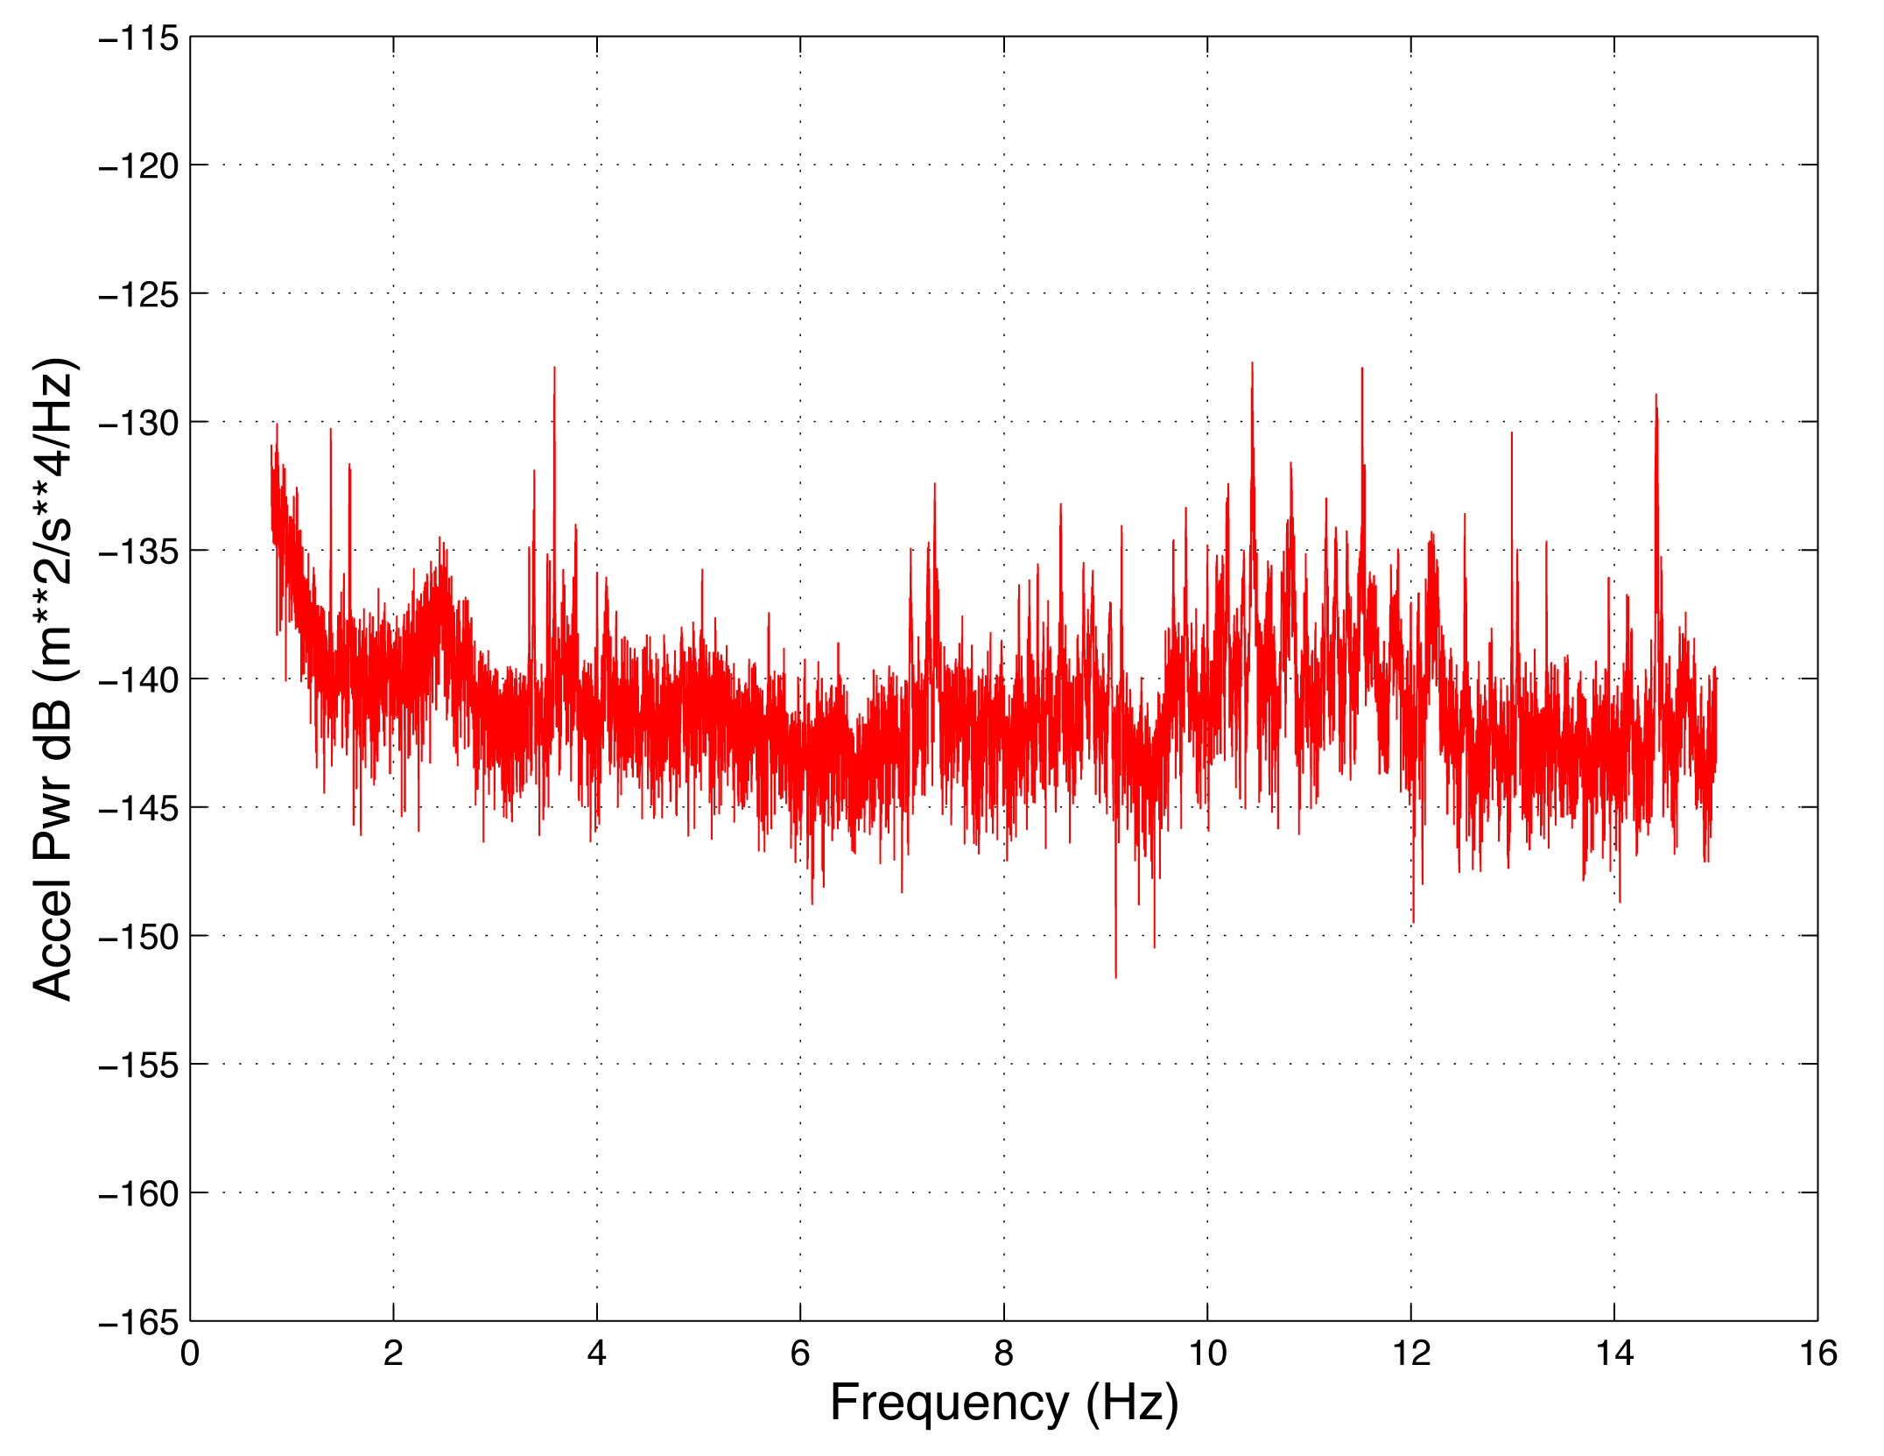

Slide 11
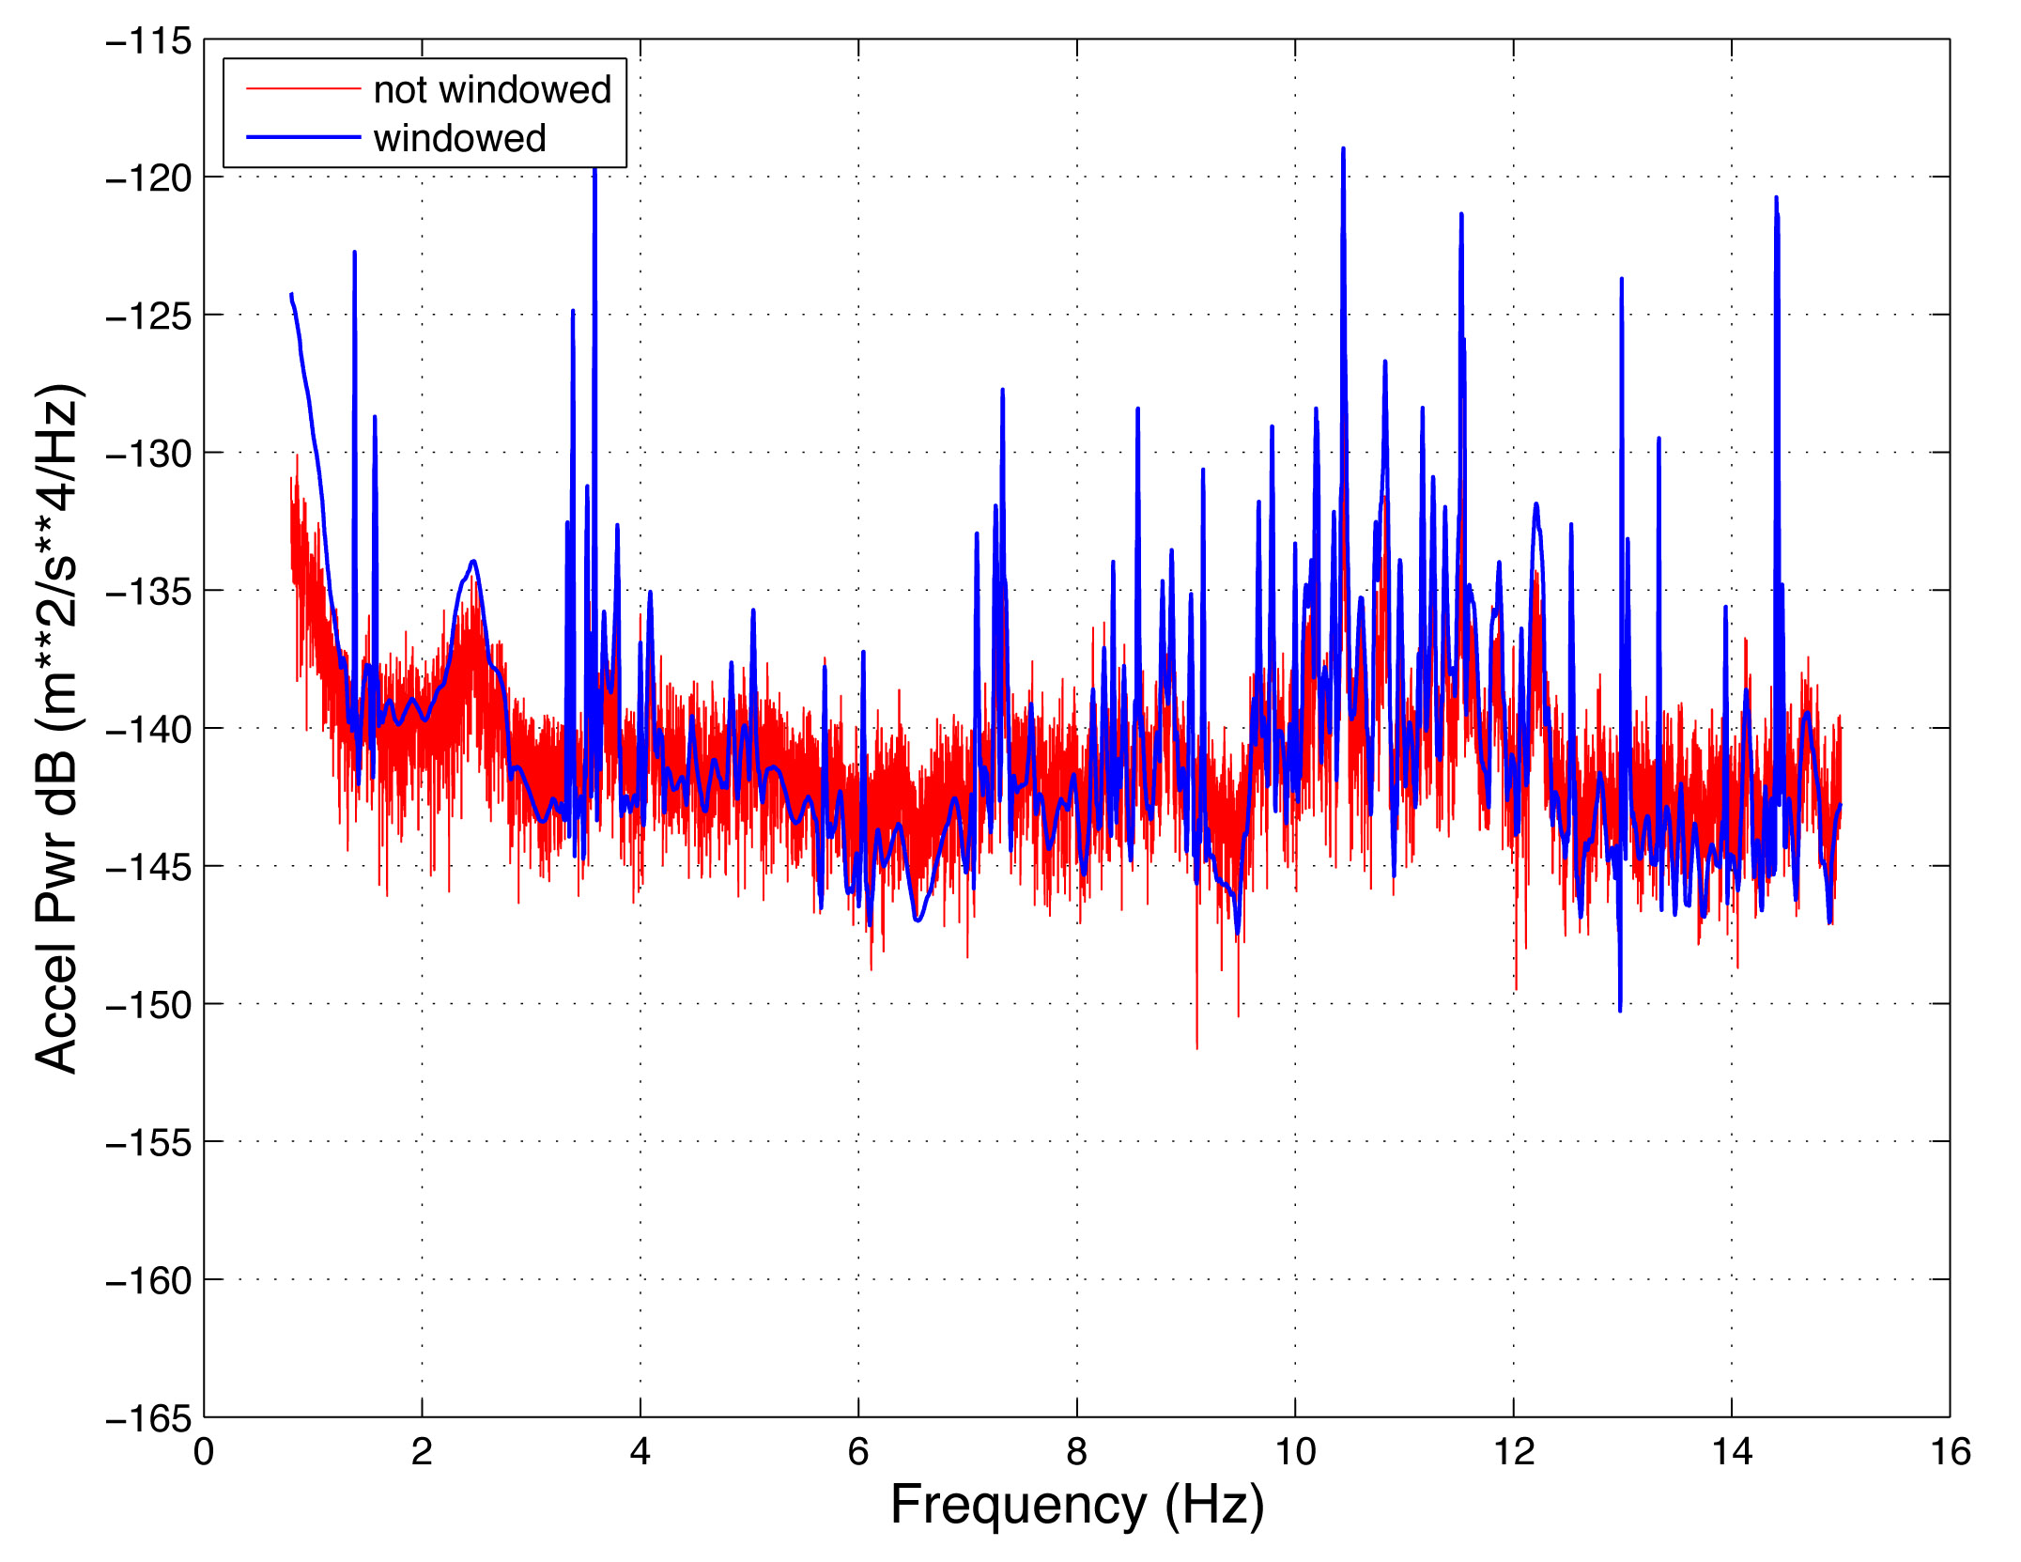

Slide 12
Calculating background noise:
  Remove mean and trend of time series
  Apply a taper to reduce spectral leakage
  Compute the Fourier transform

Slide 13
Calculating background noise:
  Remove mean and trend of time series
  Apply a taper to reduce spectral leakage
  Compute the Fourier transform
  Remove the instrument response

Slide 14
Observations from 2002

Slide 16
Ocean waves ->
Rayleigh waves

Slide 17
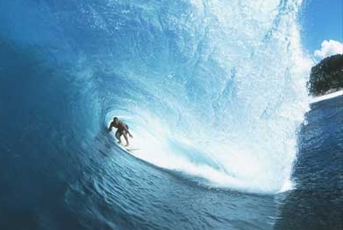
Ocean waves -> Rayleigh waves
(Hasselmann, 1963)
Dominant period – 20 seconds
Conversion at coast to Rayleigh-type motion

Slide 18
Ocean waves ->
P-waves

Slide 19
Opposing wave motion
(Longuet-Higgins, 1952):
Interaction of standing waves with ocean bottom
reflection from a coast
wake of a moving storm
center of a storm
(Haubrich and McCamy, 1969)

Slide 20
Temperature variations

Slide 21
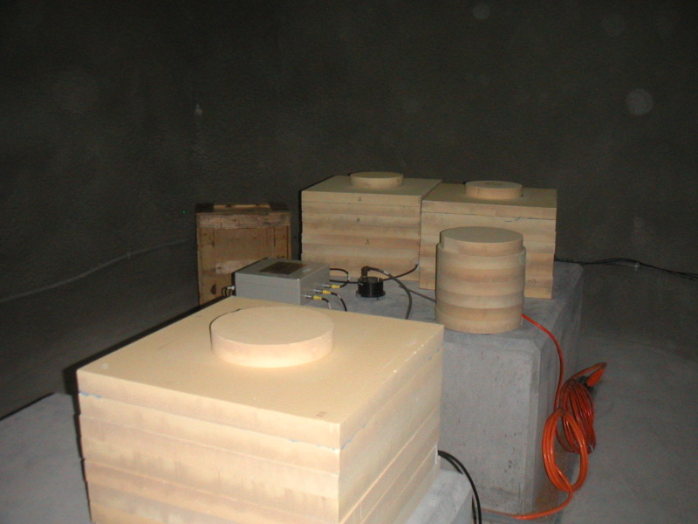
Temperature effects:
Beyond 250 seconds period, temperature becomes very important
Temperature dependence varies with the model of seismometer
Temperature changes of 1e⁻⁶ ºC are important
Foam thermal insulation at GSN station in the UAE

Slide 22
Effect of changes in barometric pressure:
  buoyancy of the seismometer mass
  Newtonian attraction of air mass

Slide 23
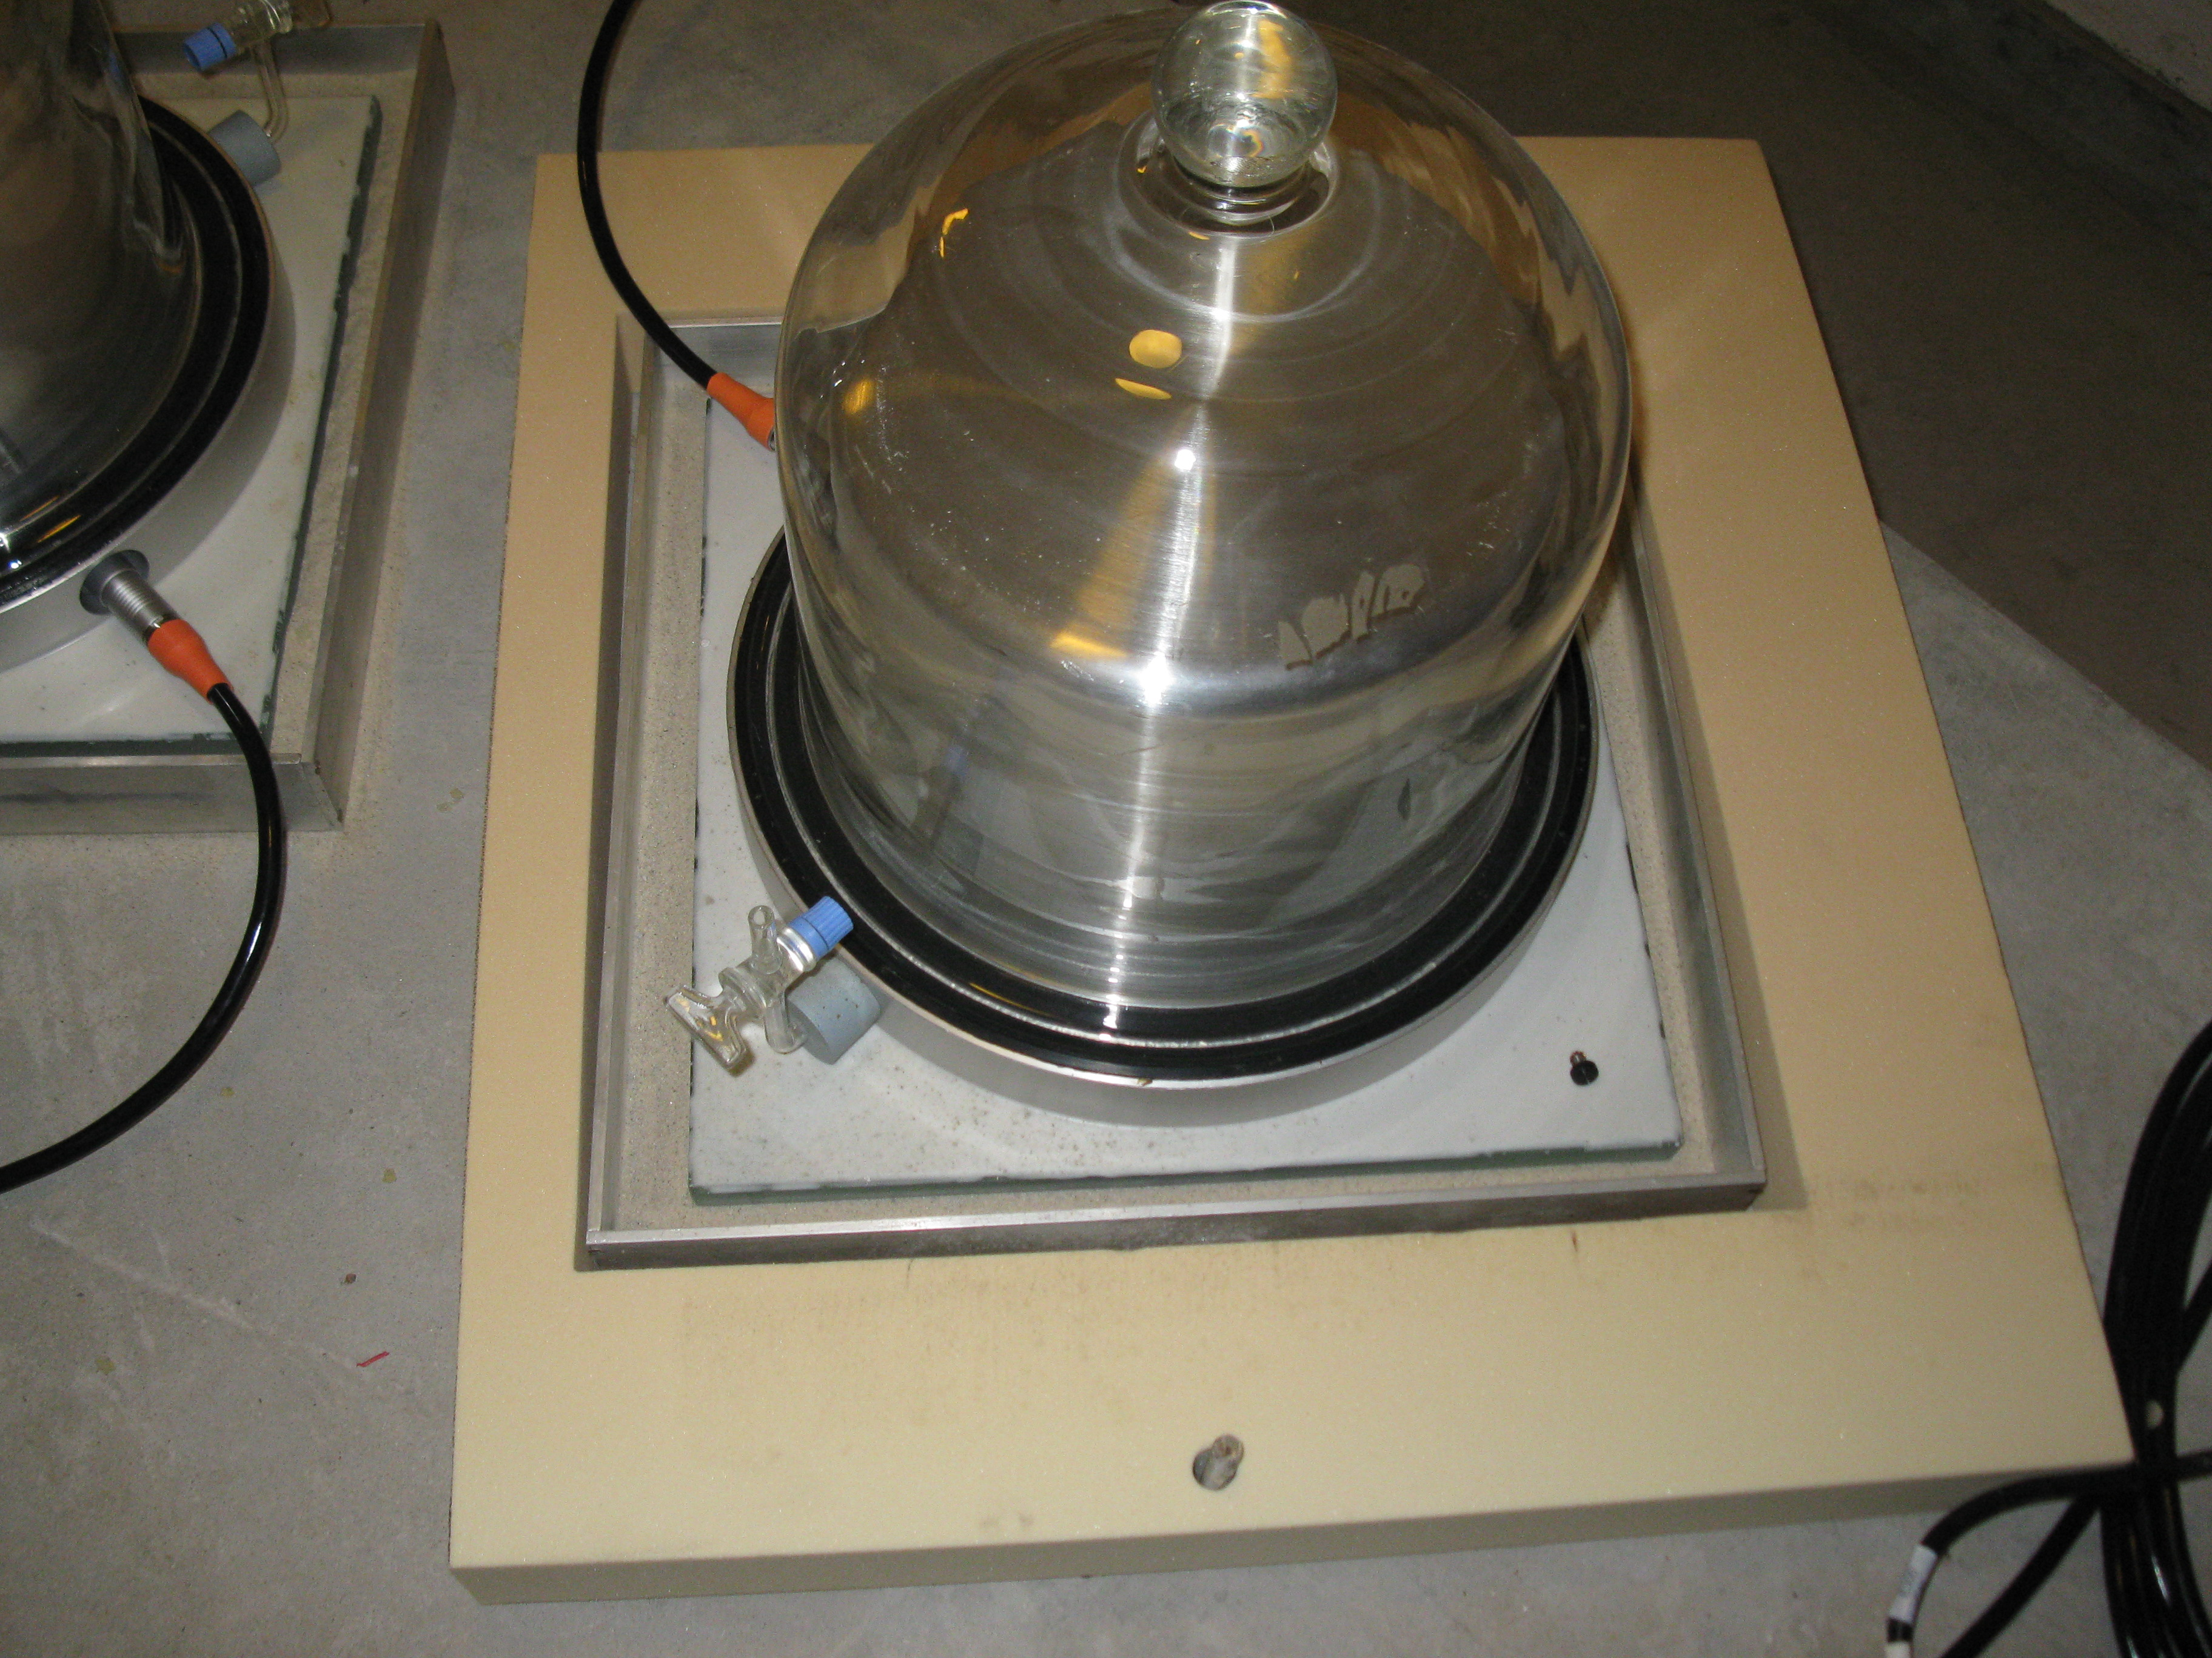
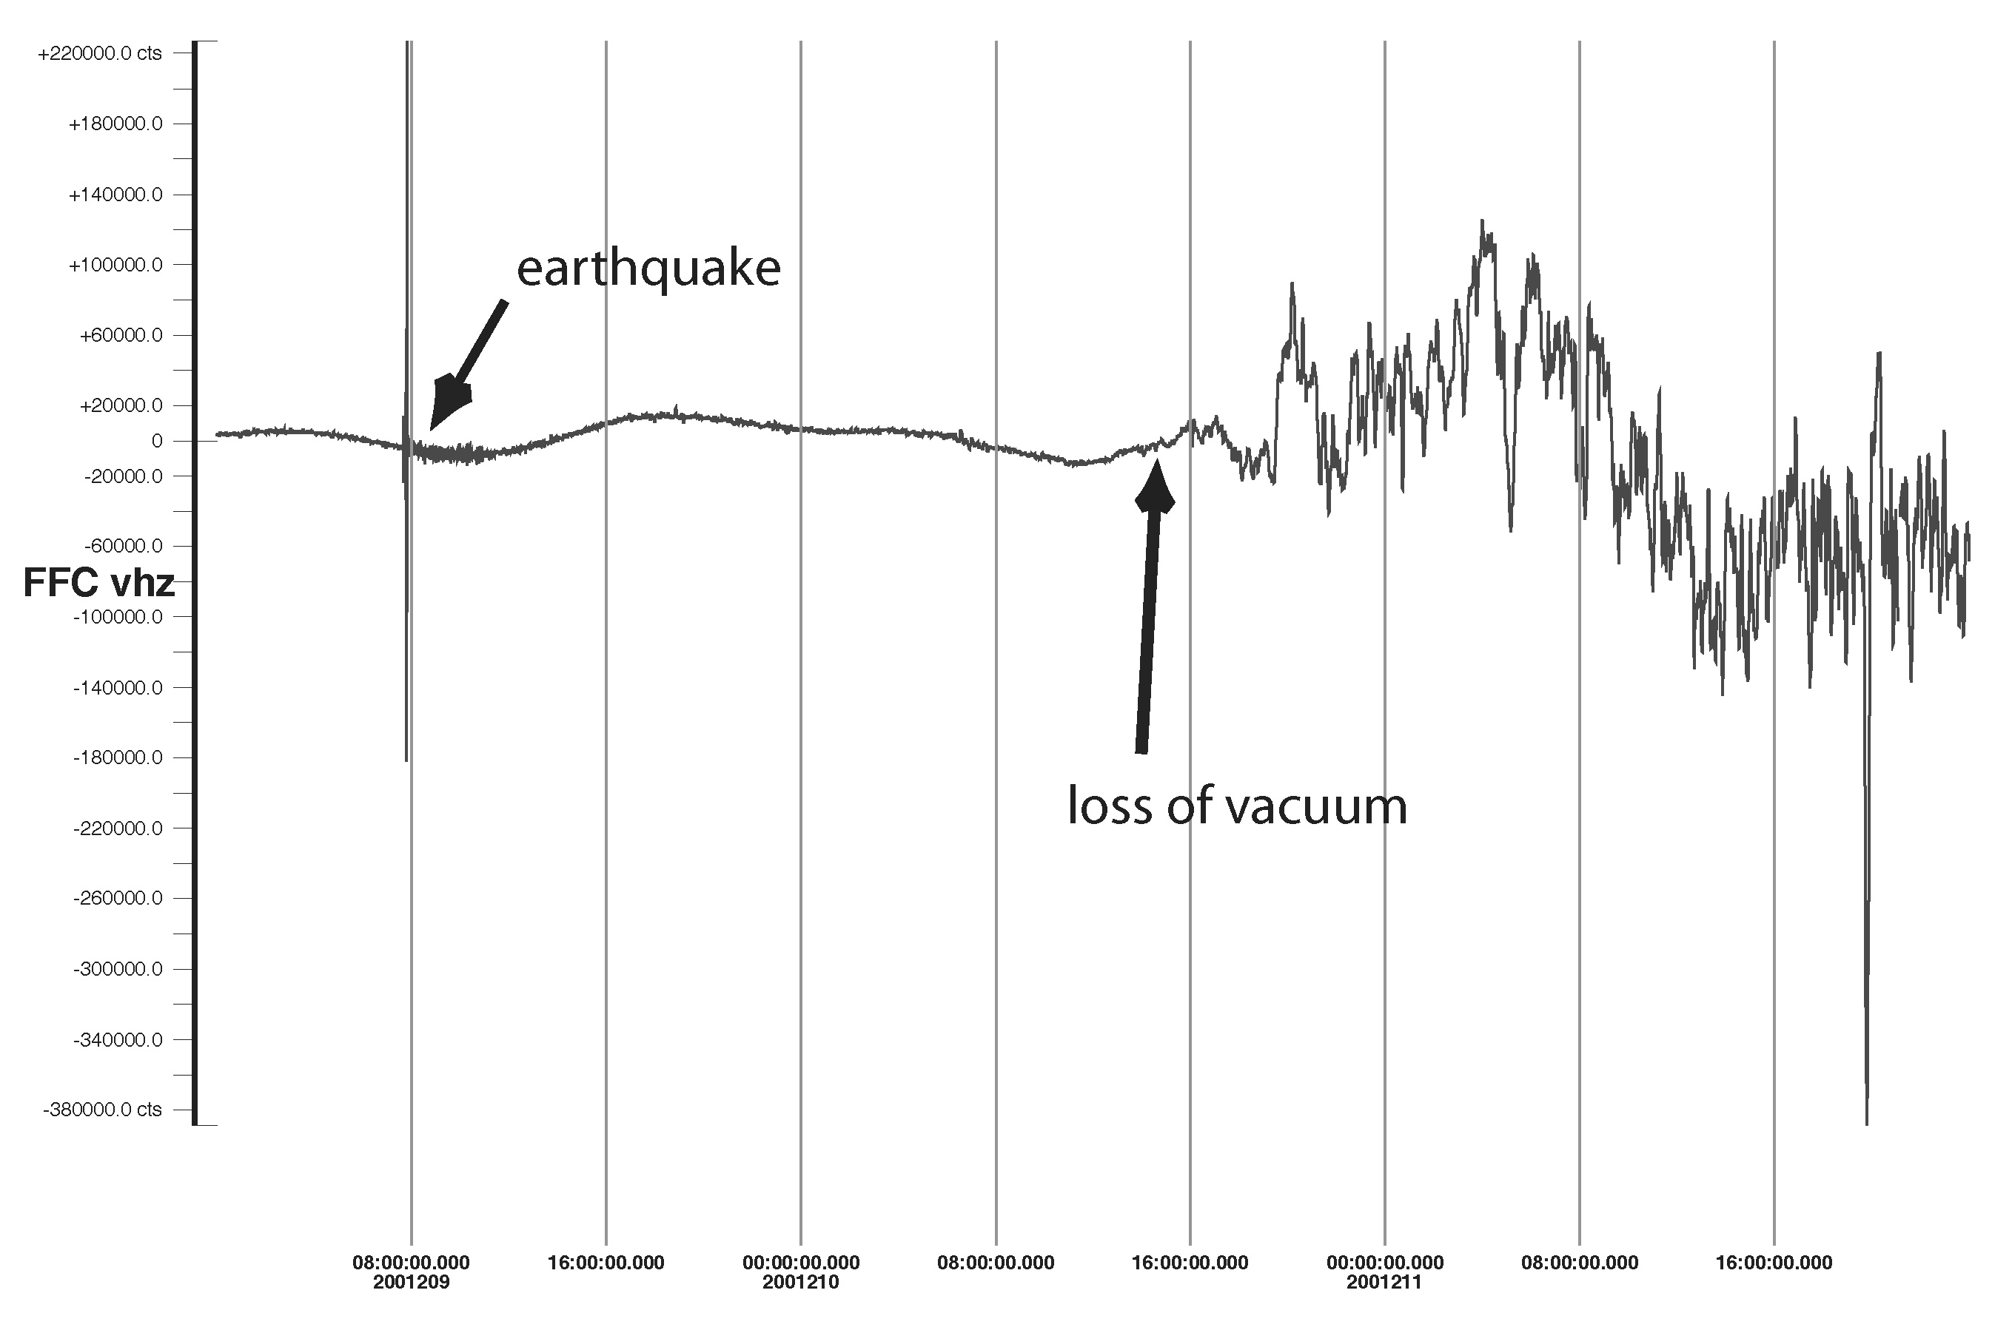
STS1 placed under vacuum at GSN station SUR
Vacuum lost!

Slide 24
Barometer data used to remove effect of air pressure changes in seismic data:
(Zuern and Widmer, 1995)

Slide 25
Effect of changes in barometric pressure:
  buoyancy of the seismometer mass
  Newtonian attraction of air mass
  loading effect of air mass

Slide 26
Change of air pressure in a cavity
Symmetric Case

Slide 27
Change of air pressure in a cavity
Asymmetric Case

Slide 28
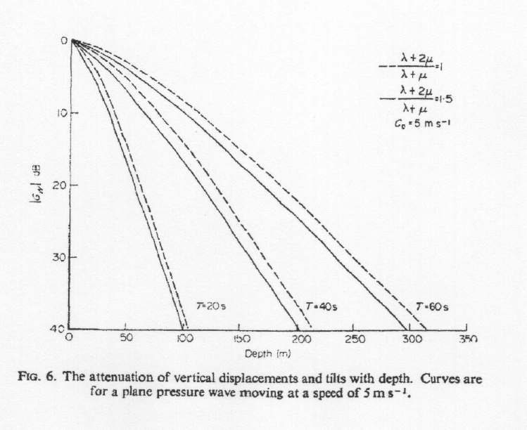
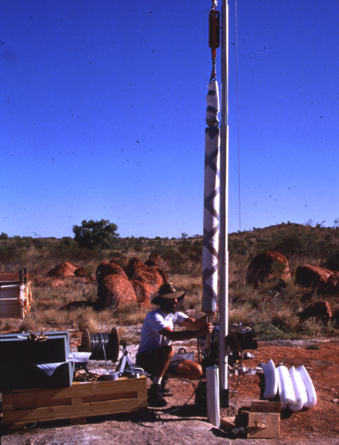
(Sorrels, 1971)
KS-54000 borehole seismometer installed at WRAB GSN station

Slide 29
Continuous free oscillations

Slide 30
(Nishida and Kobayashi, 1999)

Slide 31
Human-induced noise

Slide 32
Examples of human-induced noise:
  Car and truck traffic
  Repeating machinery (pumps, generators)

Slide 33
Frequency bands most effected by installation:

Slide 34
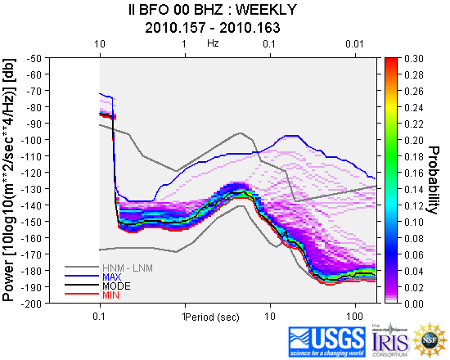
IRIS DMC provides tools to analyze data
http://www.iris.edu/servlet/quackquery/

Slide 35
Thank you!

