Slide 1
Streaming data at the IRIS DMC Collecting, consolidating and re-distribution Rick Benson
Notes:
The IRIS DMC does many different things, this presentation is focused on the real-time data collection effort and directly related systems.
The DMC is not a typical network operator, no picks or locations generated.

Slide 2
The DMC’s Import of Streaming Real Time Data: Processes
80 slarchive processes retrieve data from SeedLink Servers
20 orb2orb processes retrieve data from Antelope systems
30 ew2mseed processes retrieve data from Earthworm WaveServers
5 RRPServer processes receive data from Edge RRP feeds
An Earthworm system imports data from other earthworm, reftek, and guralp systems
A Nanometrics ApolloServer imports data from Nanometrics systems

Slide 3
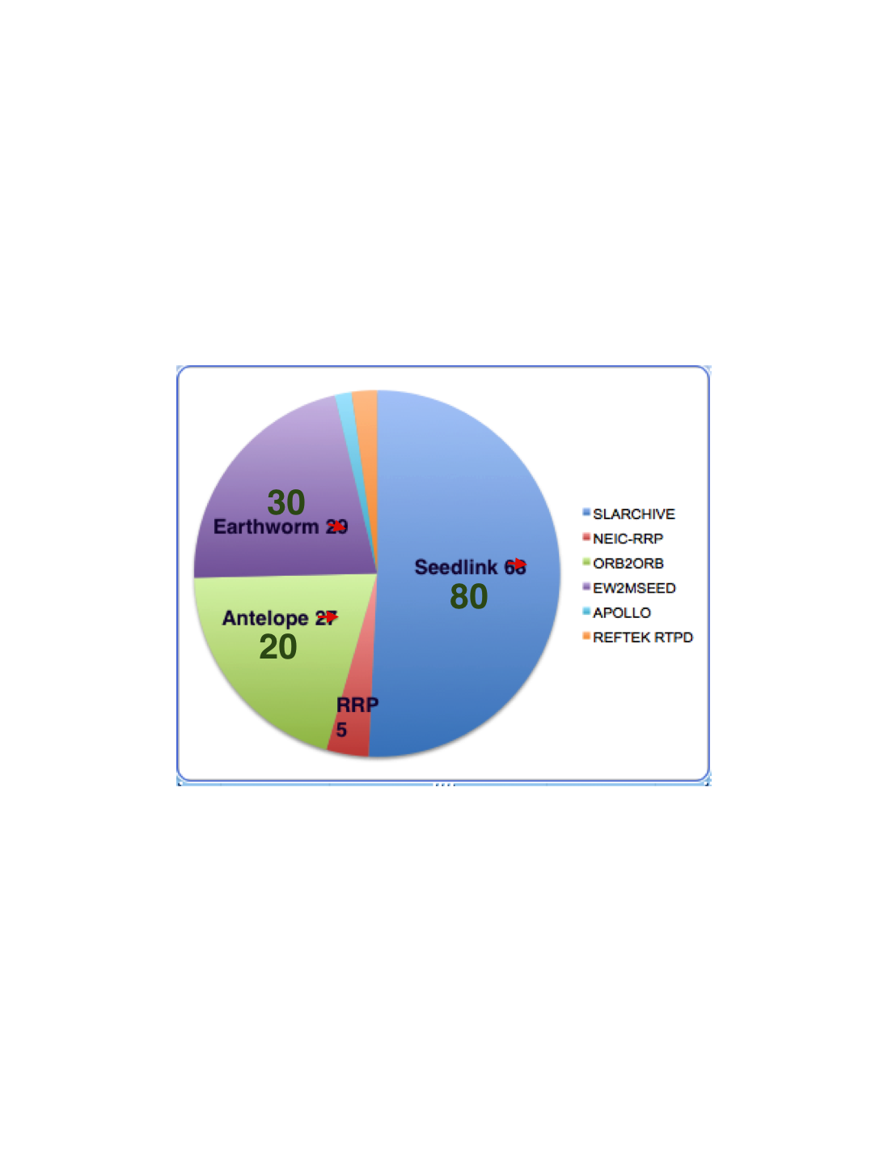
Real-Time Protocols Involved
Ways to Improve Configuration Correctness and Data Integrity:
Reduce the use of protocols that require detailed config
Ew2mseed
Nanometrics Apollo
Reftek rtpd
Increase the use of protocols that deliver native miniSEED
Ringserver/slarchive
NEIC rrp

Slide 4
Real-Time Stations in this region:
http://www.iris.edu/gmap/_REALTIME?minlat=-10&maxlat=50&minlon=61&maxlon=150

Slide 5
REAL TIME DATA STATUS Buffer of Uniform Data (BUD)
There are 177 networks currently submitting data to the DMC, and 4 are Partially or Fully Restricted
There are really 4 “BUDS”
Main BUD with 118 networks
2,233 stations, 16,496 channels
BUD Restricted (AF, EC, YN)
65 stations, 235 channels
USRA with 9 networks (AZ, C, CI, MC, N4, PB, TA, US, UU)
619 stations, 17,827 channels- TA alone has 55,655 channels
USRA Restricted (XO Flex Array)
50 stations, 420 channels
2918 STATIONS with ~107,927 CHANNELS………..and steadily increasing.

Slide 6
Purpose of collecting streaming data
Efficiency and automation of the archiving process
Much easier than infrequent data delivery
Rapid data availability for users
Batch requests, event-windowed and streaming
Allows automated, near real-time quality control
Routine measurements in near real-time
Access to data not available otherwise
For some data contributors real-time is the preferred or only option
Notes:
Not included is network operations (locations, etc.), not a function of the DMC

Slide 7
Streaming data flow to the DMC archive
DCC
ARCHIVE
DCC
BUD
Buffer of
Uniform Data
BATS
…
DCC
DCC
Data holdings:
Seconds to 8 weeks
behind current time*
12-24 hours after
arrival
Data holdings:
24 hours to
40+ years
Notes:
General schematic for data flow from DCCs to the DMC’s archive
Most Data Collection Centers (DCCs) are network data centers; There are very few direct-station feeds (Example is El Paso, TX data EP net)

Slide 8
Buffer of Uniform Data, the ins and outs
SeedLink
Wilber3
www.iris.edu/wilber3/
Earthworm
RRP
BUD
Buffer of
Uniform Data
DMC Web Services
Service.iris.edu
CD 1.x
Antelope
Mini-SEED
Guralp
Reftek
SeedLink Export
www.iris.edu/data/dmc-seedlink.htm
Nanometrics
Notes:
Data collection from 8 protocols
Unified in the BUD as Mini-SEED
Data shipped from the BUD is the same as in the archive

Slide 9
So that’s how data gets INTO the DMC.
Now, how do we EXPORT data in real-time?

Slide 10
The DMC’s SeedLink export service
SeedLink server, publically accessible
Host: rtserve.iris.washington.edu
Port: 18000
All open data in the BUD is available via SeedLink with minimal added latency.
Median latency: 40 Hz => 12 seconds, 1 Hz => 160 seconds

Slide 11
Protocol Details
The SeedLink protocol can be summarized as a simple, ASCII-based, data selection phase followed by the streaming of data packets from the server. SeedLink packets are composed of a small header followed by a 512-byte Mini-SEED record (data only SEED). The negotiation phase allows the client to request only specified data from the server for each selected data stream. A data stream is defined by a network and station code pair.
By utilizing sequence numbers for each packet in a data stream the SeedLink protocol allows for connections to be resumed, eliminating most data gaps. The ability to resume data streams is primarily dependant on how much data, time-wise, the remote SeedLink has in its buffer.
Special, out-of-band packets created by a seedlink server and recognized by libslink are used to communicate server details to clients and to implement keep-alive packet swapping. These special INFO packets are XML formatted data embedded in Mini-SEED comment records.
The protocol allows for two different modes of data transmission, uni-station and multi-station modes. Uni-station mode operates by transmitting a single data stream (data from a single station) through one network connection. In this mode the data stream does not need to be specified by the client as it is implied by the internet address and port. Multi-station mode operates by transmitting multiplexed data streams (data from multiple stations) through a single network connection. Almost all connections are negotiated as multi-station, even if only a single station is requested; uni-station mode, for most publicly accessible servers is deprecated.
SeedLink was originally created as the transport layer for the SeisComP package developed by GEOFON.

Slide 12
IRIS Supported SeedLink clients: http://www.iris.edu/data/dmc-seedlink.htm

Slide 13
SeedLink export data flow
SeisComP
Ringserver
~8 hours of data
slarchive
BUD
512-byte
Mini-SEED
Scanner
Scanner
slink2orb
Scanner
slink2ew
Scanner
NAQS
…
…
2,918 stations
33,000+ channels

Slide 14
Snapshot of SL client connections: Q1-2014
Over 65 gigabytes per day stream out
An average of 600-700 connections active at all times

Slide 15
The IRIS Turnkey SeedLink Server: Called “Ringserver”

Slide 16
Ringserver: a stand alone SeedLink server
The IRIS DMC’s SeedLink implementation is being released to promote data exchange. Any data center creating 512-byte Mini-SEED records can have a SeedLink server.
Source code:
https://seiscode.iris.washington.edu/projects/ringserver
SeedLink server configuration instructions:
https://seiscode.iris.washington.edu/projects/ringserver/wiki/How_to_configure_ringserver_as_a_SeedLink_streaming_server

Slide 17
Highlights of ringserver implementation
Stateful and self-correcting operation
Extremely scalable threaded architecture
Ring buffer is First In First Out (FIFO)
Buffer size & number of clients limited only by hardware
Dynamic configuration file options
Control access by IP address, limit access at stream level
SeedLink 3.1 plus Network and Station wildcarding
Comprehensive transfer logging
Runs on Linux, Mac OSX and Solaris (32 and 64-bit )
Integrated MiniSEED file system scanner
Notes:
Data submission is done by network interface as well

Slide 18
Ringserver related software
dalitool – General purpose ringserver query
Report server ID, version, general status, transfer rate
List connected clients and associated stats
Data stream inspection
dali2liss – Create LISS servers from ringserver streams
slink2dali – Send SeedLink streams to ringserver (beta)
mseedscan2dali – Alternate Mini-SEED scanner
Notes:
Caveat: limited support

Slide 19
Ringserver conclusions
Scales to huge numbers of stations and channels
Has run uninterrupted at the IRIS DMC for many months
Dynamically reconfigurable to limit downtime
Tracks and logs comprehensive user statistics
ringserver created after attempts at using other systems

Slide 20
Submitting Non-Real Time Data to IRIS
miniseed2dmc: A dedicated program for submitting batches of Mini-SEED data directly to the IRIS DMC.
Robustly transmits data to the DMC, tolerant of network disconnects and transmission restarts
Designed to transmit very large data sets
Reports transmission summary
Dataless SEED metadata must be supplied separately
Distributed as source code, a C compiler is required
Coordination with the IRIS DMC is required before submitting data.

Slide 21
Sources of Data: Specific Solutions

Slide 22
IRIS DMC Earthworm: Data to Archive
As part of our Earthworm system, the IRIS DMC runs an
ew2ringserver=>ringserver=>SeedLink server
and an slarchive process internally to write data imported by our earthworm into our standard archival of miniSEED.
We suggest that, where possible, network operators running earthworm also run these processes to best serve data to the DMC.

Slide 23
Network Operators Can Run An Integrated Earthworm to SeedLink Server using ‘Ringserver’
Serves buffered Earthworm data to the DMC and and any other data clients via the widely used standard SeedLink protocol (tcp, miniSEED)
Can be controlled with earthworm startstop and write log files to earthworm log file area
Convenient way to get miniSEED data out of earthworm for local use too

Slide 24
It works like this: ew2ringserver->ringserver->SL clients
ew2ringserver is available in earthworm v7.7 and is a standard earthworm module. Ew2ringserver exports data to a ringserver.
ringserver is a stand alone C program that runs on unix/linux* and serves data via the seedlink protocol. Standard SL (SeedLink) clients can access ringserver data.
ringserver has features that allow it to easily integrate with earthworm
Detailed instructions to run ew2ringserver->ringserver are available at:
https://seiscode.iris.washington.edu/projects/ew2ringserver/wiki/A_SeedLink_server_for_Earthworm
*If you are running earthworm on Windows but have access to a unix system, you can still run ew2ringserver to export data to a ringserver running on the unix system. However, the ringserver will be running outside earthworm startstop control so is less well integrated.
I

Slide 25
To Run a Ringserver…
Download, compile, and place the resulting executable ringserver in the earthworm user’s PATH. Get ringserver here:
https://seiscode.iris.washington.edu/projects/ringserver
Prior to running ringserver, you will need to create a directory that will be used by ringserver as the buffer area for data
If needed open a hole in your firewall to allow data client to open the seedlink port (defined in the ringserver.d file, typically 18000)

Slide 26
Ew2ringserver
Add an ew2ringserver instance to your earthworm system in the standard earthworm module way.
In the ew2ringserver.d file, the ringserver’s IP address and data input port (typically port 16000) is specified by this parameter:
RSAddress localhost:16000

Slide 27
To Integrate Ringserver with Earthworm You Need to:
Put a ringserver.d file in your earthworm params dir like:
---
RingDirectory /data/my_ringserver_data
DataLinkPort 16000
SeedLinkPort 18000
ServerID “MySeedlinkServer”
---
Put an entry in the startstop.d file like:
…
Process "ringserver /my_ew_run_dir/params/ringserver.d -STDERR"
Class/Priority TS 0
…

Slide 28
Useful Auxilary Programs to Monitor a Ringserver Seedlink Server
slinktool – use to to confirm that a seedlink server is up, that you can connect to it, and that it is serving data.
dalitool – use to view clients connected to a ringserver and more
slarchive – use to download data from a SeedLink server

Slide 29
Use dalitool to monitor a ringserver
Specific to ringserver, not for generic seedlink server
Dalitool can be used to inspect currently connected clients of a ringserver
Source code for dalitool can be downloaded from:
http://www.iris.edu/pub/programs/ringserver/

Slide 30
View clients of a ringserver using dalitool:
dalitool –ff –C your.ringserver.ip.address:16000
…
ops1.iris.washington.edu [192.168.166.67:56328]
[SeedLink] SeedLink Client 2014-05-21 20:58:22.983494
Packet 1598812 (2014-05-21 20:45:39.069500) Lag 0%, 1.8 seconds
TX 185 packets 0.0 packets/sec 94720 bytes 0.0 bytes/sec
RX 0 packets 0.0 packets/sec 0 bytes 0.0 bytes/sec
Stream count: 46
Match: ^IU_.*_.*$
Reject:
…
The above example connection displayed by dalitool is from running the command ‘slinktool -p -S "IU_*" rtserve:18000’

Slide 31
Use slinktool to query any seedlink server
slinktool –h for help/usage
slinktool –Q localhost:18000 – for a list of streams and time spans of data currently available on the SeedLink server running on the local machine, port 18000
Slinktool –L localhost:18000 – for a list of stations served by the SeedLink server running on the local machine, port 18000

Slide 32
slarchive
Slarchive can be used to retrieve data from a SeedLink server, write it to disk
specify “stream selection”, etc
-S streams Define a stream list for multi-station mode
'stream' is in NET_STA format, for example:
-S "IU_KONO:BHE BHN,GE_WLF,MN_AQU:HH?.D"
Slarchive –h for help/usage
Download slarchive from here:
http://www.iris.edu/dms/nodes/dmc/software/downloads/slarchive/

Slide 33
The DMC’s Export of Streaming Real Time Data
We Use Ringserver as our SeedLink Server
Typically there are approx 650+ connections to our SeedLink server at all times
Real time data is also available from Web services and Breq_fast
Real time data is used for some of the IRIS DMC’s data products

Slide 34
Real-Time Data from IRIS DMC
The DMC runs a publicly accessible SeedLink server on the following
host and port:
host: rtserve.iris.washington.edu port: 18000 (default SeedLink port)
All open data that the DMC receives in real-time is available via this SeedLink server.
Data arriving at the DMC more than 48 hours behind real-time are not exported via
SeedLink.
Usage Restrictions: Users are welcome to any data available via the server as long as client actions do not
inhibit our capability to deliver data to other users.
To view all currently available real-time stations:
http://www.iris.edu/mda/_REALTIME
http://www.iris.edu/gmap/_REALTIME
Currently 2918 stations (On July 3, 2014) and >32,647 chans

Slide 35
Real-Time mailing list
To improve communication about real time data issues, the DMC manages a real time mailing list. When problems with real time data flow are observed, messages will be posted to this list as the problems are discovered. Solutions to the problems or information regarding resumption of real time data feeds will also be posted to this list.
You can subscribe to this list at http://www.iris.washington.edu/mailman/listinfo/iris-rtfeeds

