Slide 1
Quality Control of IRIS/IDA data using MUSTANG
Managing Data from Seismic Networks Workshop
Hanoi, Vietnam
September 2015
Peter Davis, IGPP
INTERNATIONAL DEPLOYMENT OF ACCELEROMETERS

Slide 3
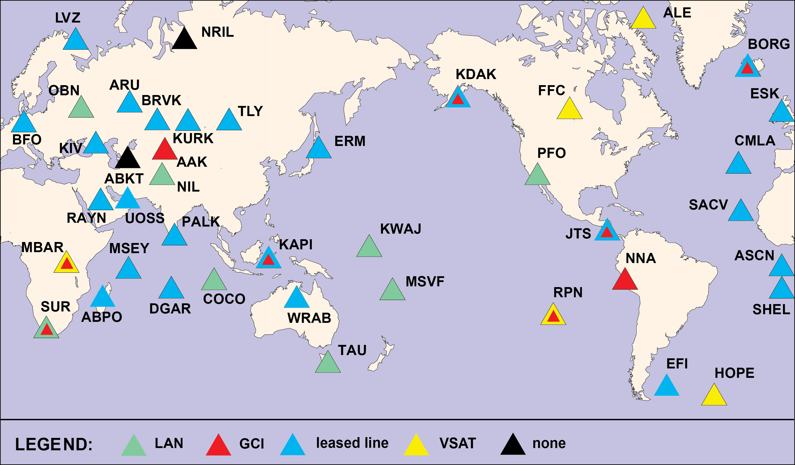
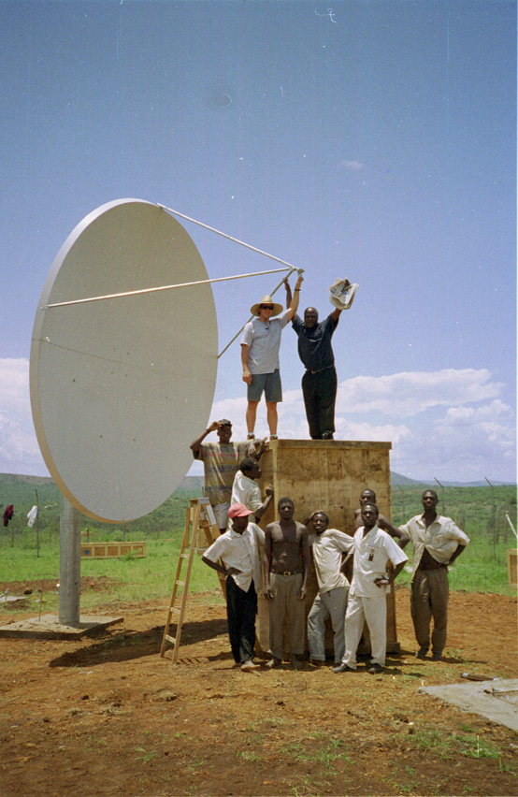
Telemetry links:
LAN
leased lines / VSATs
local ISP

Slide 4
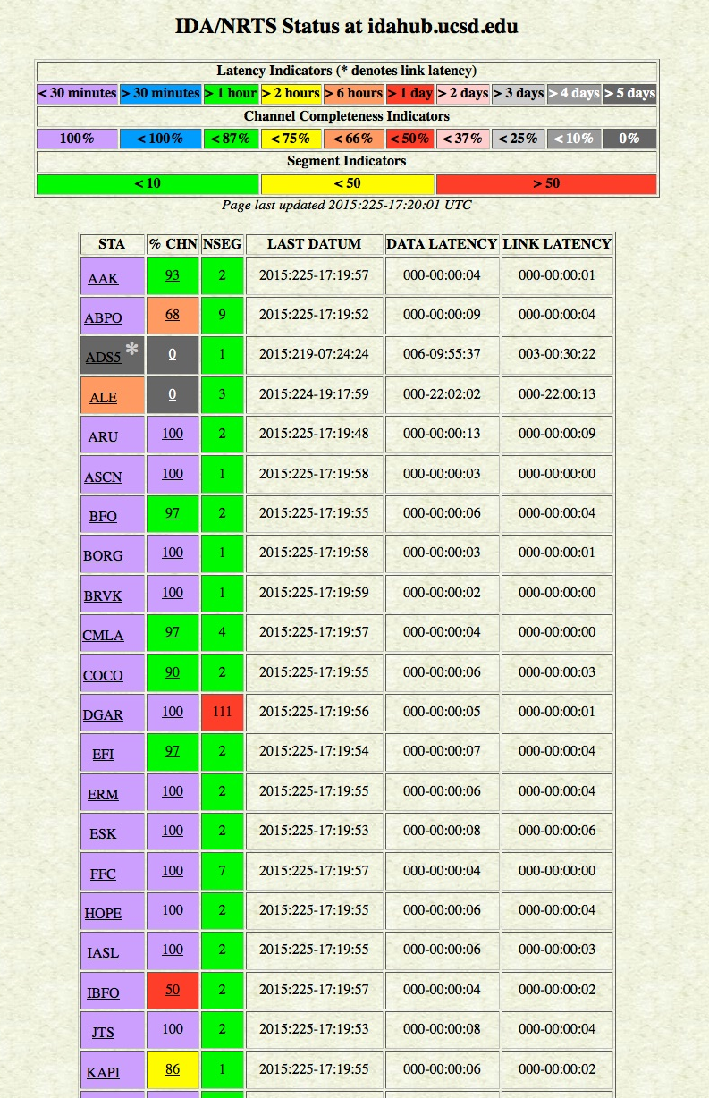
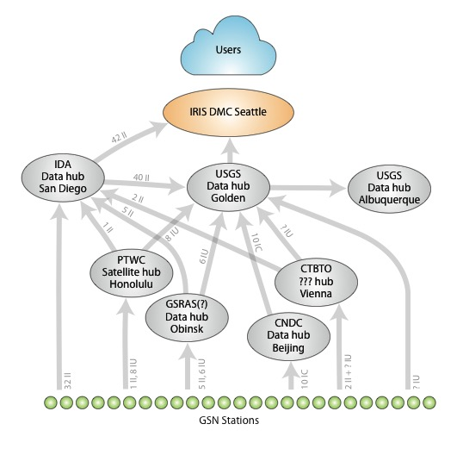
Robust system to telemeter data
← Tools to monitor flow

Slide 5
Quality control focuses on:
Timing
Waveform quality
Accuracy of instrument responses (metadata)
At GSN stations, QC exploits presence of more than one broadband sensor
Past experience guides what problems to look for

Slide 6
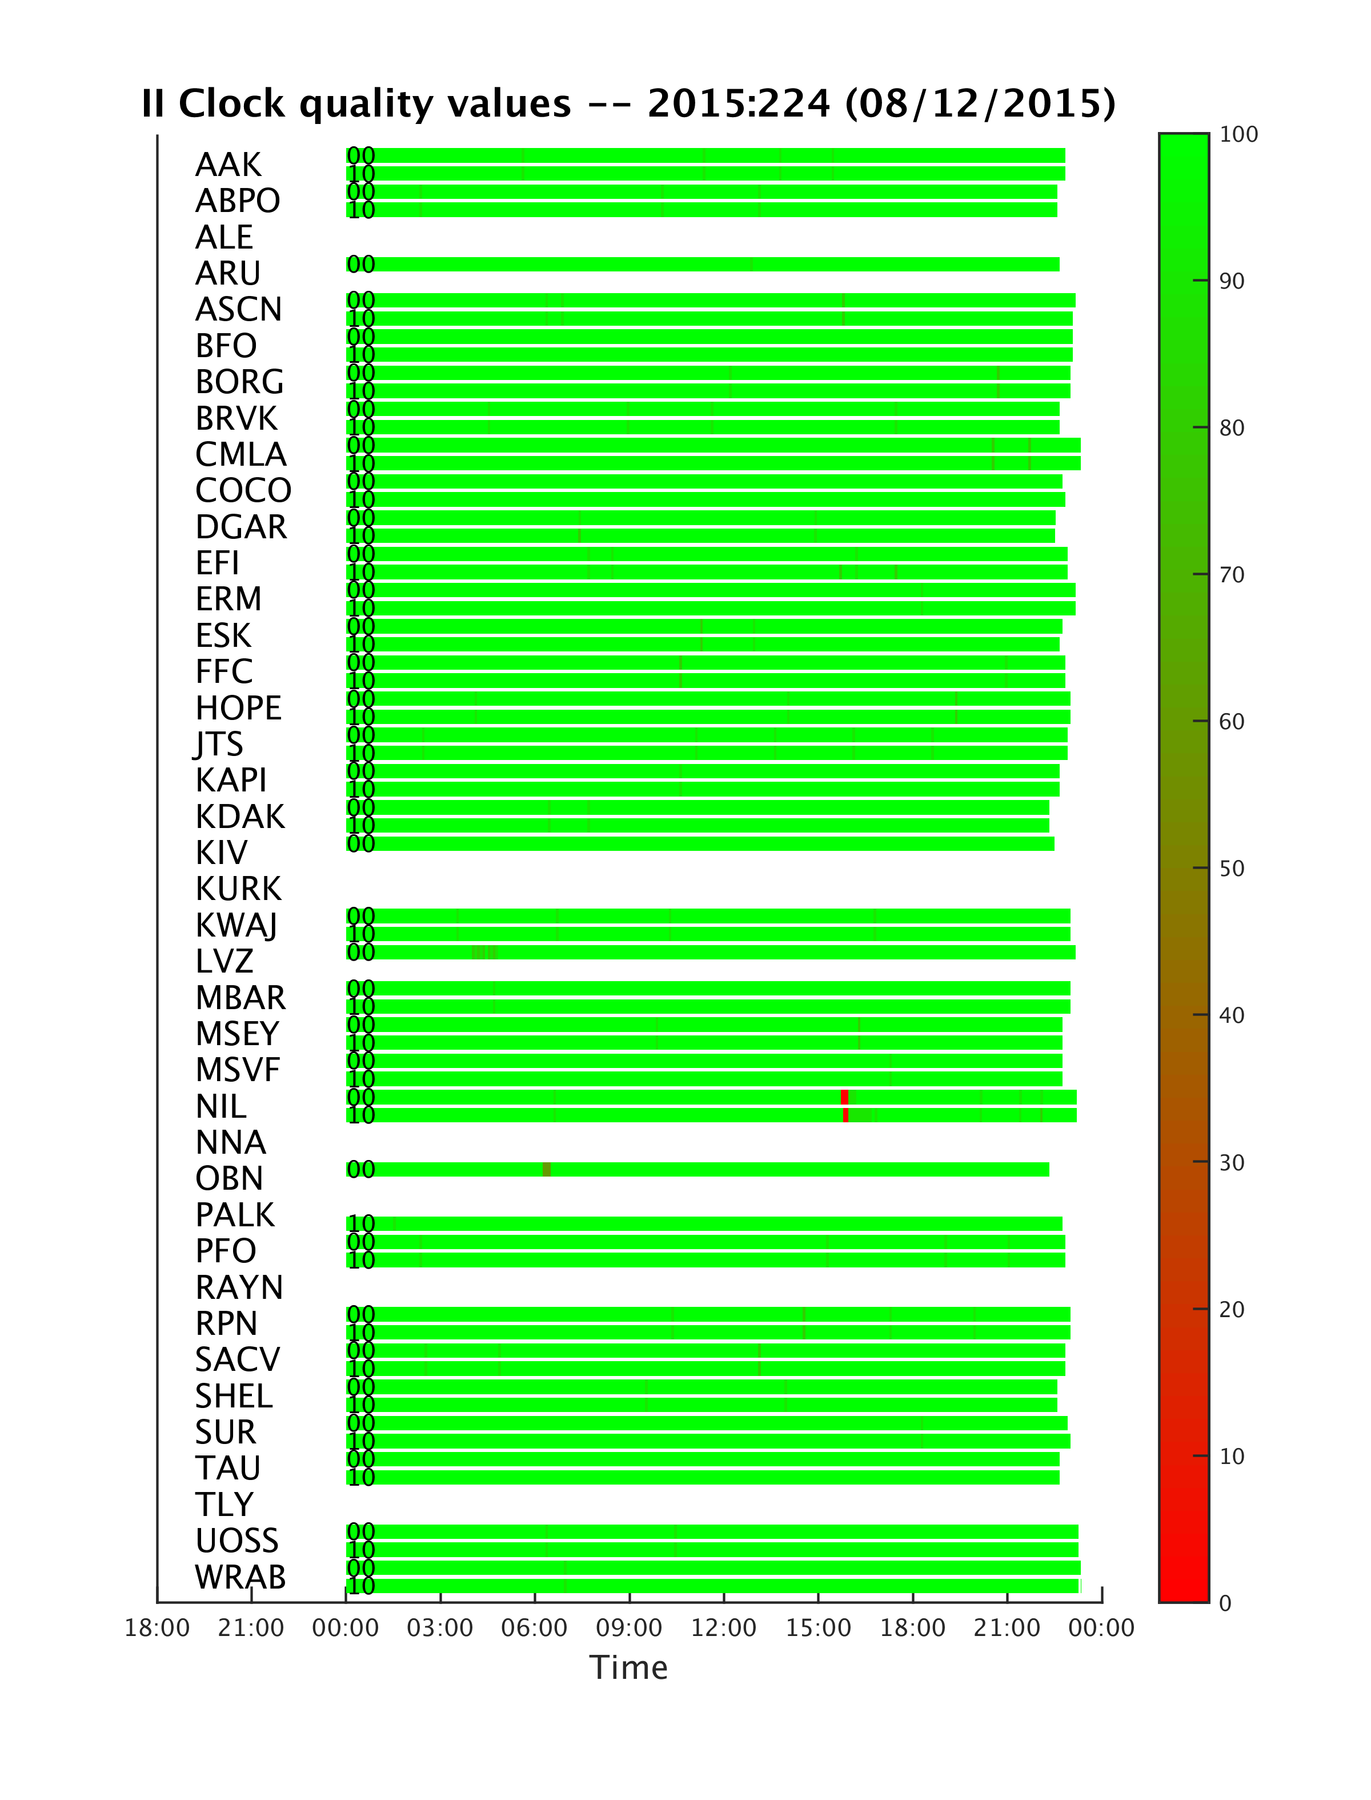
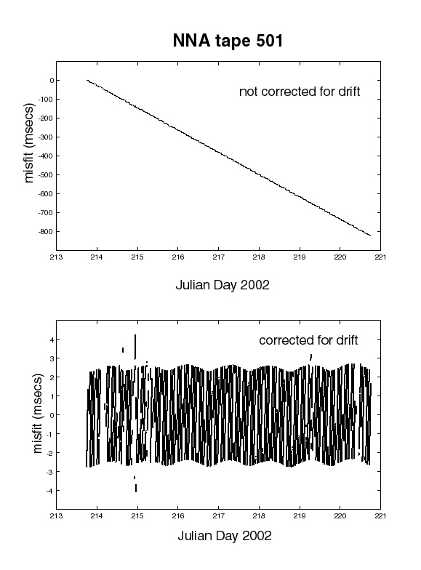
Verify Timing
DCC staff checks for proper clock operation and for mass position offsets
sample rate correction (clocks on old systems are permitted to drift freely)

Slide 7
Quake 1
Timing check:
(We make use of earthquake locations announced by USGS NEIC.)
Quake 2
Quake 3

Slide 8
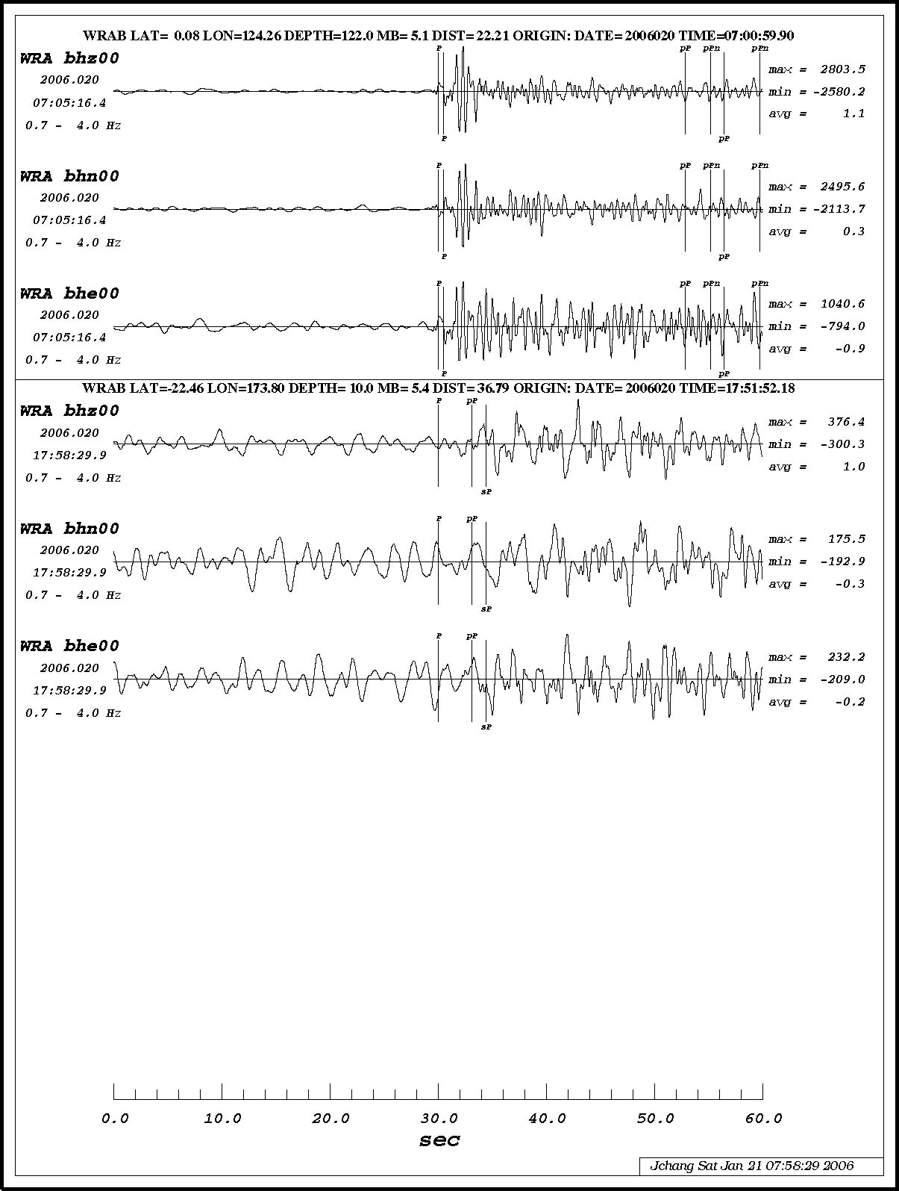
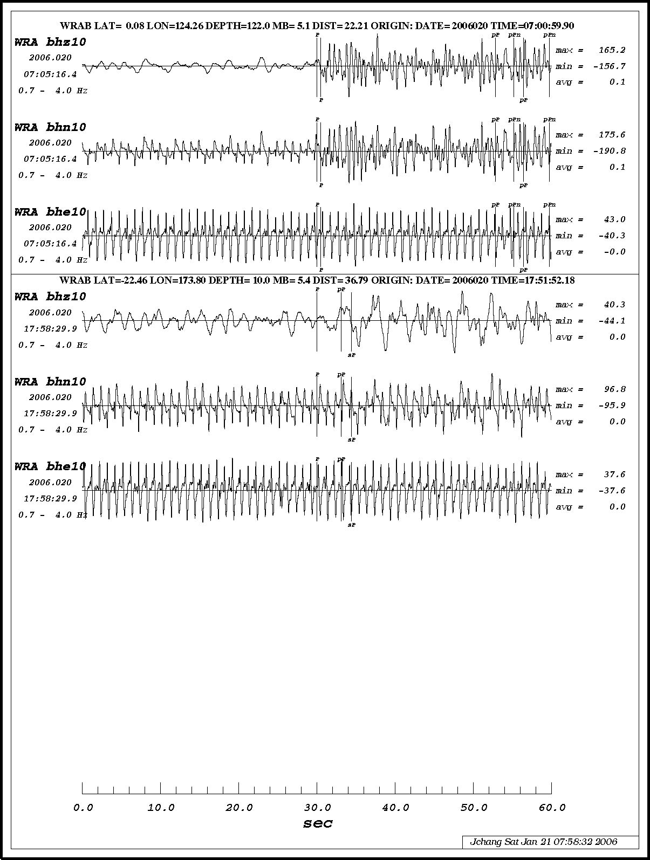
compare primary and secondary sensors (We exploit data redundancy.)
STS2 – failed
KS-54000 – OK

Slide 9
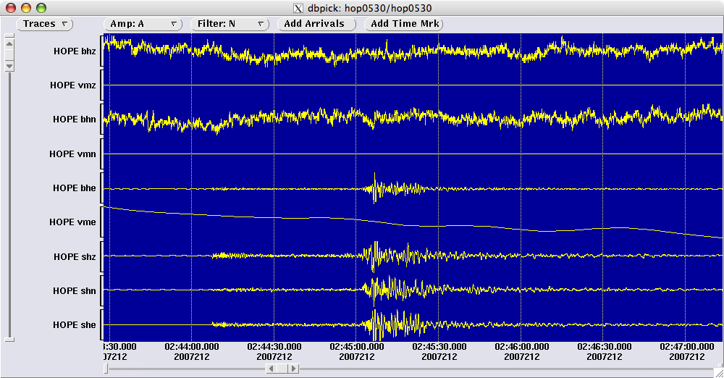
Seismometer masses saturated

Slide 10
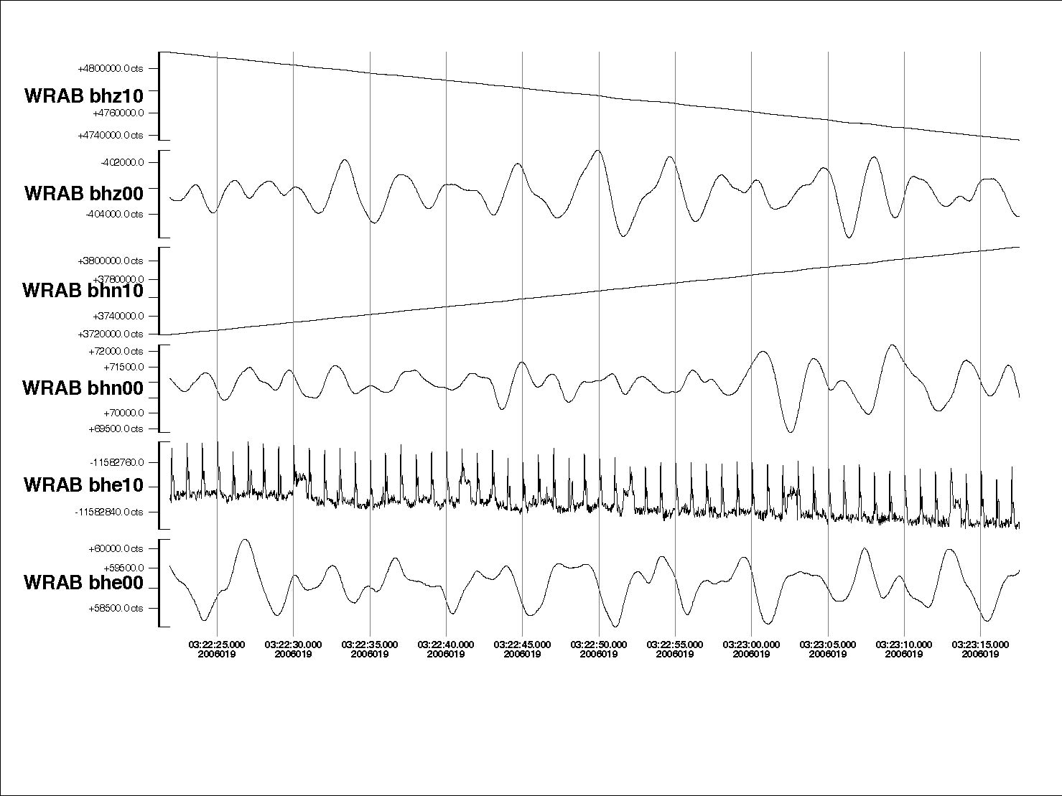
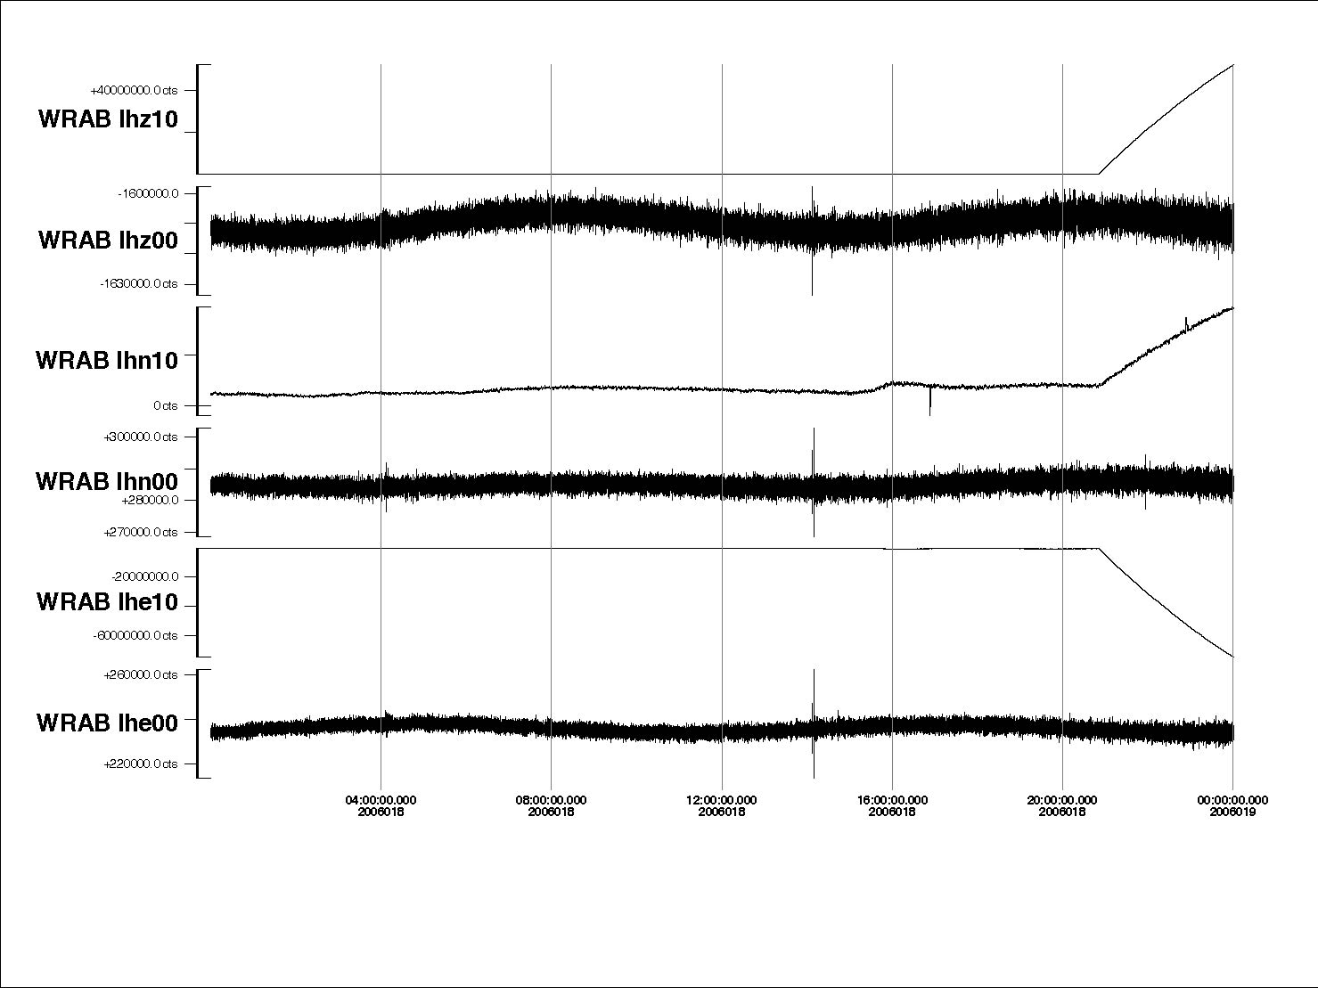
STS2
KS-54000
STS2
KS-54000
STS2
KS-54000
problems unique to tri-axial sensors

Slide 11
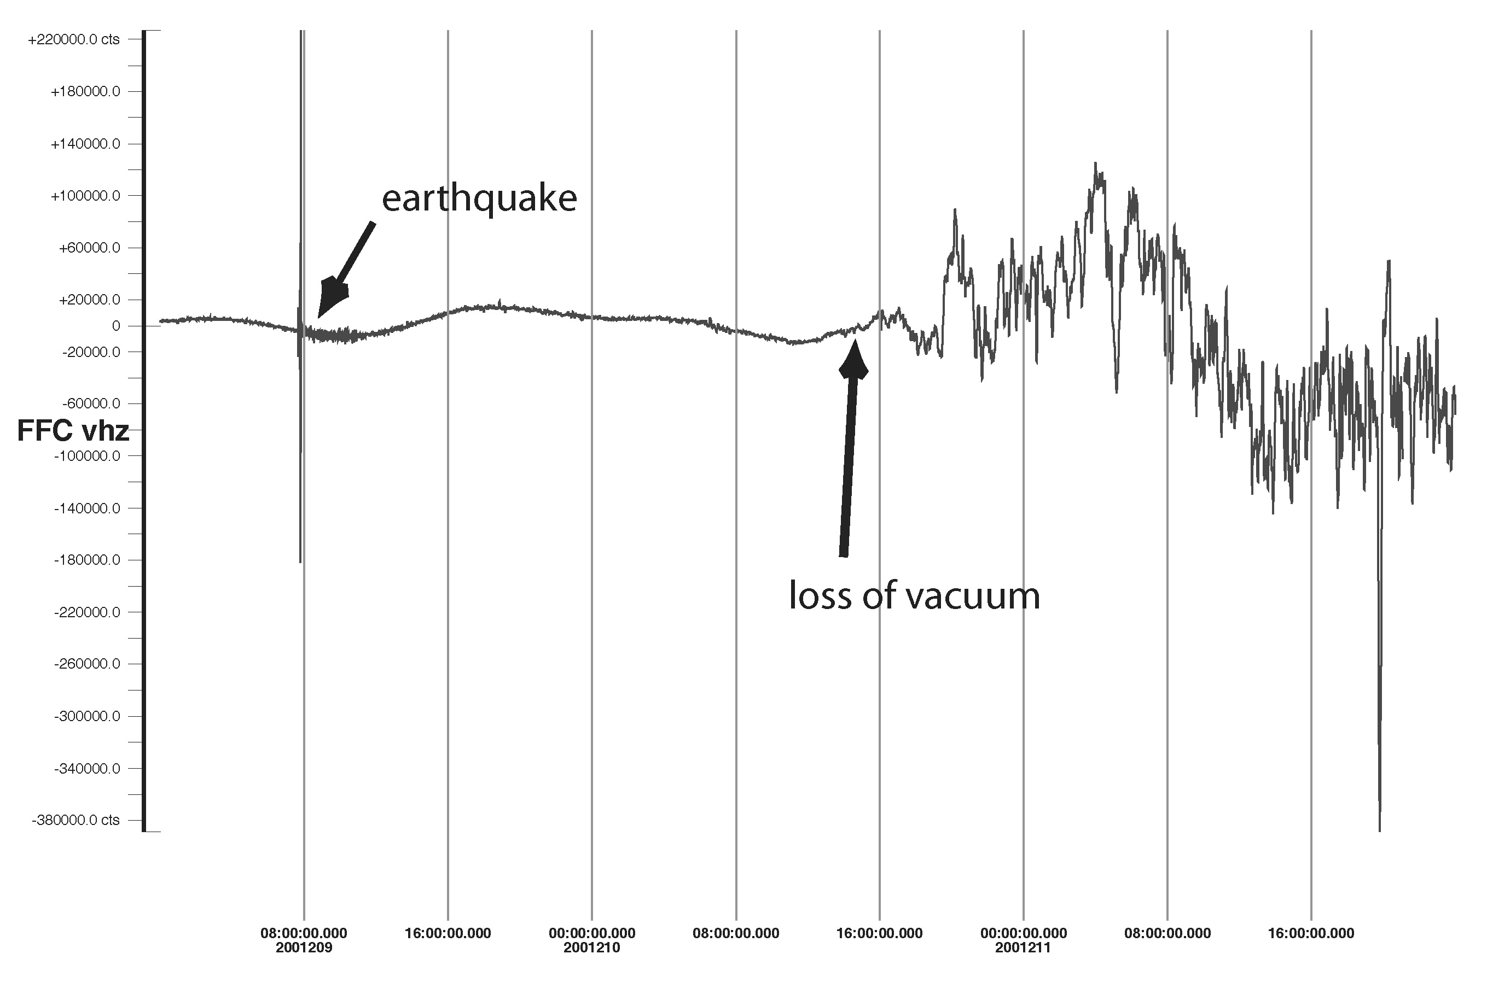
loss of vacuum (We examine long data segments.)

Slide 12
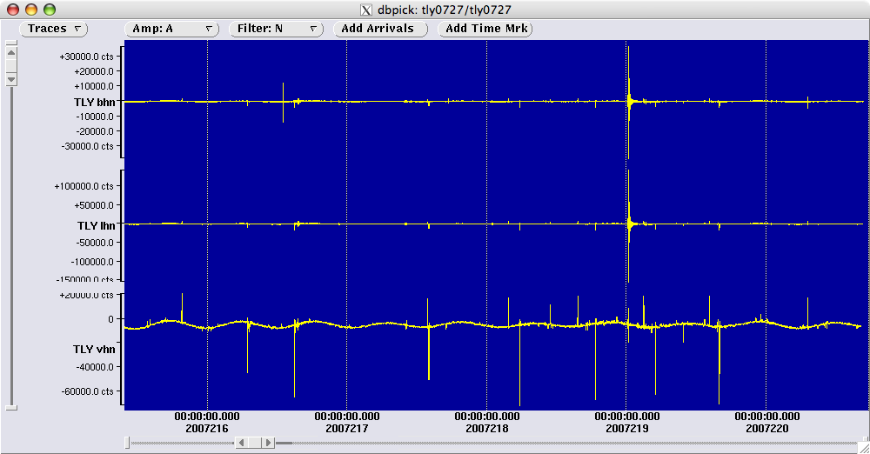
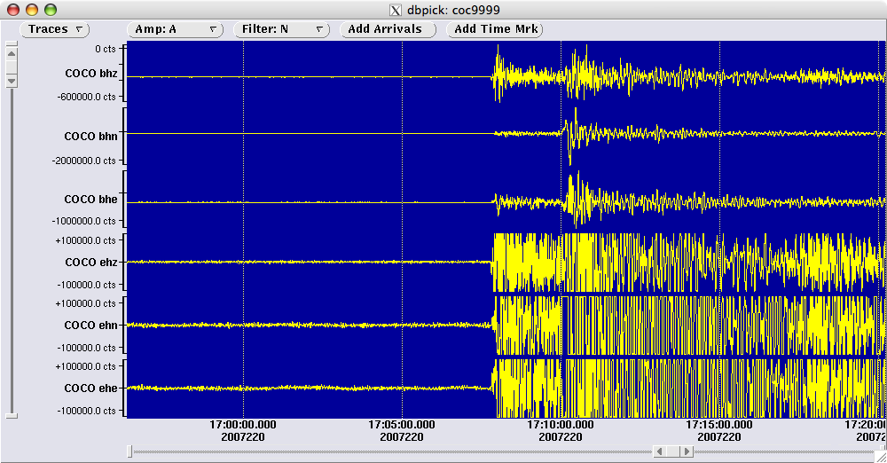
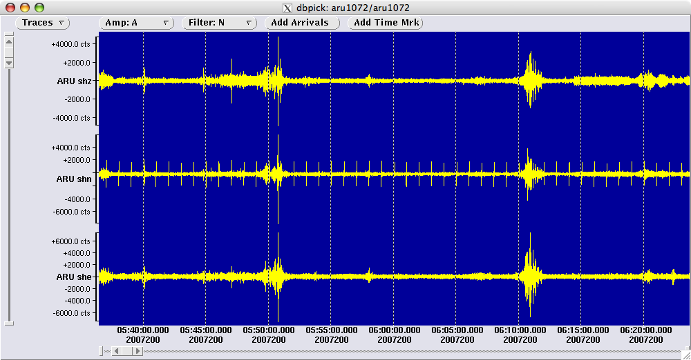
Excessive Spiking:
Clipping

Slide 13
Take advantage of IRIS resources:
Web services: http://service.iris.edu/
MUSTANG: http://service.iris.edu/mustang/

Slide 14
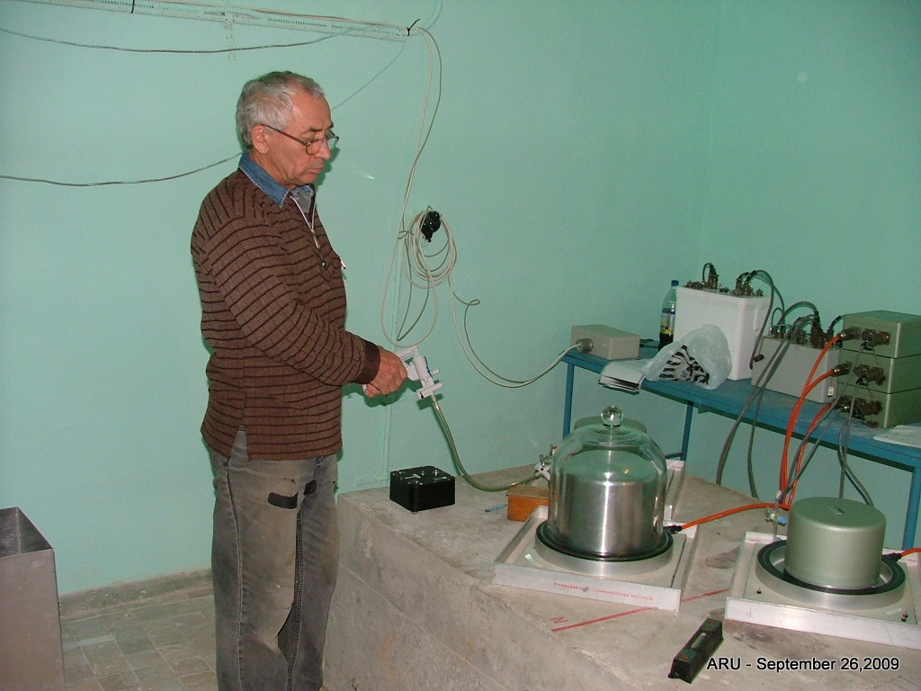
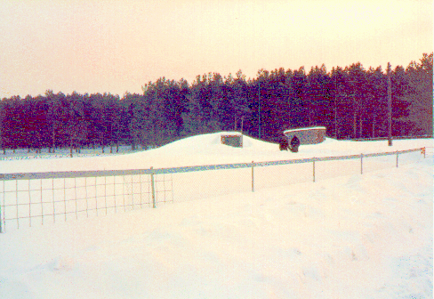
II.ARU:
Equipment was relocated to new vault by EME staff
Was the new vault quieter?

Slide 15
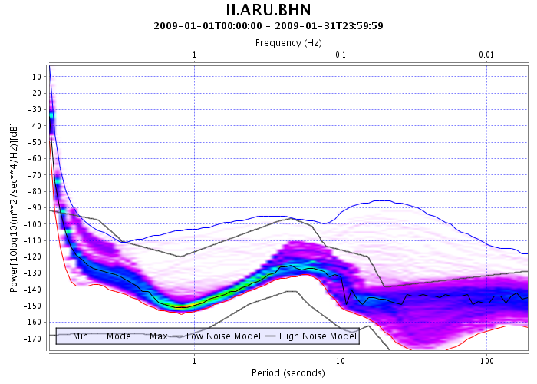
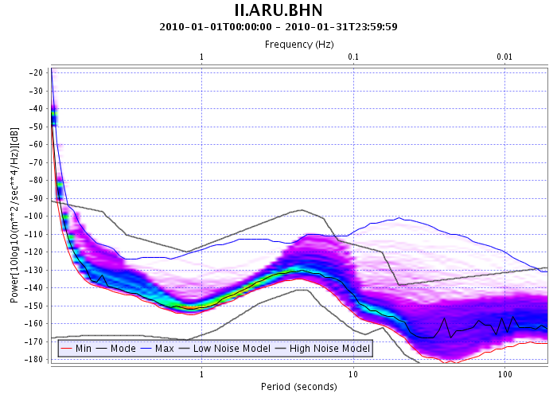
MUSTANG example:
http://service.iris.edu/mustang/noise-pdf/docs/1/builder/
Before relocation
After relocation
http://service.iris.edu/mustang/noise-pdf/1/query?net=II&sta=ARU&loc=00&cha=BHN&quality=M&starttime=2010-01-01&endtime=2010-01-31&format=plot&plot.title=II.ARU.BHN&plot.interpolation=bicubic

Slide 16
Using Web Services for QC:
Checking performance of strong motion instruments
Replacing legacy code with platform-independent routines
Using synthetic seismogram resources

Slide 17
Strong motion sensor issues:
Mixture of sensor models (FBA-23, Episensor) and DASs (Reftek, SAN, Q330) in network; signal detection threshold varies widely
Most signals below detection threshold for these sensors – hard to evaluate if unit is operating correctly

Slide 18
Used web services product IrisFetch.m to (1) find earthquake, (2) retrieve data into Matlab©, (3) deconvolve signal, then (4) plot data.
A well performing Episensor :
Signal too small for FBA23
Blue=broadband sensor Red=Episensor/FBA

Slide 19
Replacing legacy code:
A plot produced by a very old computer program…

Slide 20
P-wave arrivals for both the primary (blue) and secondary (red) sensors at II.PFO. Plot replaces legacy code using web services under Matlab©.
Used web services product IrisFetch.m to (1) find earthquake, (2) retrieve data into Matlab©, (3) deconvolve signal, then (4) plot data.

Slide 21
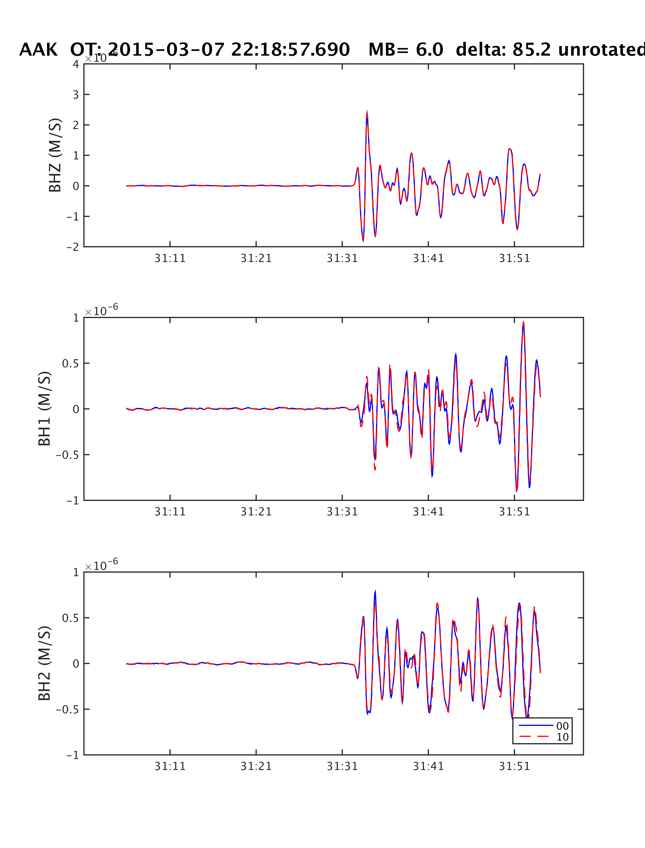
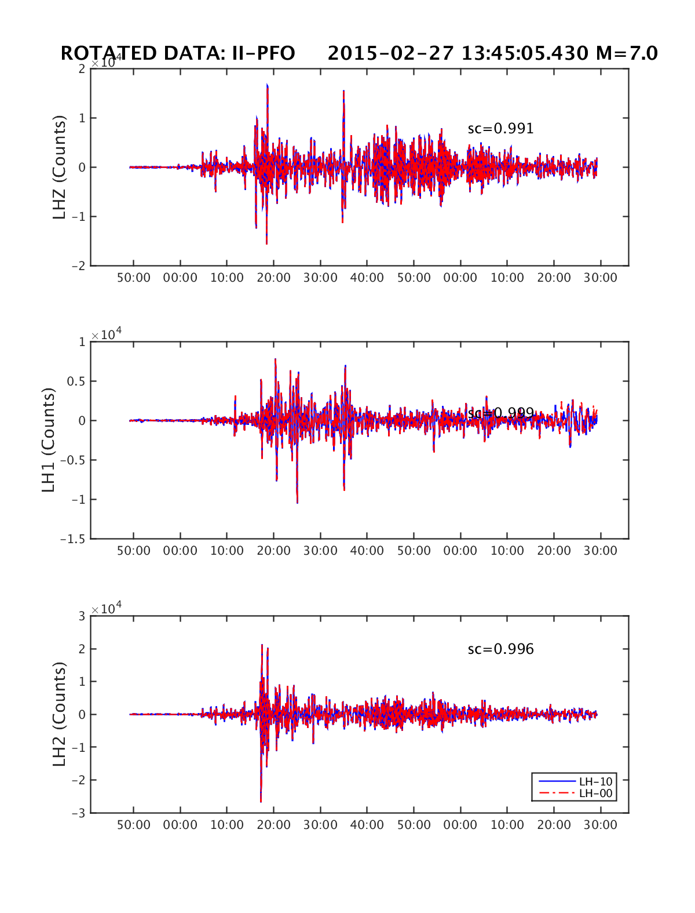
and for waveform quality:
Used web services product IrisFetch.m to (1) find earthquake, (2) retrieve data into Matlab©, (3) deconvolve signal, then (4) plot data.

Slide 22
Match of Specfem3D synthetics (red) to observed data (black) for event at II.PFO. (Web services)
Using synthetic seismograms
(Synthetics available courtesy J. Tromp, Princeton University.)

Slide 23
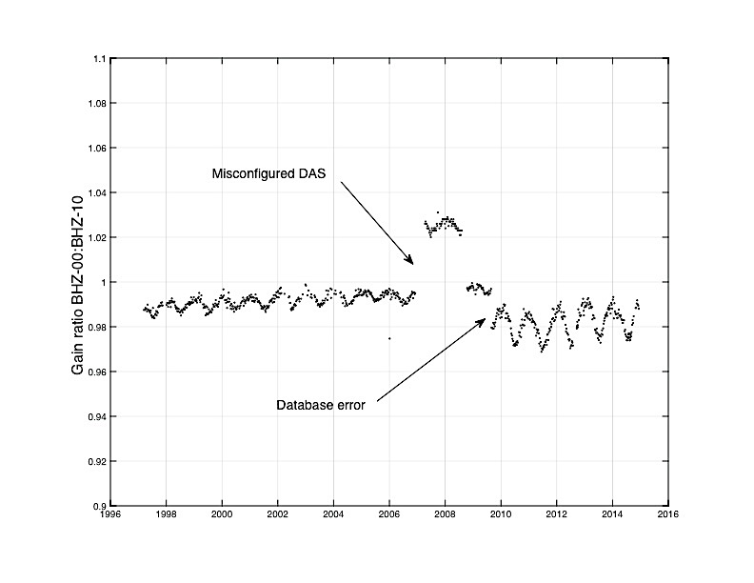
Use of MUSTANG in analysis of WRAB
http://service.iris.edu/mustang/measurements/docs/1/builder/
“Transfer function metric”

Slide 24
Example of MUSTANG metric
  Computed at IRIS DMC
  Reviewed at IDA DCC
  Other examples include:
    percent_availability
    Mean
    Median
    RMS
    SNR
    up_down_times

Slide 25
IDA leverages academic research results to improve quality control:
Lamont Waveform Quality Center’s measurements are reviewed regularly for evidence of problems with sensor response information.

Slide 26
Checking that the metadata are correct…

Slide 27
Metadata Accuracy
Traditional calibration procedures verify the DAS sensitivity and measure shape of system response.

Slide 28
DC Calibration Test

Slide 29
Random binary calibration tests are performed annually to determine the shape of the sensor’s response.
Calibration

Slide 30
Convolve model of sensor response with input
Compare observed output with model
Iterate until fit acceptable

Slide 31
Seismometer calibration:
Individual elements of recording systems are well calibrated, but overall system response may be in error.
Independent recording system used to check the GSN system in place with no need to perturb in situ instruments.

Slide 32
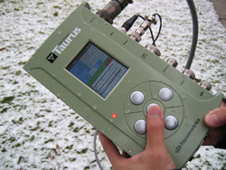
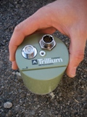
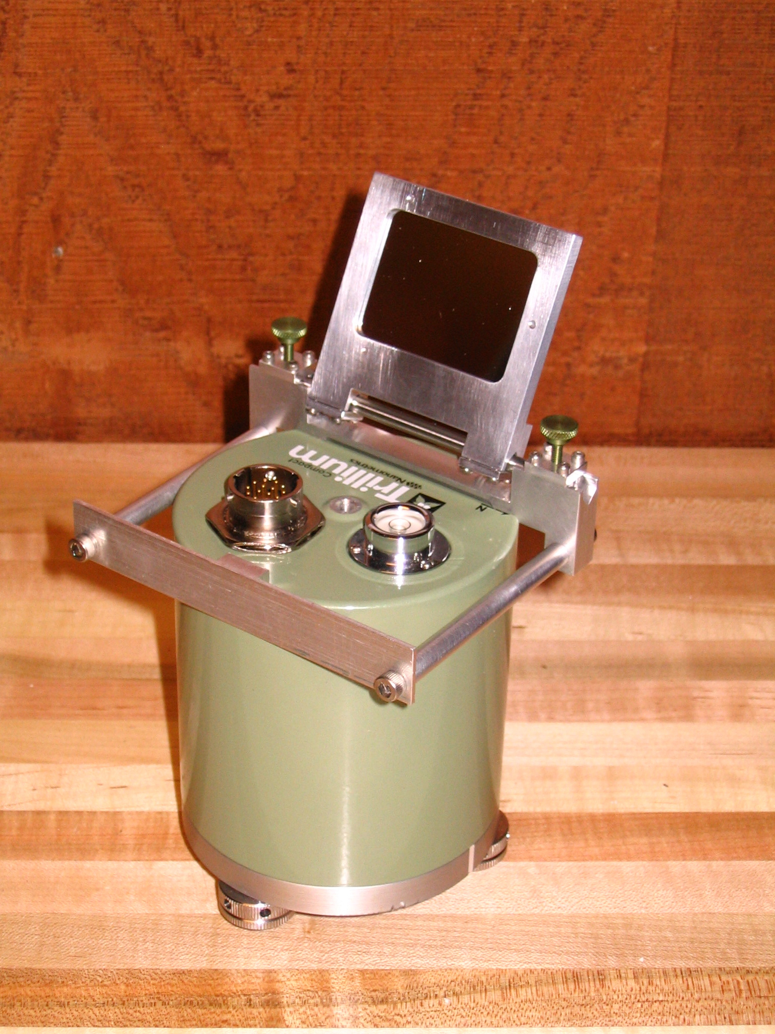
Calibrate with independent, portable sensor:
Nanometrics compact Trillium 120 and Taurus digitizer

Slide 33
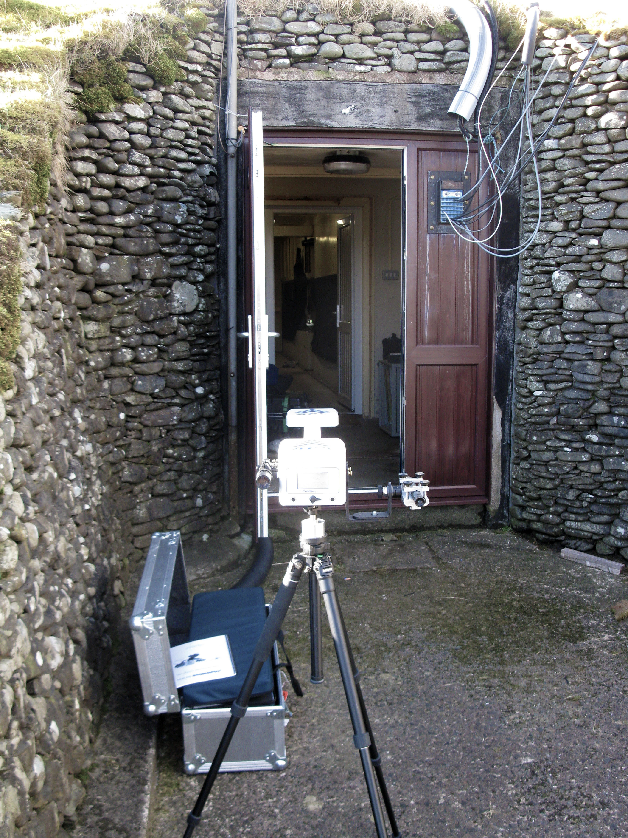
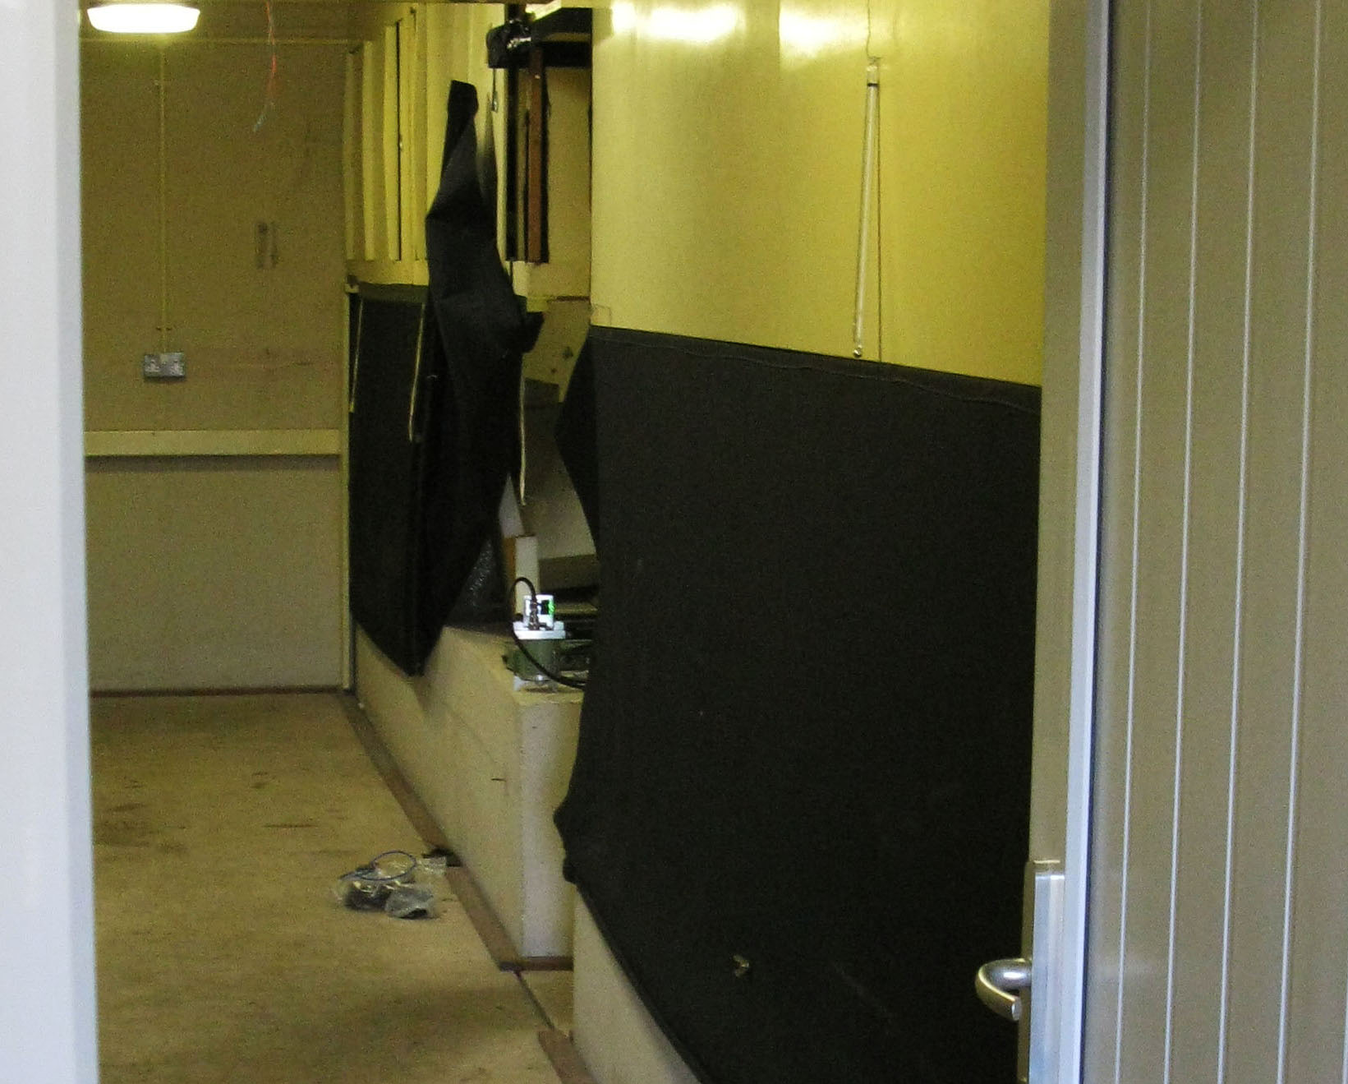
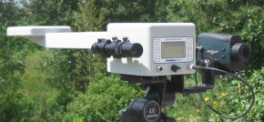
APS used to measure orientation of Trillium
Vault at II- ESK (Eskdalemuir, Scoltland)

Slide 34
Accurate determination of relative response of the common instruments
Accurate determination of relative orientation
2+ hours of microseismic background noise is sufficient for accurate reading

Slide 35
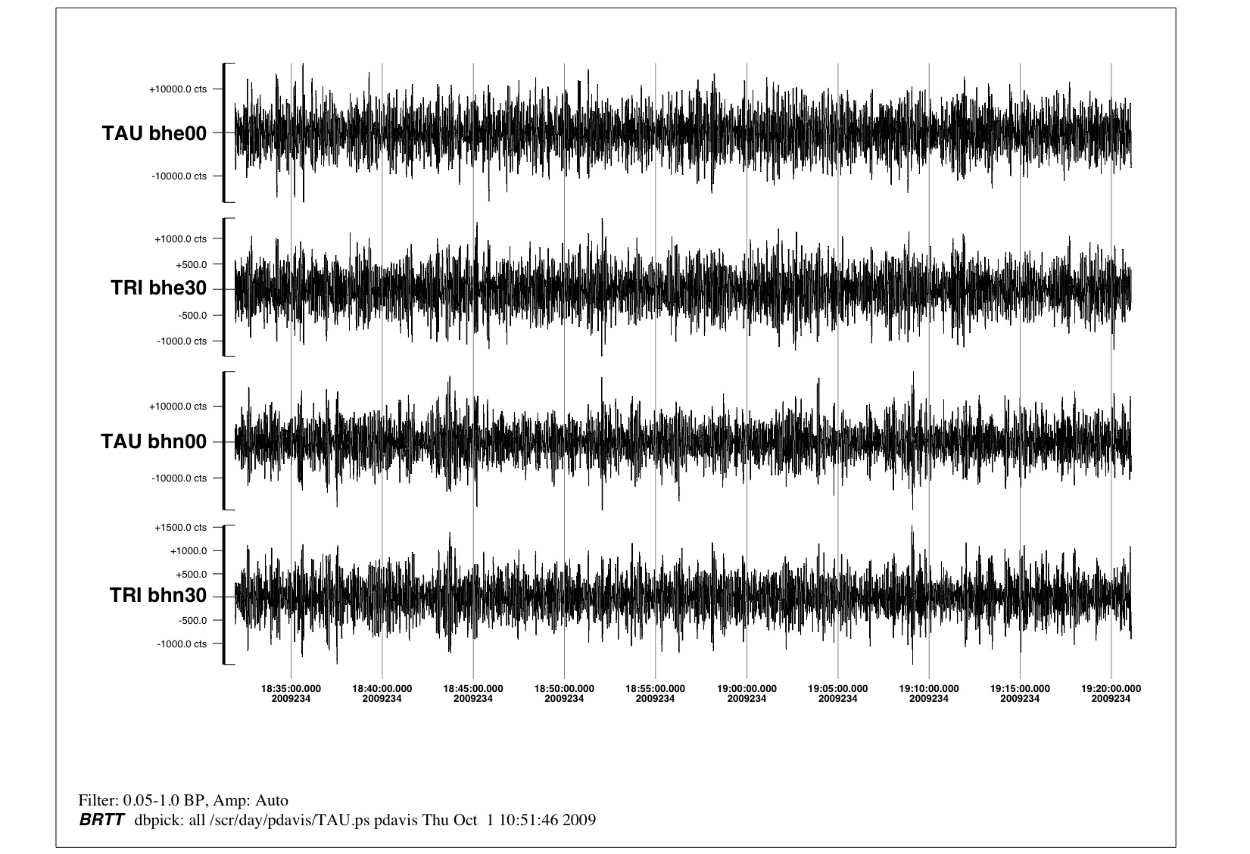
GSN sensor
Reference sensor
GSN sensor
Reference sensor
Sensor Calibration and Orientation

Slide 36
Analysis of microseisms yield relative amplitude accurate to < 1%, orientation < 1 deg

Slide 37
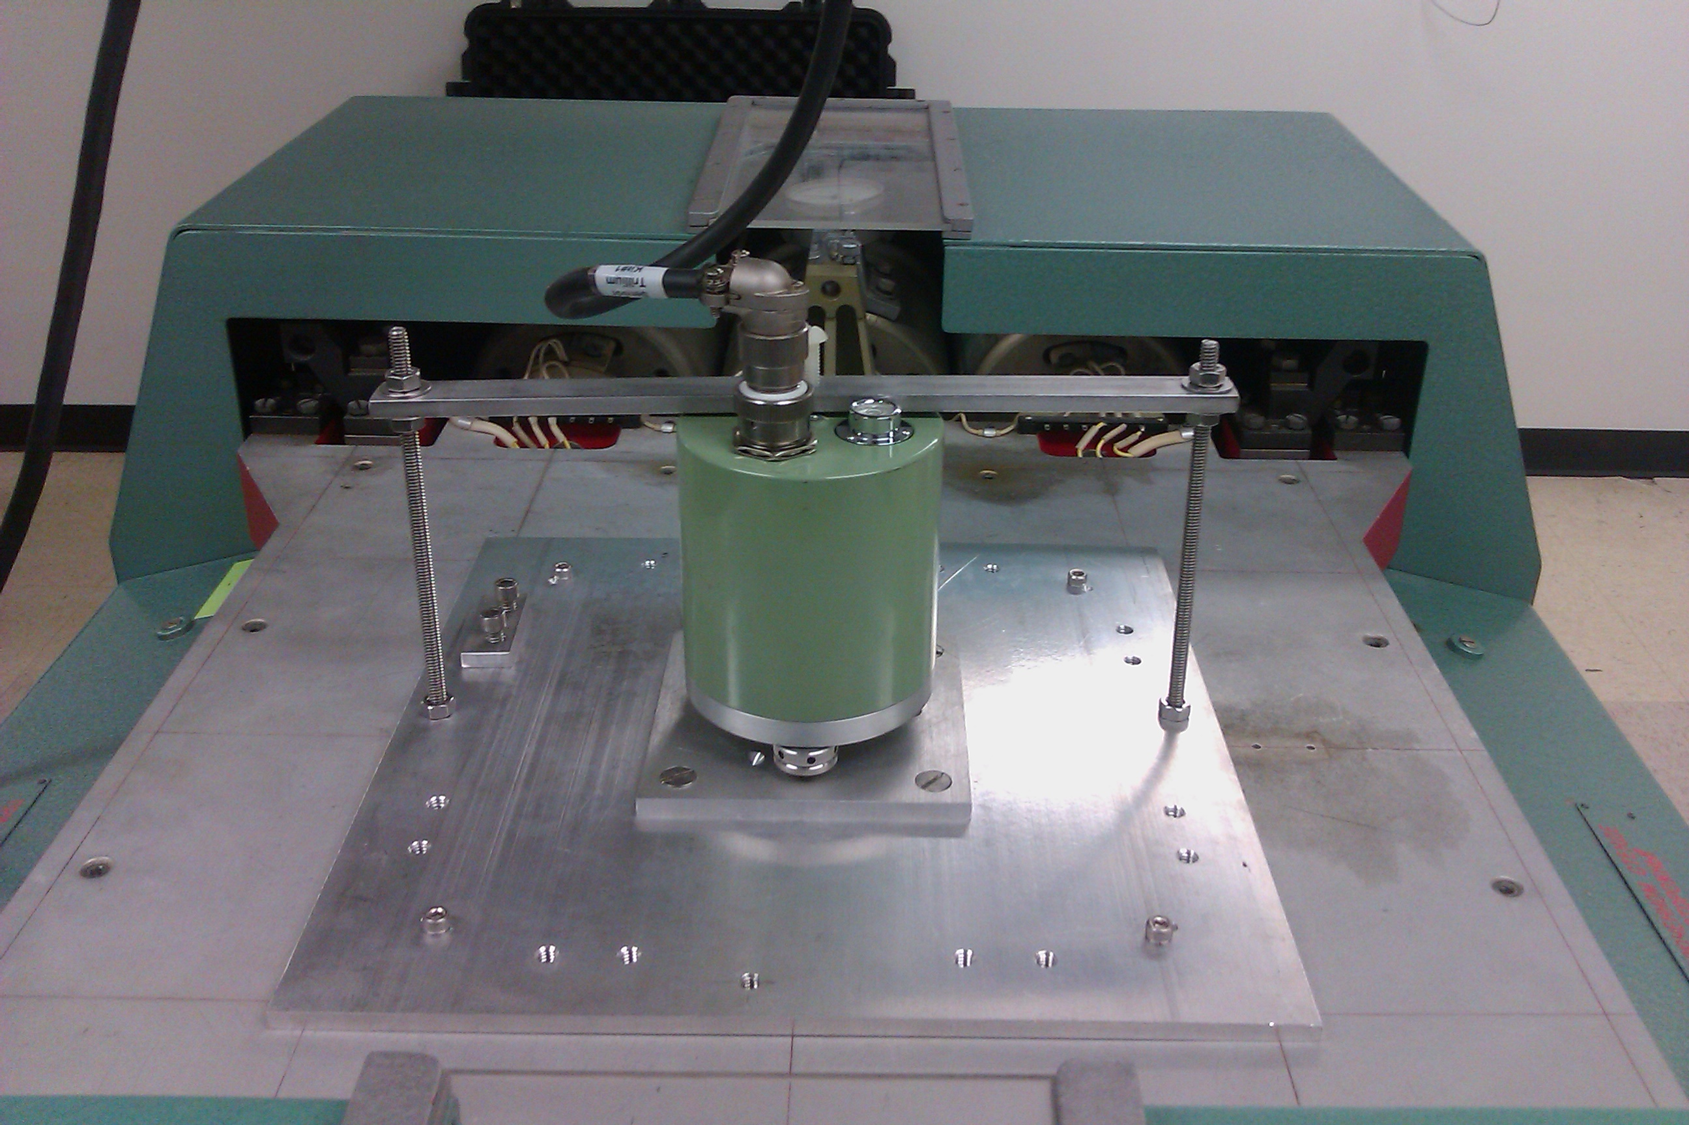
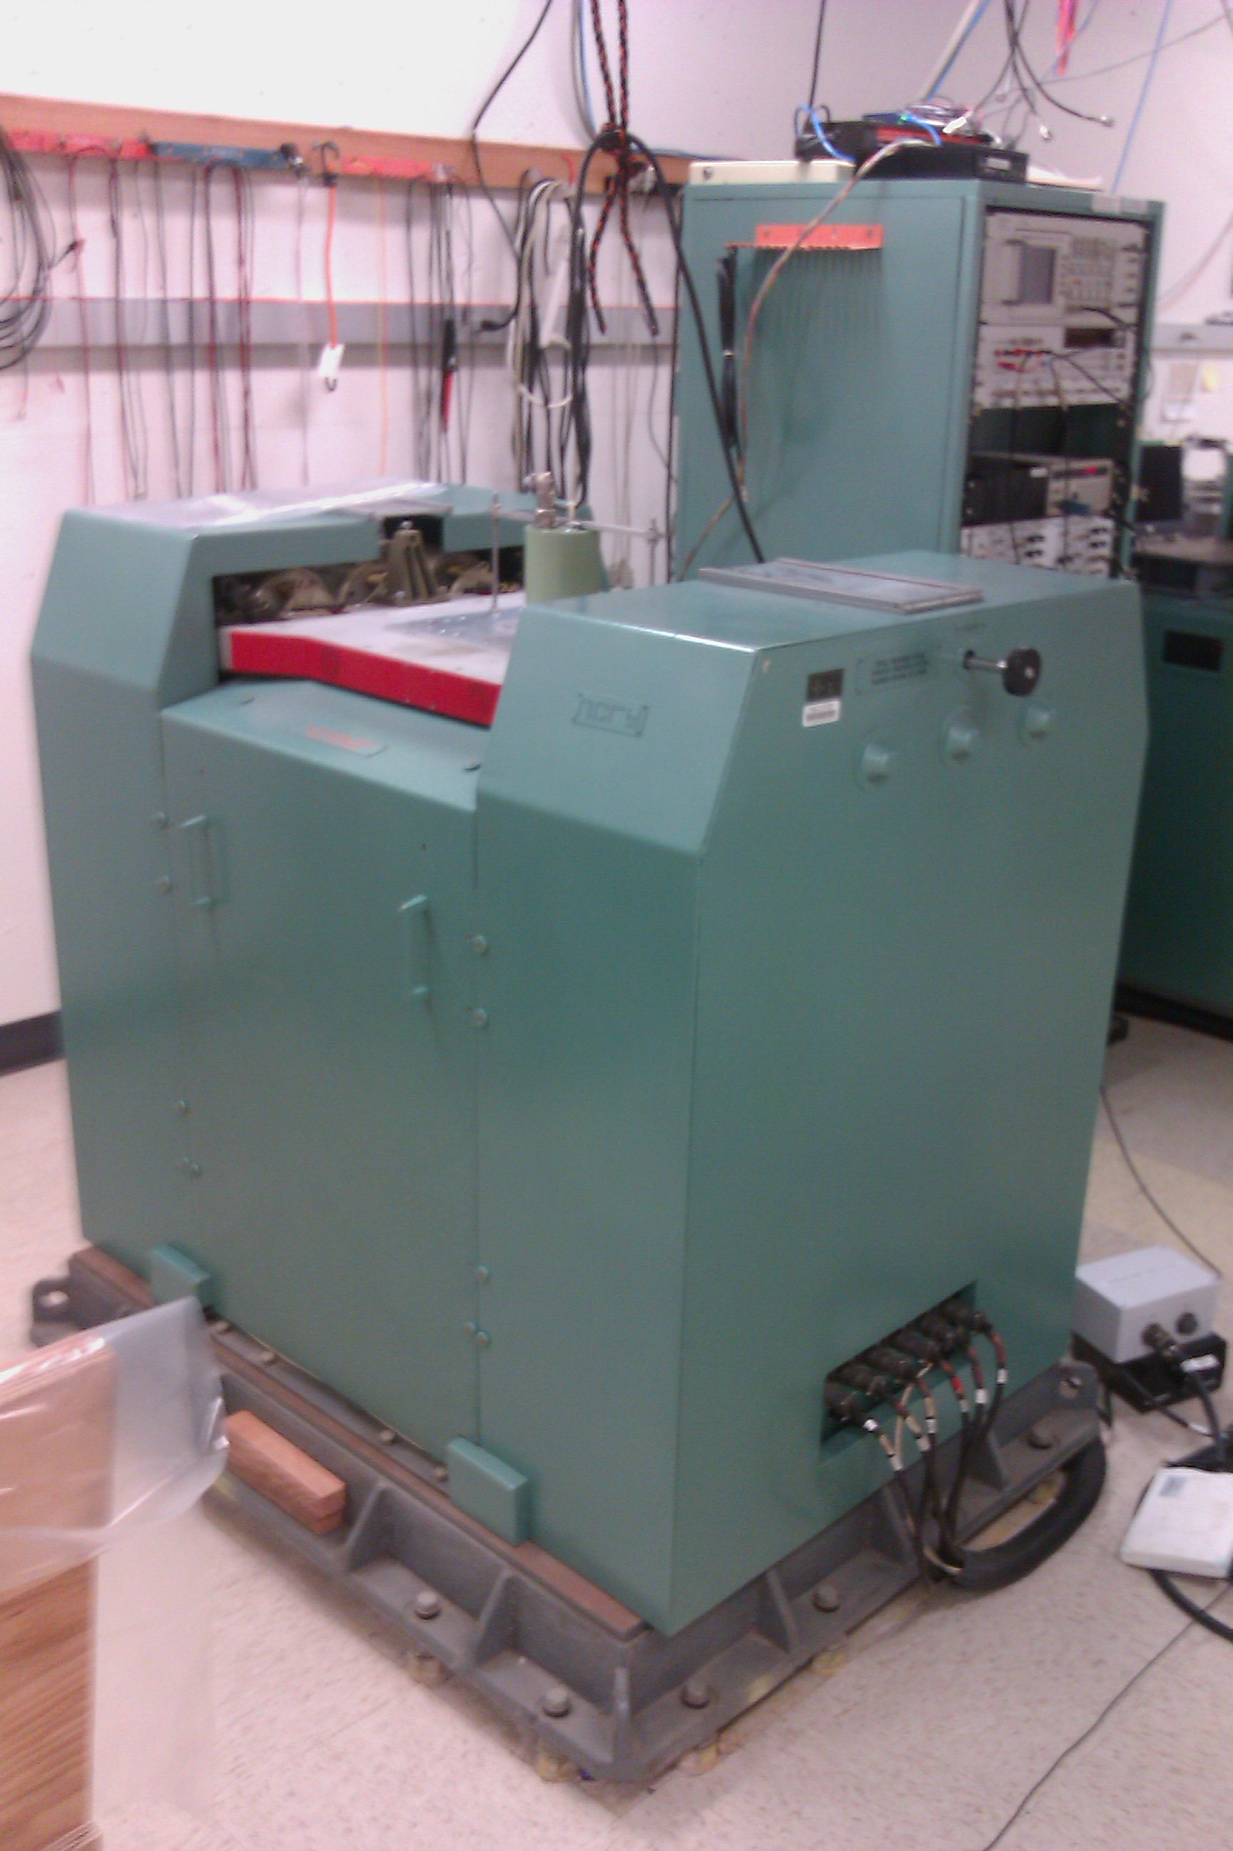
Shaketable at UCSD

Slide 38
Effectiveness of the calibration program can be assessed using long period modes excited by large earthquakes
First used by Davis et al. (2005)

Slide 39
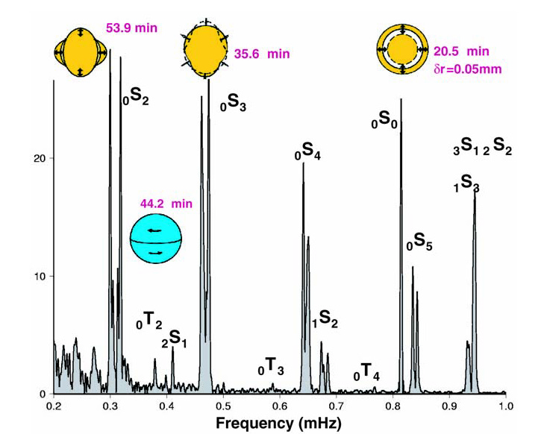
Sumatra-Andaman earthquake excited many low frequency normal modes
Figure from Park et al. (2004), courtesy G. Roult

Slide 40
Distributions identify problematic responses…

Slide 41
Software Developments:
Broad adoption of FDSN web services standards leads to many useful quality assessment tools
  Checking performance of strong motion sensors
  Replacing legacy code with platform-independent routines
  Using synthetic seismogram resources
IRIS MUSTANG program promoting improved quality control of GSN and other data sets

Slide 42

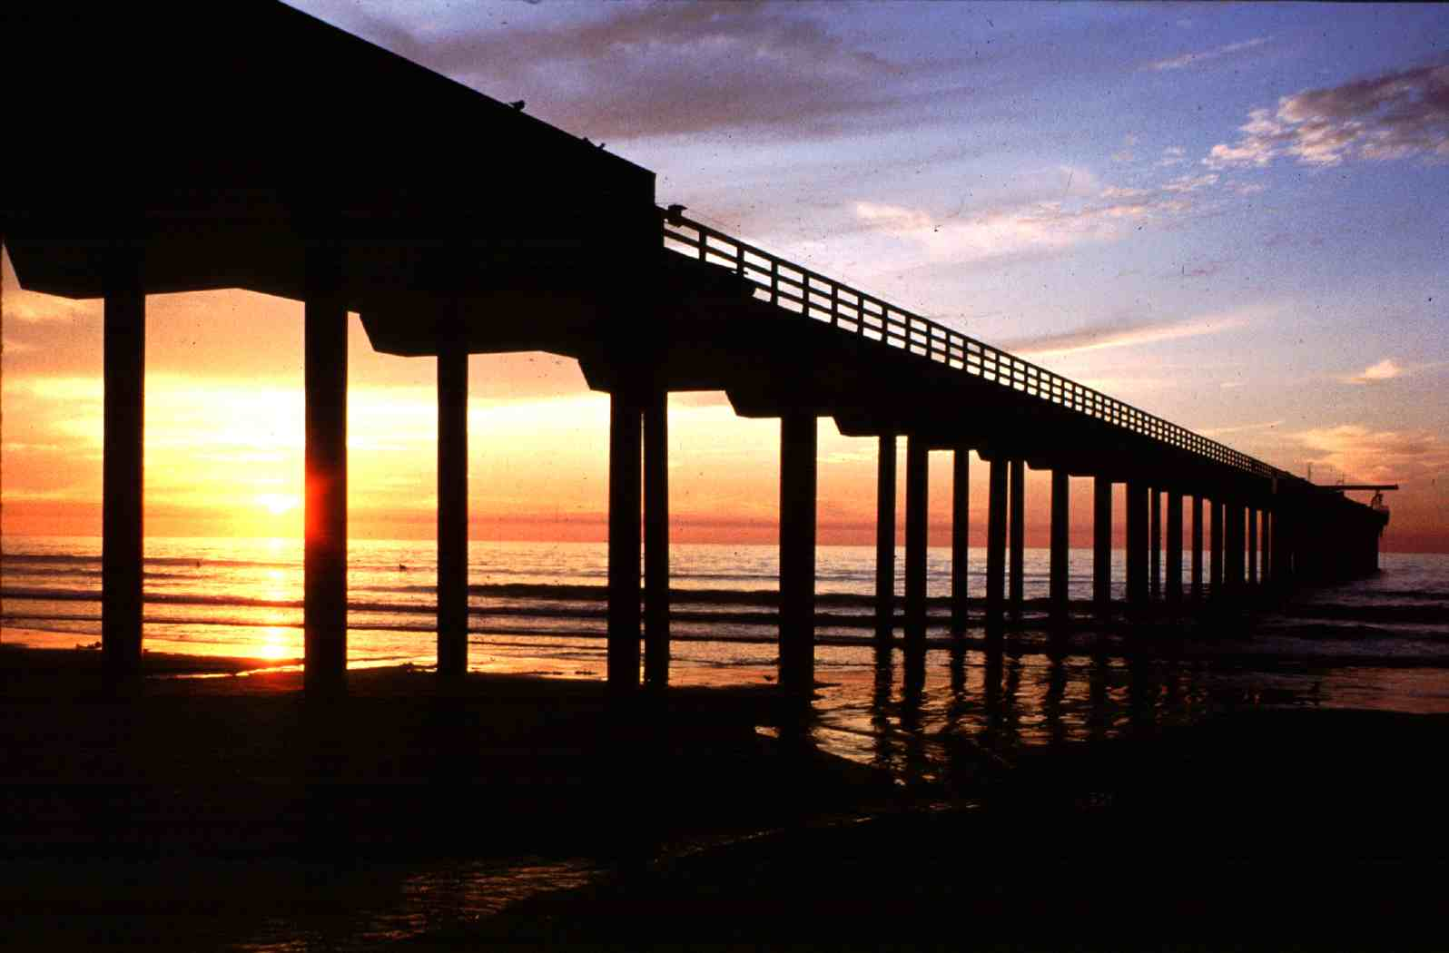
Pier at the Scripps Institution of Oceanography, UCSD

