Slide 1
Accessing Data Using Web Services

Slide 2
IRIS Services – service.iris.edu
FDSN Web services
dataselect
station
event
Documentation
IRIS web services
fedcatalog
timeseries
rotation
sacpz
resp
evalresp
virtualnetwork
traveltime
Flinnengdahl
distaz
metadatachange
products

Slide 3
IRIS Services
- easy to use through a variety of tools
IRIS and FDSN Services
Extensive documentation
Builders exist to help understand URL patterns
Key Links
service.iris.edu

Slide 4
Programmatic support is widespread
Modern computer languages that include support for basic web services include:
Java
Perl
Python
PHP
MatLab
JavaScript
R (e.g. Rcurl)
C#
C/C++ (multiple libraries)

Slide 5
Perl Fetch scripts:
command line access
http://service.iris.edu/clients/
FetchData
FetchEvent
FetchMetadata

Slide 6
Fetch Data Options
FetchData retrieves miniSEED, simple metadata, SEED RESP and/or SAC Poles and Zeros
using the following selection criteria:
Network, Station, Location and Channel
all optional, can contain ‘*’ and ‘?’ wildcards, virtual networks supported
Start and end time range
Geographic box or circular region
Selections: command line, selection list file or BREQ_FAST file

Slide 7
FetchData Example
Request 1 hour of GSN/ANMO long-period vertical (LHZ) data and simple metadata for 2010-2-27 M8.8 Chilean earthquake:
$ FetchData
-N IU –S ‘ANMO’ –L 00 –C ‘LHZ'
-s 2010-02-27,06:34:00 -e 2010-02-27,07:34:00
-o /data/Chile-GSN-LHZ.mseed
-m /data/Chile-GSN-LHZ.metadata
Convert the miniSEED to SAC with metadata
$ mseed2sac Chile-GSN-LHZ.mseed –m Chile-GSN-LHZ.metadata
-E '2010,058,06:34:11/-36.122/-72.898/22.9'

Slide 8
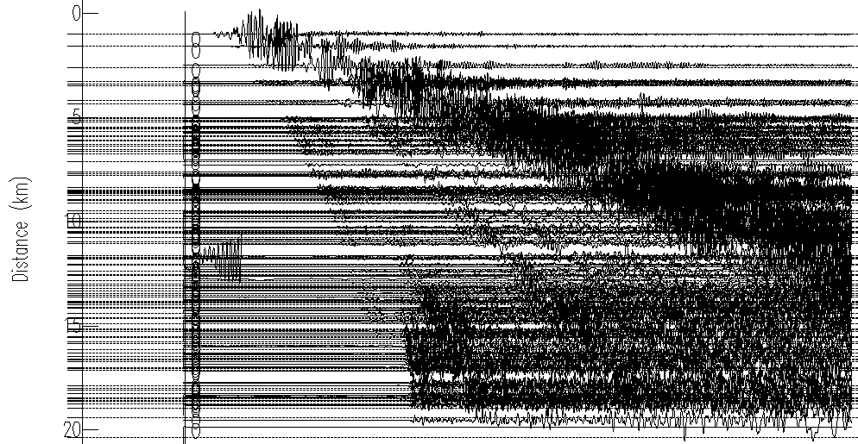
FetchData Example Results
2 minutes later…
121 SAC files and a quick-n-dirty record section:

Slide 9
Performance of dataselect
WS-dataselect has been shown to be able to deliver 5 terabytes of data per day to a single remote user

Slide 10
FetchEvent Options
FetchEvent retrieves event information from ws-event and prints simple ASCII output.
Events can be selected using these criteria:
Start and end time range
Geographic box or circular region
Depth range
Magnitude range and type
Catalog and contributor
IRIS event ID
Other options:
Include secondary origins (default is primary only)
Order results by magnitude or time
Limit to origins updated after a specific date

Slide 11
FetchEvent Example
Request events for a 20 minute period including secondary origins:
$ FetchEvent -s 2010-2-27,6:30 -e 2010-2-27,6:50 -secondary

Slide 12
The success of web services
700 of 1100 terabytes delivered using web services

Slide 13
International Coordination
through Federation

Slide 14
International Coordination
FDSN web services are well coordinated between Europe and the US
Americas – US (IRIS, NCEDC, NEIC/USGS), Brazil
Europe – France (IPGP, RESIF), Germany (BGR, LMU, GFZ), Italy, Netherlands, Romania, Switzerland, Turkey, UK (ISC)
Work in progress
Canada, Mexico, New Zealand, California (SCEDC)
Many developers producing ws enabled clients
ObsPy • jWeed
SOD • WILBER 3

Slide 15
International Coordination
Next Focus for IRIS
Western Pacific, Asia, Australia, New Zealand, Oceana
Intend to promote them elsewhere
Who is interested at this workshop?
Any network using SeisComp3 running a version since the Seattle version can serve data through FDSN web services

Slide 16
IRIS Federator
IRIS is developing a federating web service that will allow a user to make a request to a catalog web service at IRIS. This service will return a set of URLs that will allow the software running on a user’s computer to directly access the appropriate data center to service their request
IRIS
Federator
USER

Slide 17
Federated Fetch
./FetchData-2015.135 -F -C LHZ
-s 2011-3-11T05:46 -e 2011-3-11T06:15:00
-o tohoku.mseed -m tohoku.meta

Slide 18
The Results – from 9 centers
./FetchData-2015.135 -F -C LHZ -s 2011-3-11T05:46 -e 2011-3-11T06:15:00 -o tohoku.mseed -m tohoku.meta
Received 10.0 KB from federator catalog in 1.3 seconds (7.5 KB/s)
Fetching data from BGR (http://eida.bgr.de)
Received 4.1 KB of metadata in 2.7 seconds (1.5 KB/s)
Processed metadata for 101 channel epochs in 2.8 seconds
Received 205.5 KB of time series data in 12.6 seconds (16.3 KB/s) - written to BGR-tohoku.mseed
Writing metadata (101 channel epochs) to file: BGR-tohoku.meta
Fetching data from GEOFON (http://geofon.gfz-potsdam.de)
Received 22.7 KB of metadata in 8.7 seconds (2.6 KB/s)
Processed metadata for 184 channel epochs in 9.1 seconds
Received 608.0 KB of time series data in 11.0 seconds (55.4 KB/s) - written to GEOFON-tohoku.mseed
Etc for all federated centers

Slide 19
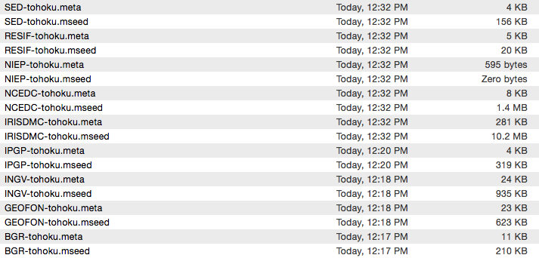
The Results – from 9 centers

Slide 20
The Results – from 9 centers
Returned 2,388 stations
IRIS 1,434 stations
SED 462 stations
INGV 189
GEOFON 142
BGR 68
IPGP 58
NCEDC 32
RESIF 3
NIEP 0

