Slide 1
Improved Quality Control for Seismic Networks ---MUSTANG

Slide 2

Quality Assurance Using MUSTANG
Modular Utility for Statistical Knowledge Gathering
What is MUSTANG
MUSTANG is an automated data quality assurance system that stores measurements of seismic data quality for the entire IRIS archive and makes them available to the community through standard web services.
Currently, 45 metrics are calculated.
The system is modular; new metrics can be added readily.
MUSTANG will have the capability to automatically update metrics values when the data, metadata, or metrics algorithm changes.

Slide 3
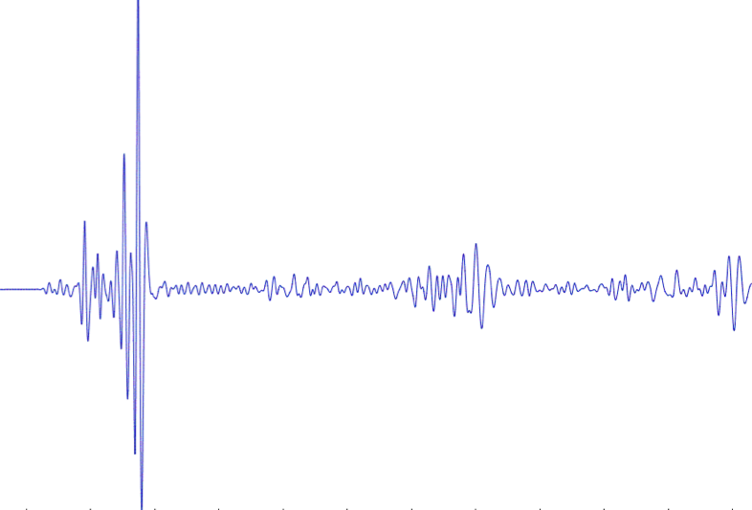
IRIS DMC:
Enhanced Quality Assurance
MUSTANG Metric Estimators
Gaps, overlaps, completeness, signal to noise, power density, pdf mode changes,
Glitches, (46 metrics as of August 2015)
PostgreSQL Database
Data Quality Technician
Domestic & Non-US
Network Operators
Archived and Real Time Data

Slide 4
The MUSTANG System
IRIS SEED Archive
Metadata
database
Real time
miniseed
miniSeed
archive
Contributed metrics
MUSTANG
Metrics job
Metrics scheduler
Metrics database
Metrics updater
Metrics job
Metrics job
MUSTANG clients
Web service call
Other communication
graphics
Text-based data
Other Analysis software

Slide 5
MUSTANG Web Services http://service.iris.edu/mustang
Measurements
returns metrics values
Noise-pdf
returns Probability Density Functions in frequency ‘bins’ or plots
Noise-psd
returns Power Spectral Density estimates in frequency, power values or plots
Noise-mode-timeseries
returns Power Spectral Density estimates in values or plots
Metrics
returns descriptions of the metrics available
Targets
returns a list of stations and channels that have values for a given metric

Slide 6
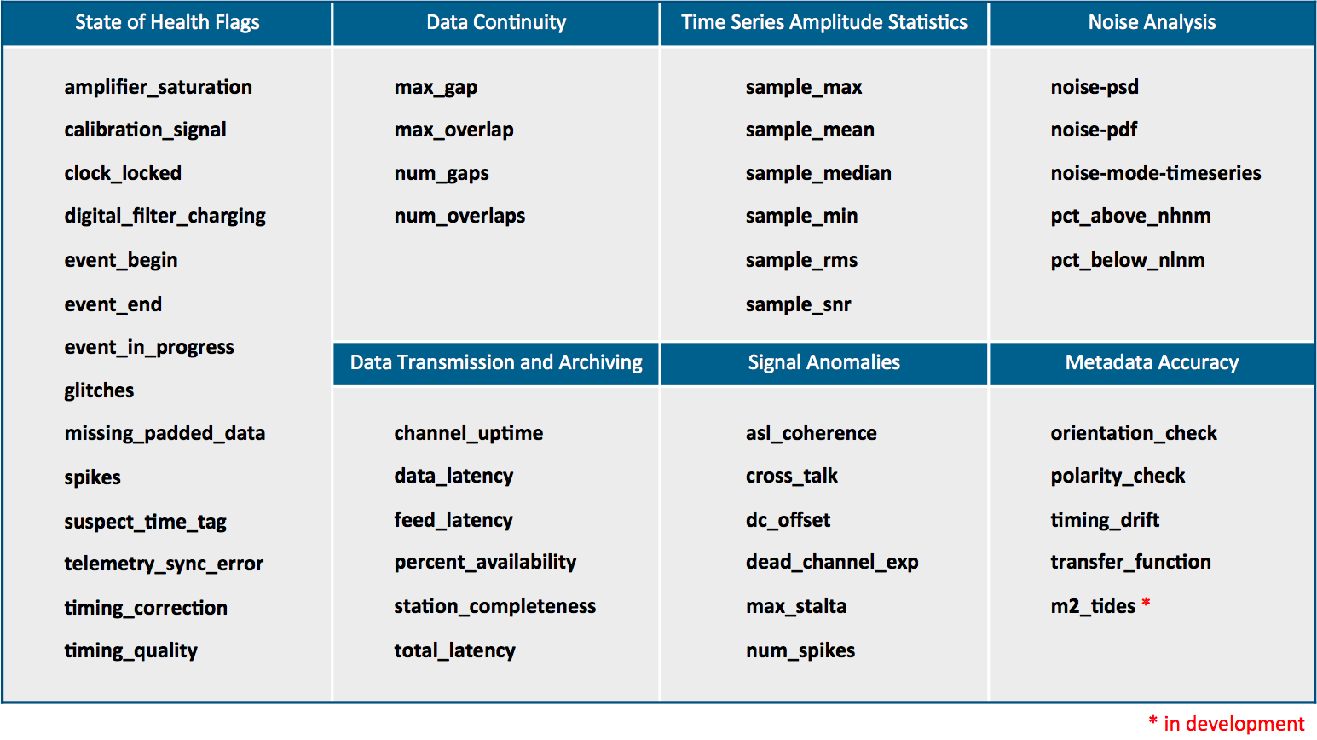
MUSTANG
46 Metrics Available
* in development

Slide 7
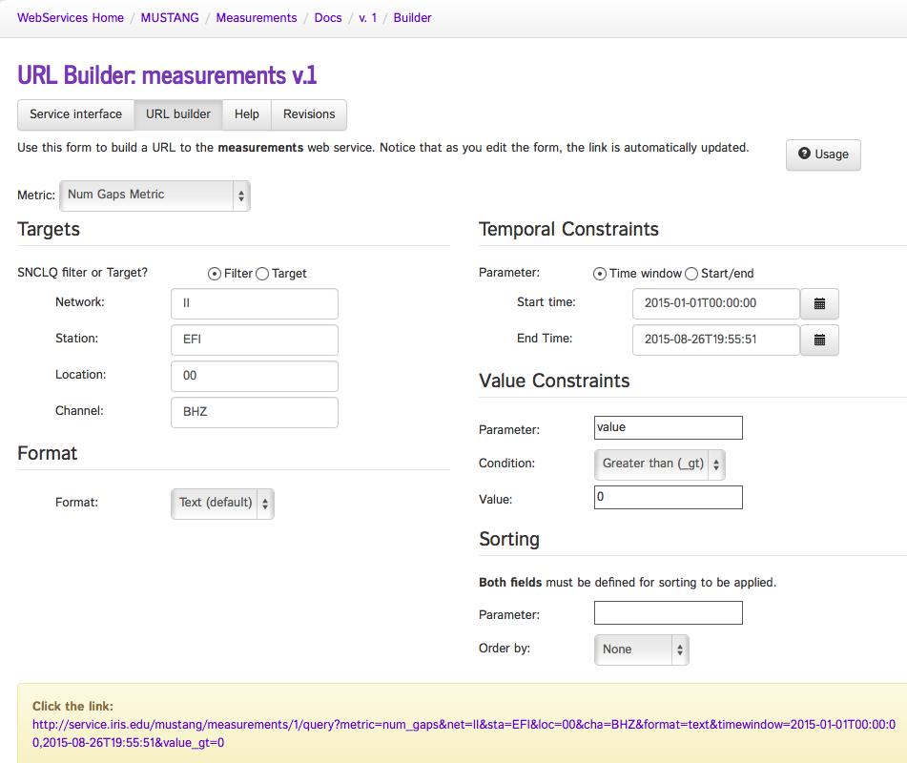
Number of Gaps Metric - builder

Slide 8
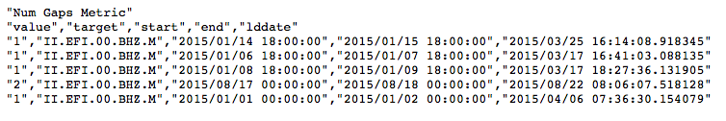
Number of Gaps metric as a text file or an XML doc, JSON, or CSV file

Slide 9
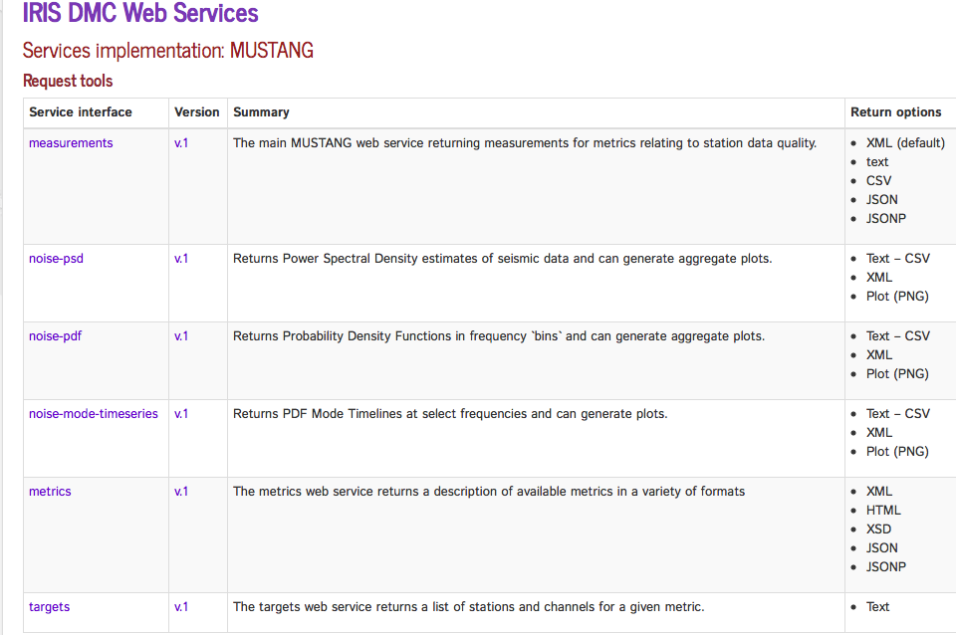
MUSTANG builds upon web services experience
http://service.iris.edu/mustang/

Slide 10
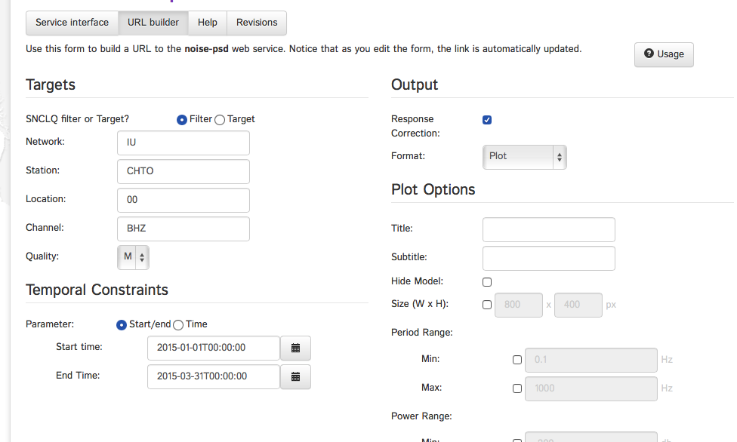
Builder for Power Spectral Densities

Slide 11
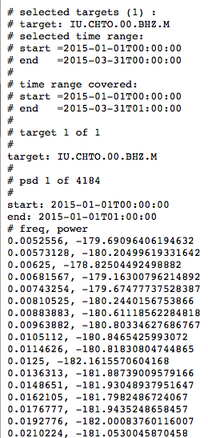
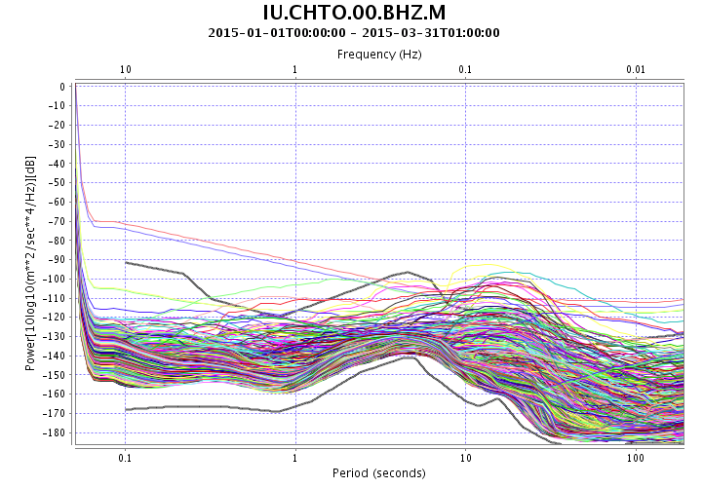
Multiple output options for PSDs
XML, Text, Plots

Slide 12
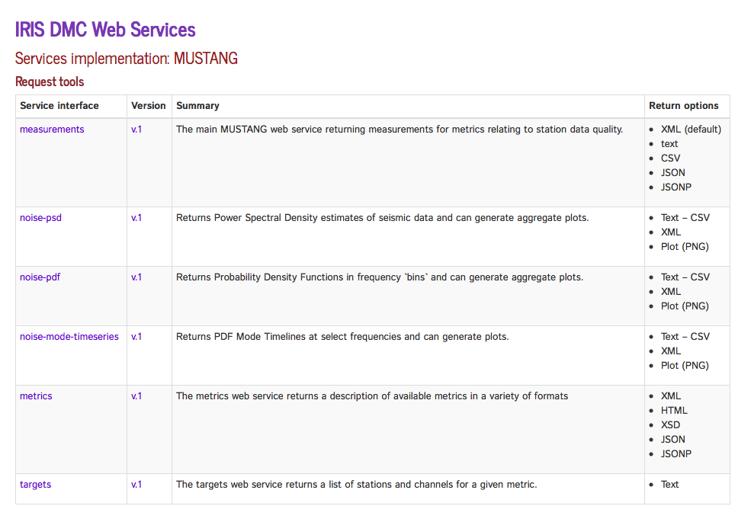
MUSTANG builds upon web services experience
http://service.iris.edu/mustang/

Slide 13
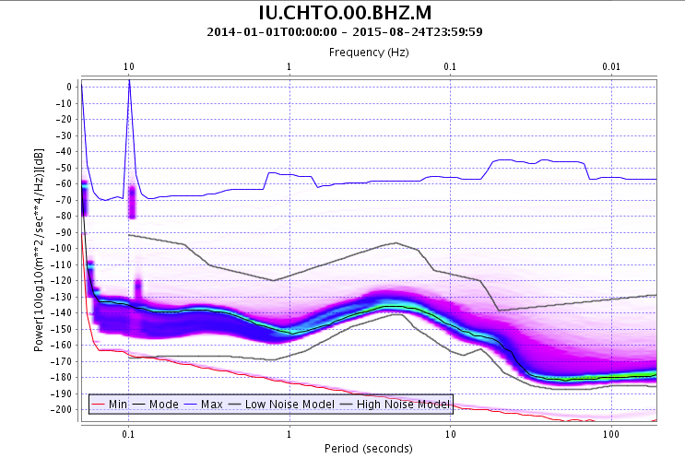
Similar usage for PDFs pdf for 20 months of data

Slide 14
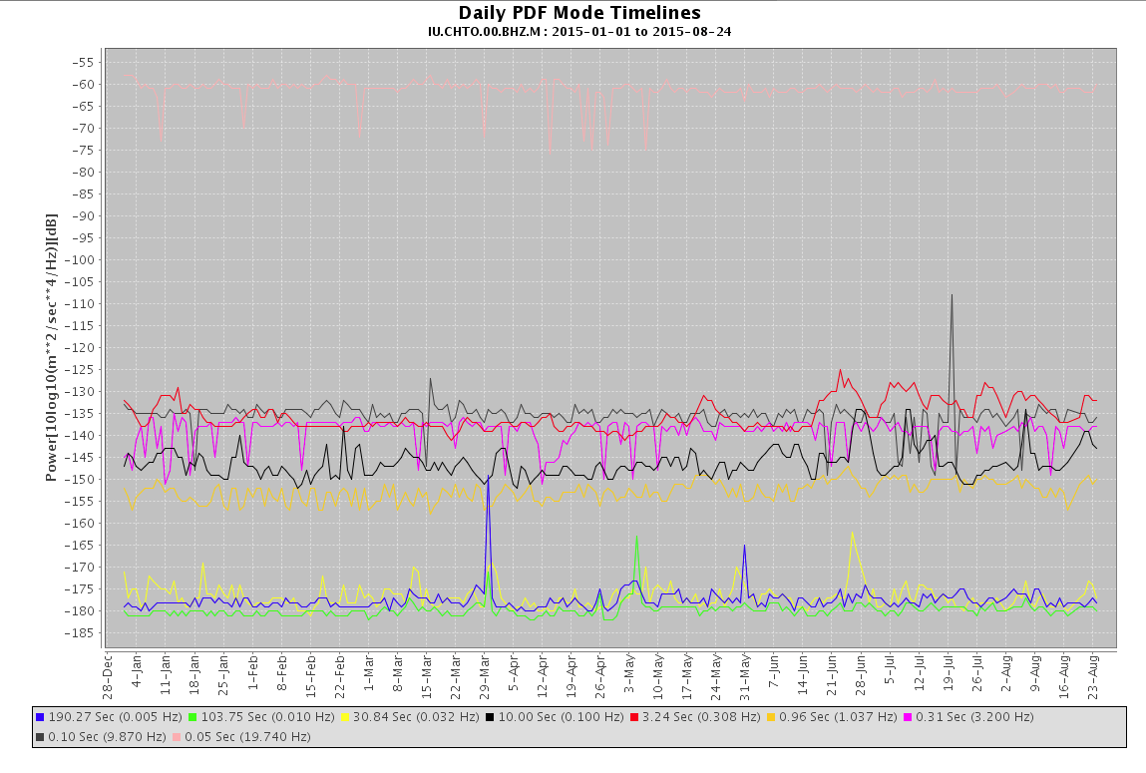
Modes of the PSDs

Slide 15
Visualization Clients that connect with MUSTANG
IRIS Data Services Browser
http://www.iris.edu/mustang/databrowser

Slide 16
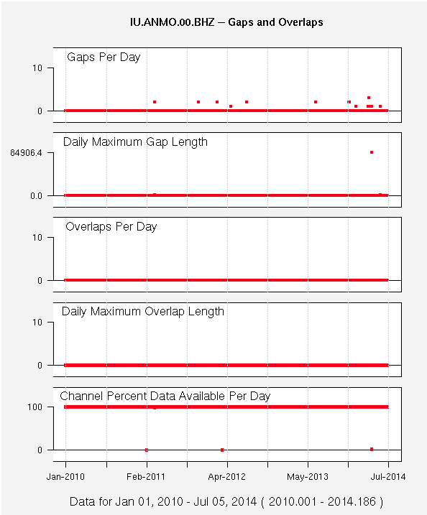
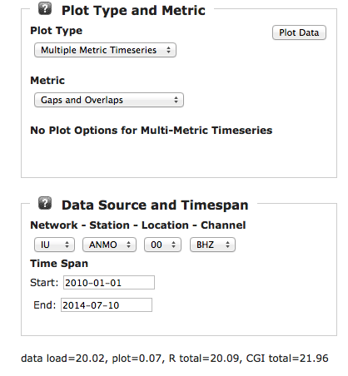
Multiple Metric Displays

Slide 17
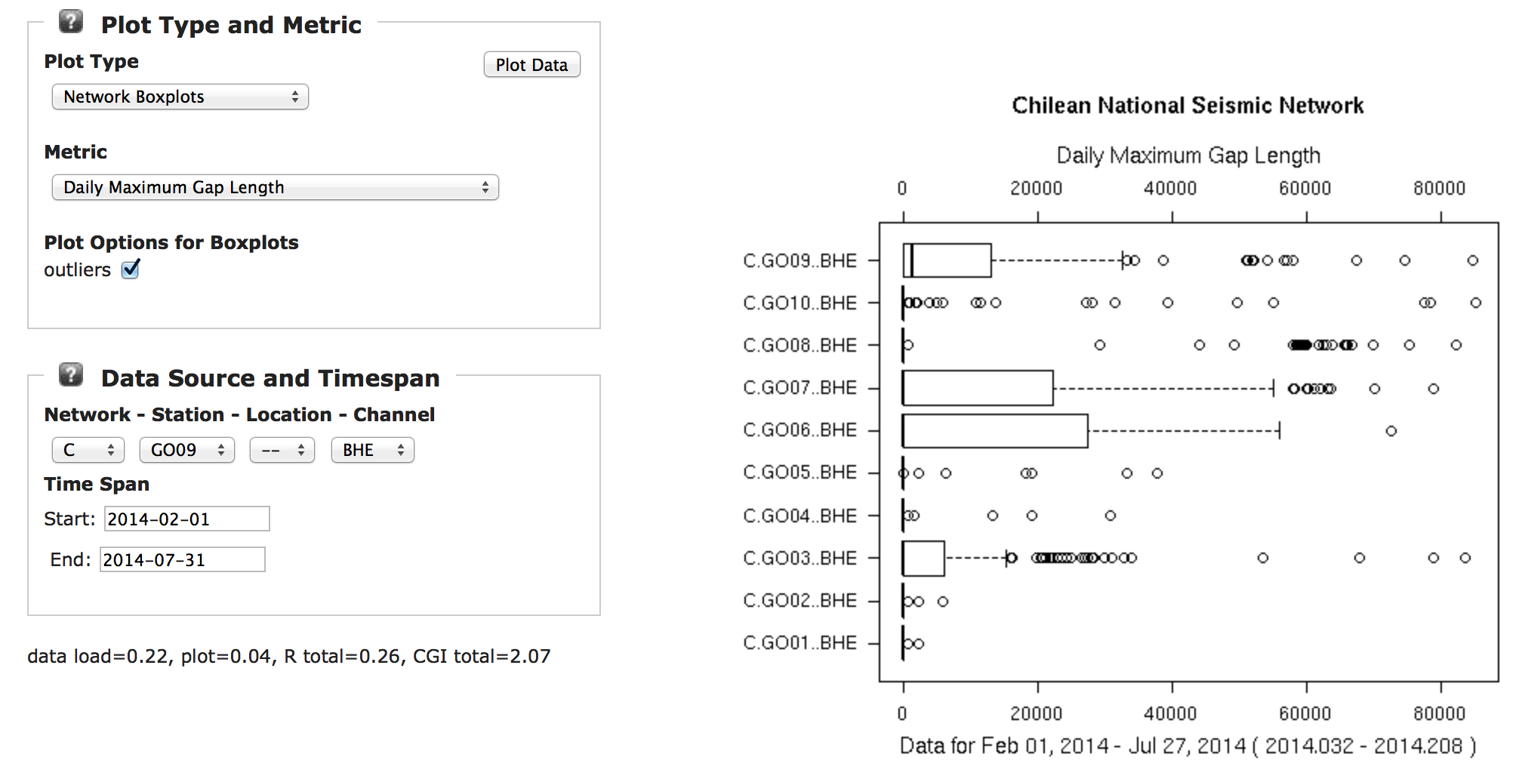
Network Box Plots

Slide 18
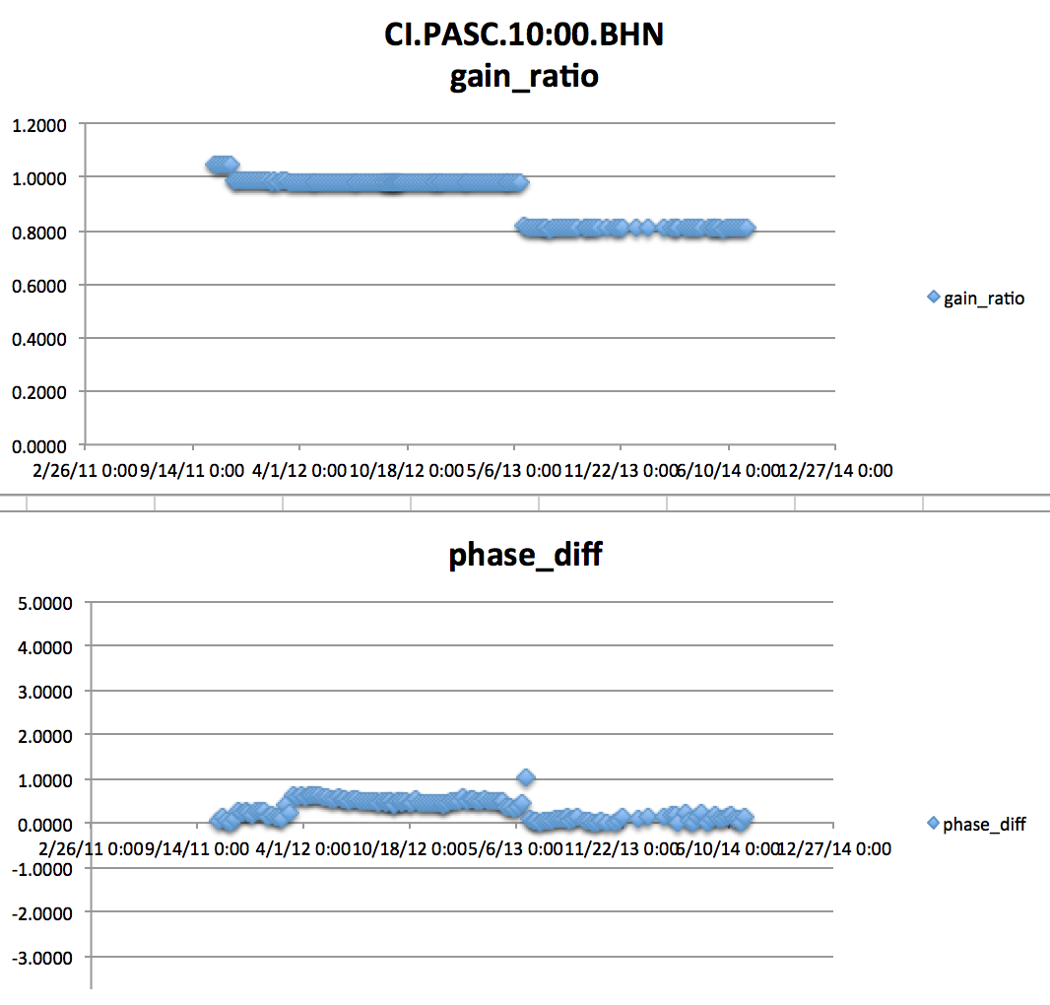
New metrics can always be added
The two steps in gain ratio steps can be tracked to metadata changes taking place
This plot represents gain ratios and phase differences
  @ T=6s
  measured weekly
  only values with magnitude squared coherence > 0.999 are shown

Slide 19
What is MUSTANG’s biggest challenge

Slide 20
IRIS System for Portable Assessment of Quality (ISPAQ) – a work in Progress
MUSTANG is a very large system with many dependencies
  Web services
  Postgres DBMS
  PASTURE recalculation
  Scalable to many terabytes of data holdings and thousands of seismic statins
  etc.

Slide 21
ISPAQ
Most networks operate a smaller network with at most a few hundred stations
They know when changes occur in metadata, or time series, etc
ISPAQ will leverage this as a system that is scriptable and will execute specific metric calculations against specfic data targets
  Will use the existing MUSTANG metric calculators that are in the CRAN repository
  Will work with a system that has web services in place (SeisComp3)
  Will work with local waveform and metadata files
  Will store results as simple text files

Slide 22
ISPAQ
When completed, ISPAQ should provide a portable solution that can be used with smaller networks in a much less complicated environment than is found at the IRIS DMC
But the metrics will be calculated using identical algorithms
Hope to extend ISPAQ across the FDSN

Slide 23
IRIS DMC:
Research Ready Data Sets
MUSTANG Metric Estimators
Gaps, overlaps, completeness, signal to noise, power density, pdf mode changes,
Glitches, (~24 metrics in phase 2)
PostgreSQL Database
Data Quality Technician
Domestic & Non-US
Network Operators
DMC Filters Data Request Using Defined Constraints
Research Ready Data Sets
Archived and Real Time Data
Filtered Data Request Returned to Researcher
Researcher Specifies Required Data Metric Constraints

Slide 24
For More Information:
MUSTANG Services
http://services.iris.edu/mustang
MUSTANG Tutorial
http://ds.iris.edu/ds/nodes/dmc/tutorials/getting-started-with-mustang/
Quality Assurance at the IRIS DMC
http://ds.iris.edu/ds/nodes/dmc/quality-assurance

Slide 25
The End
Thanks for your attention

