Slide 1
Introduction to MUSTANG
TIM AHERN, DIRECTOR, IRIS DATA SERVICES

Slide 2
Quality Assurance Using MUSTANG Modular Utility for Statistical Knowledge Gathering
What is MUSTANG
MUSTANG is an automated data quality assurance system that stores measurements of seismic data quality for the entire IRIS archive and makes them available to the community through standard web services.
Currently, 45 metrics are calculated.
The system is modular; new metrics can be added readily.
MUSTANG will have the capability to automatically update metrics values when the data, metadata, or metrics algorithm changes.

Slide 3
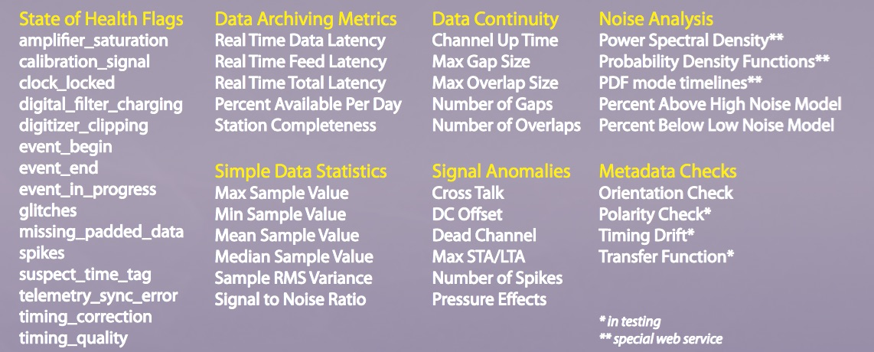
MUSTANG: Quality Assurance System
Research Ready Data Sets (RRDS)
Allows users to filter requests for data based upon quality assurance metrics

Slide 4
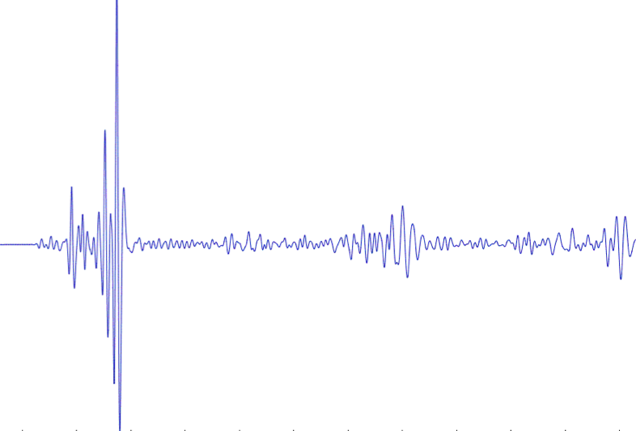
IRIS DMC: Enhanced Quality Assurance
MUSTANG Metric Estimators
Gaps, overlaps, completeness, signal to noise, power density, pdf mode changes,
Glitches, (46 metrics as of August 2017)
PostgreSQL Database
Data Quality Technician
Domestic & Non-US
Network Operators
Archived and Real Time Data

Slide 5
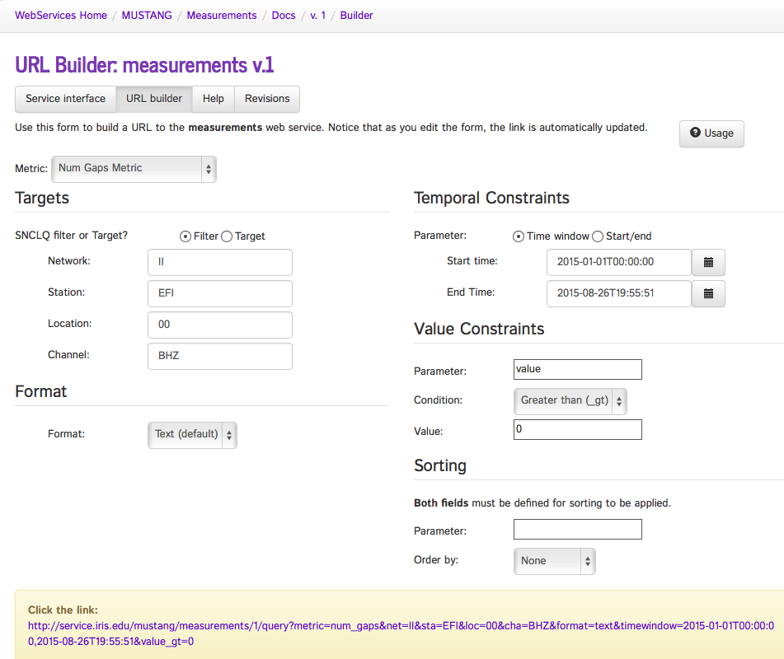
Number of Gaps Metric - builder

Slide 7
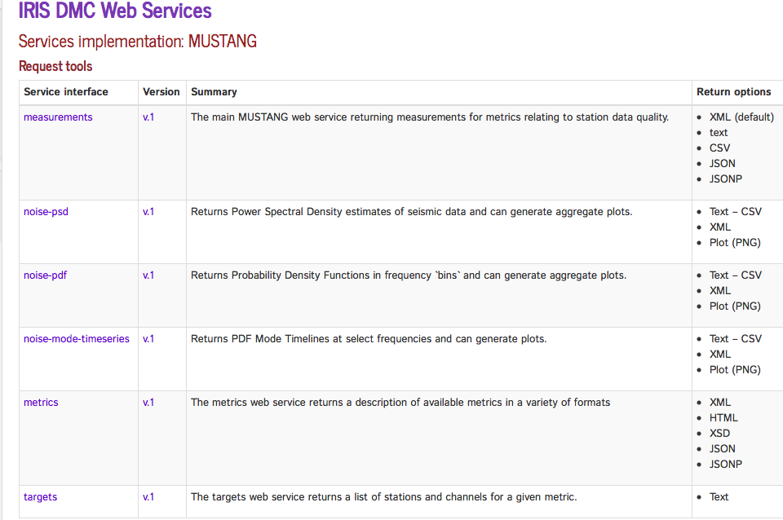
MUSTANG builds upon web services experience
http://service.iris.edu/mustang/

Slide 8
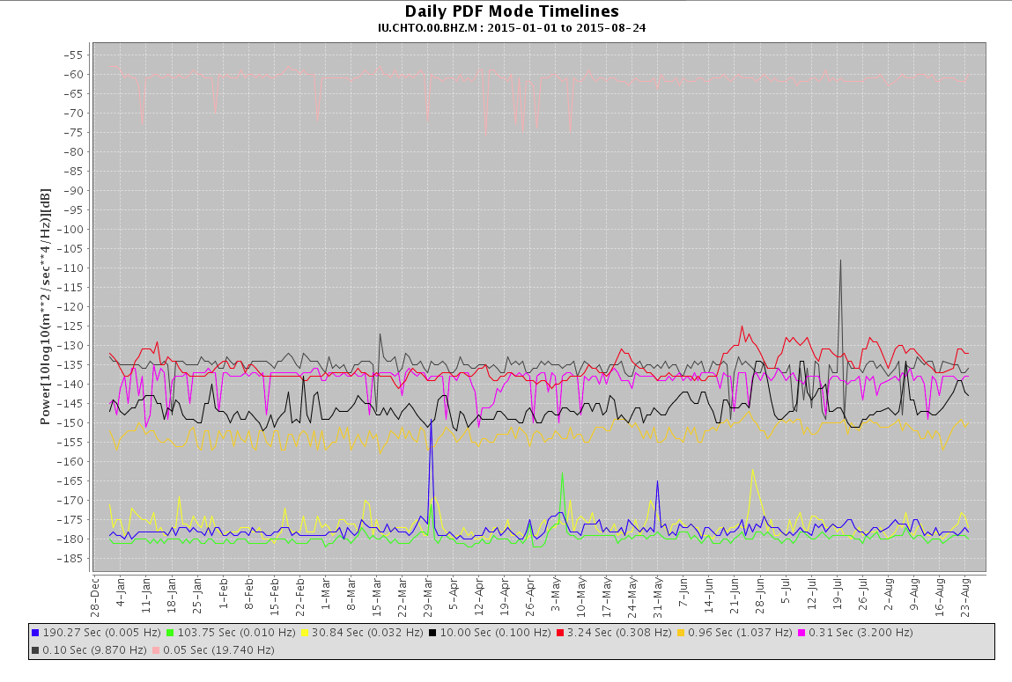
Modes of the PSDs

Slide 9
Builder for Power Spectral Densities

Slide 10
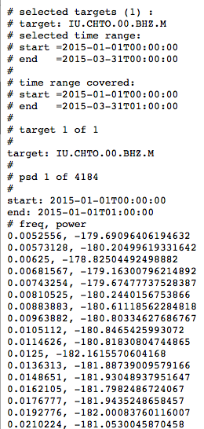
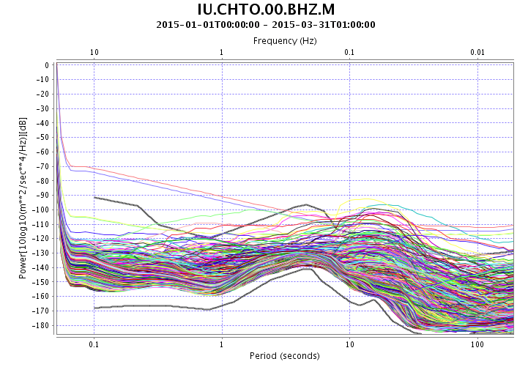
Multiple output options for PSDs XML, Text, Plots

Slide 11
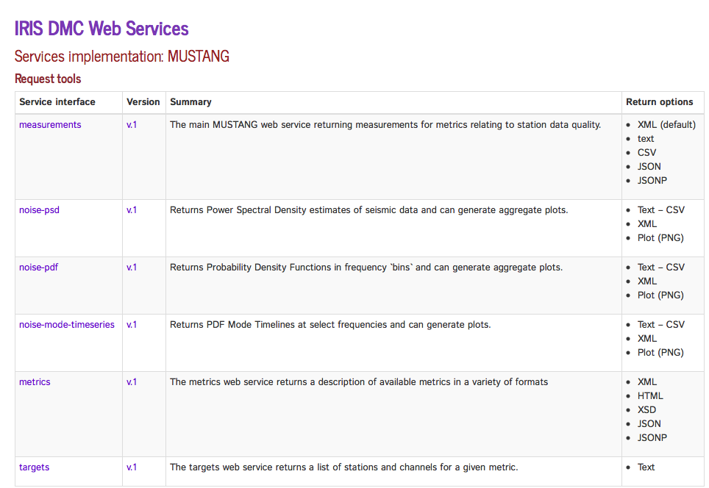
MUSTANG builds upon web services experience
http://service.iris.edu/mustang/

Slide 12
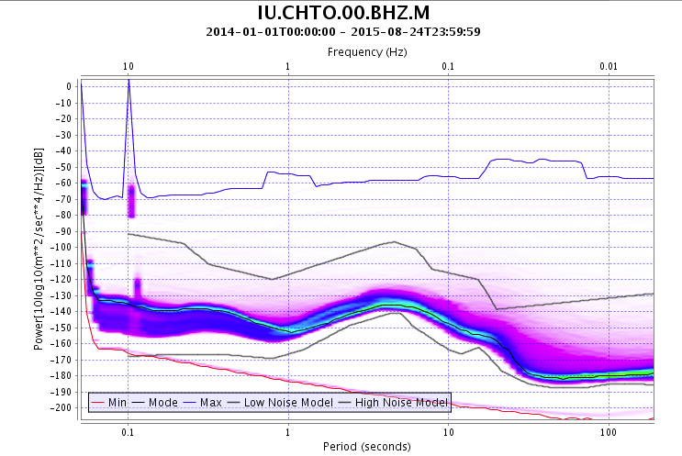
Similar usage for PDFs pdf for 20 months of data

Slide 13
IRIS System for Portable Assessment of Quality (ISPAQ)
MUSTANG is a very large system with many dependencies
Web services
Postgres DBMS
PASTURE recalculation engine
Scalable to many terabytes of data holdings and thousands of seismic statins
etc.

Slide 14
ISPAQ
Most networks operate a smaller network with at most a few hundred stations
They know when changes occur in metadata, or time series, etc
ISPAQ will leverage this as a system that is scriptable and will execute specific metric calculations against specfic data targets
Will use the existing MUSTANG metric calculators that are in the CRAN repository
Will work with a system that has web services in place (SeisComp3)
Will work with local waveform and metadata files
Will store results as simple text files

Slide 15
ISPAQ
ISPAQ can provide a portable solution that can be used with smaller networks in a much less complicated environment than is found at the IRIS DMC
But the metrics will be calculated using identical algorithms
Hope to extend ISPAQ across the FDSN

Slide 16
IRIS DMC: Research Ready Data Sets
MUSTANG Metric Estimators
Gaps, overlaps, completeness, signal to noise, power density, pdf mode changes,
Glitches, (~24 metrics in phase 2)
PostgreSQL Database
Data Quality Technician
Domestic & Non-US
Network Operators
DMC Filters Data Request Using Defined Constraints
Research Ready Data Sets
Archived and Real Time Data
Filtered Data Request Returned to Researcher
Researcher Specifies Required Data Metric Constraints

Slide 17
For More Information:
MUSTANG Services
http://services.iris.edu/mustang
MUSTANG Tutorial
http://ds.iris.edu/ds/nodes/dmc/tutorials/getting-started-with-mustang/
Quality Assurance at the IRIS DMC
http://ds.iris.edu/ds/nodes/dmc/quality-assurance

