Slide 1

Wrapup
TIM AHERN, DIRECTOR, IRIS DATA SERVICES

Slide 2
Thanks to so many but especially
Our host and local organizer
  Council for Geosciences, Michelle and Juanita
Lecturers
  Alex, Joachim, Mary, Pete, Stefan
IRIS Facilitator
    Gale Cox
Sponsors
  US NSF, IRIS, IASPEI, FDSN

Slide 3
Thanks to the Participants
Great group dynamics and friendliness
Everyone seemed engaged and had great questions!
Active Participation from
17 countries
Algeria Cameroon D.R. Congo Ethiopia
Ghana Jordan Kenya Madagascar
Malawi Mozambique Nigeria South Africa
Uganda Zambia Zimbabwe
Germany United States

Slide 4
Workshops, SeieComp3 and REED Projects

Slide 5
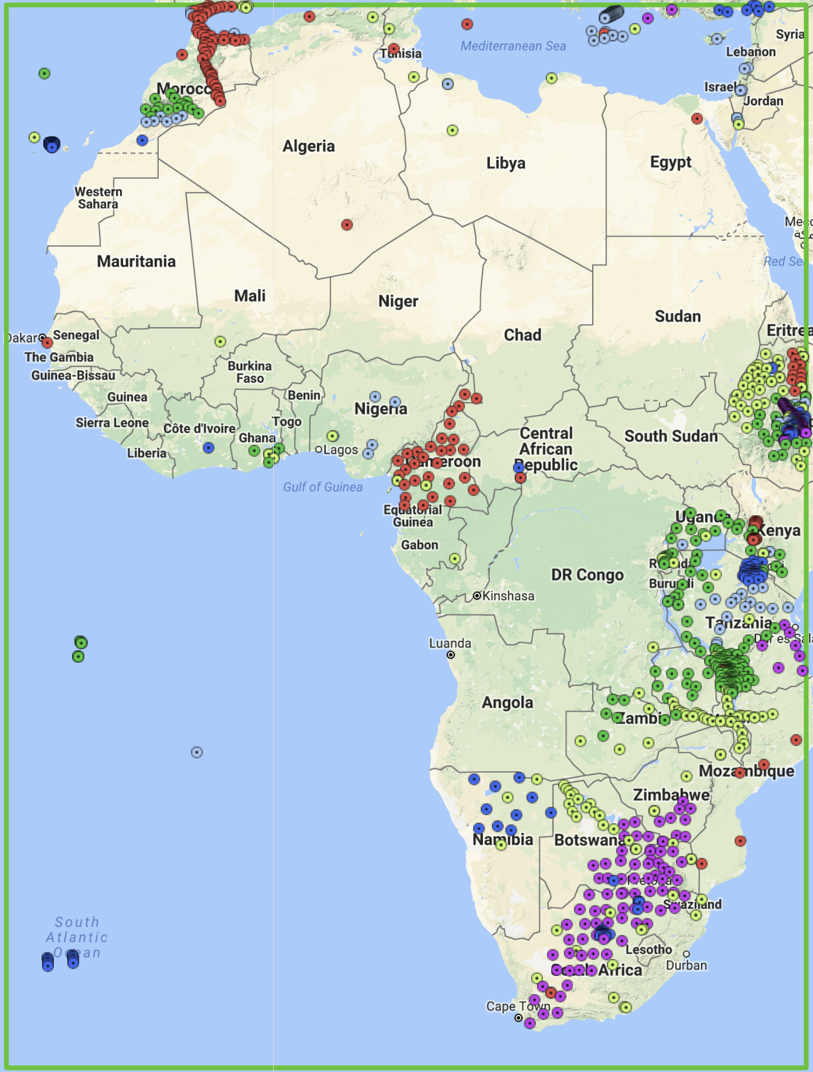
Known Stations with Data at the DMC
1190 Stations
19 permanent networks
27 temporary deployments

Slide 6
Announcements
Travel details for your return trip
Expense Reports for lecturers
Additional questions: Please contact gale@iris.washington.edu

Slide 7
Workshop Evaluation
We need your input to improve the course
https://www.surveymonkey.com/r/PretoriaWS
  Password is ………
PRETORIA2017

