Slide 1
IRIS QA Network Reports – Finding Issues
Specifics of how we use MUSTANG to identify data and instrument issues

Slide 2
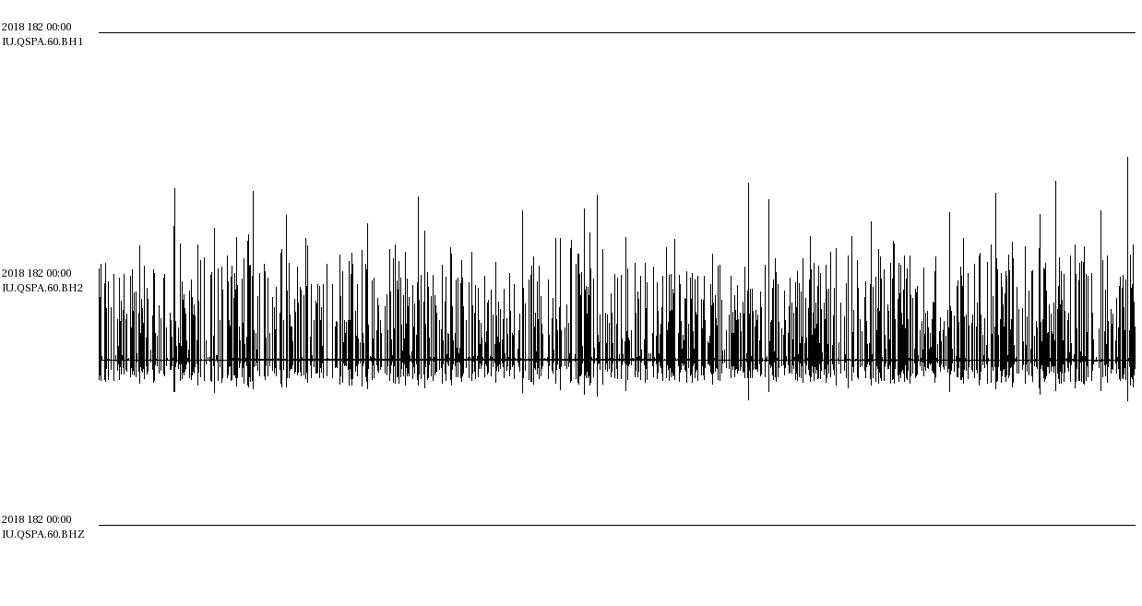
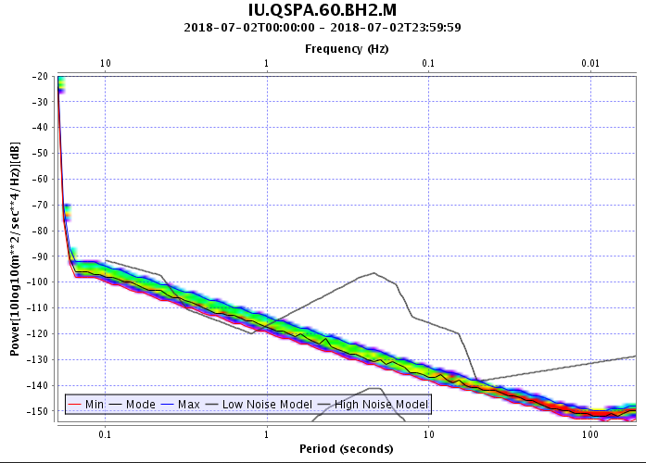
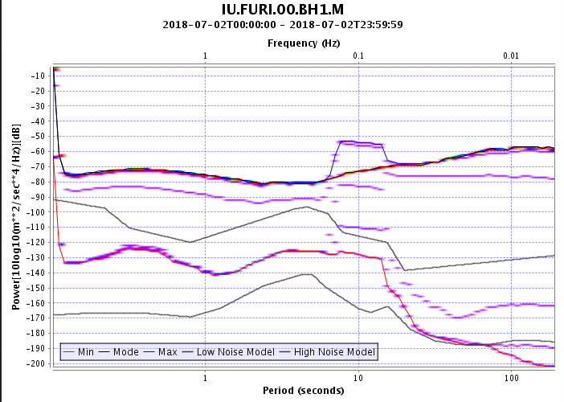
QA Reports
review
Concept: different issues can be identified by using different metrics in combination
IU.QSPA.60.BH2
IU.FURI.00.BH1
dead_channel_lin
pct_below_nlnm
num_gaps
num_spikes
sample_rms
pct_above_nhnm
sample_rms

Slide 3
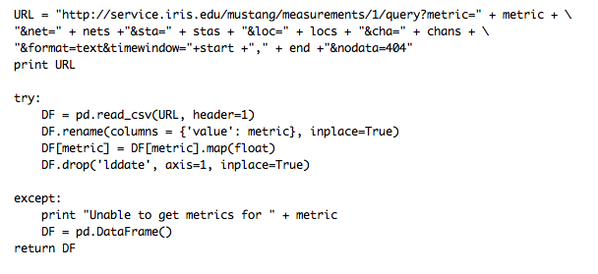
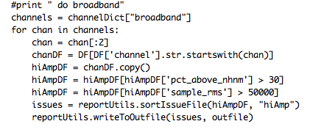
QA Reports
review
Concept: scripts can call the web services and combine values based on defined criteria
By setting up scripts to combine the metrics for us, we can automate the process of “issue finding”
There are likely to be false positives, so the issues should be reviewed
This can only pick up issues that are catchable by MUSTANG metrics – we have a decent list at this point, but are always happy to hear about new metrics or thresholds that could be useful

Slide 4
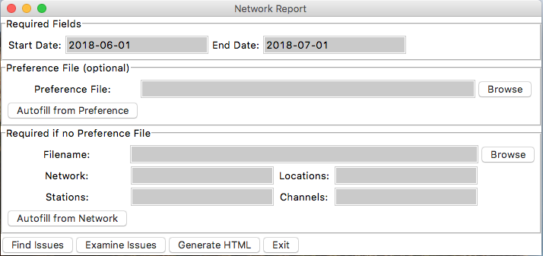
QA Reports
doQA
The Scripts We Use
There are a few scripts that we use that we are making available to you
One is the “work horse” – it grabs all of the metrics and combines them
One generates the actual HTML report
The rest are used to facilitate the process from start to finish
I’m going to go through these in some detail so that they can be used or adapted to your needs.

Slide 5
QA Reports
doQA
Overview GUI (doQA.py)
Autofills based on date. Reporting period for last month
Path to preference file
Facilitates start-to-finish of reporting process
Python
Preference file or manual input
Run the scripts
If no preference file, then need to fill in these fields

Slide 6
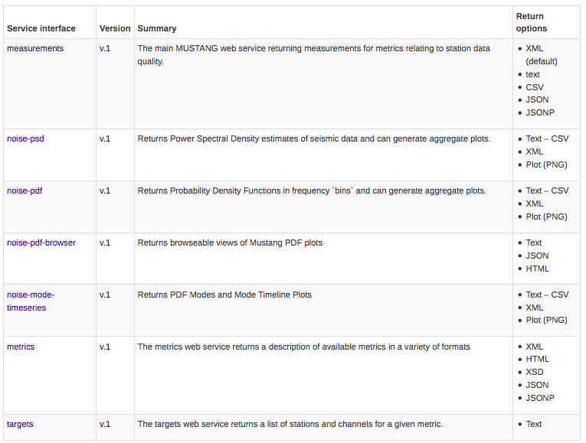
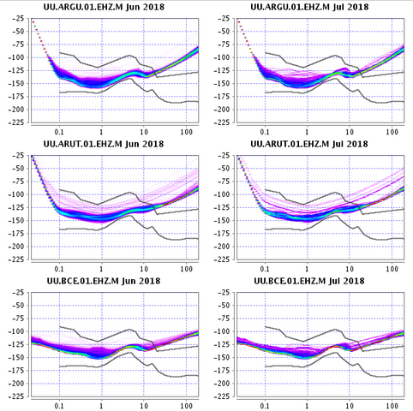
QA Reports
overview
Process:
Find Issues
Evaluate Issues
Generate Report
Process:
Find Issues
Evaluate Issues
Generate Report
Use MUSTANG web services to retrieve measurements
Combine different metrics to find different issues
Manual review of PDFs

Slide 7
QA Reports
Find Issues
Finding Issues
“Work horse”
Python code
Web services
Preference file optional
OR: python findIssues.py --start=2018-06-01 --end=2018-07-01 --preference_file=/path/to/preference.py --network=IU --stations=* --channels=BH?,HH? --locations=* --outfile=/path/to/report.orig
Report Utilities
Preference
File
Find Issues
Thresholds
Issue List

Slide 8
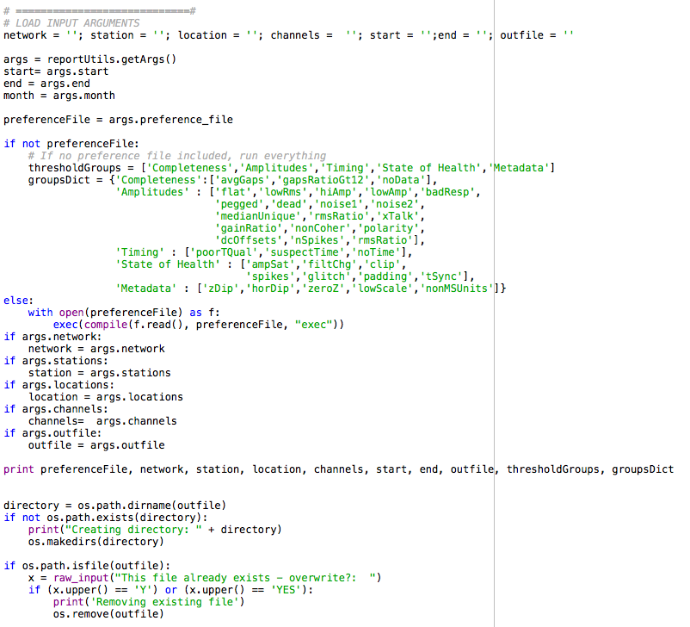
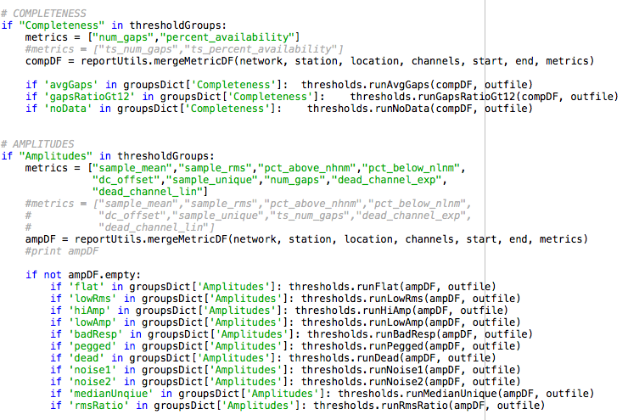
QA Reports – Finding Issues
Find Issues
findIssues.py
Report Utilities
Preference
File
Find Issues
Thresholds
Goes through the list of threshold “Groups”
Grabs metrics required for all thresholds in that group
Subsets based on listed thresholds
Writes offenders to outfile
Issue List

Slide 9
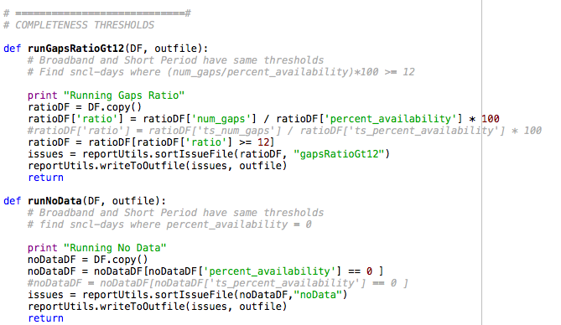
QA Reports – Finding Issues
Find Issues
thresholds.py
Report Utilities
This is where you can change threshold definitions
Requires: pandas, reportUtils.py
Each threshold is its own defined function
Ex: runGapsRatioGt12
Instrument types are defined by channel names
channelDict = {"broadband" : ['BH?','HH*'], "short period" : ["EH*","SH*"]}
Preference
File
Find Issues
Thresholds
Issue List

Slide 10
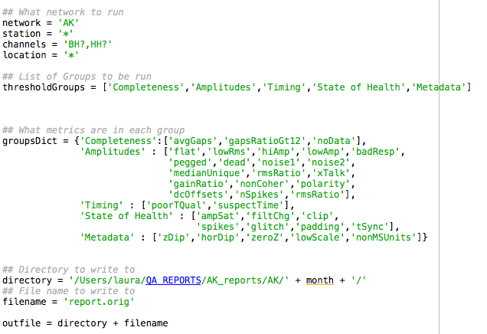
QA Reports – Finding Issues
Find Issues
preference.py
Report Utilities
Preference file is used to define:
SNCL information
Threshold Groups
Directory and name for outfile
Preference
File
Find Issues
Thresholds
Issue List
This is useful for when QA may be done separately on different channel groups or networks.
Ex. Some stations may not have any timing information, while others do. To prevent cluttering the outfile, they can be divided into two separate preference files.

Slide 11
QA Reports – Finding Issues
Find Issues
reportUtils.py
Report Utilities
This is where the utility work happens
Parses input arguments
Grabs metrics through web services
Combines metrics as defined in thresholds.py
Sorts and writes outfile
Requires: pandas, numpy, datetime, argparse, sys
Preference
File
Find Issues
Thresholds
Issue List

Slide 12
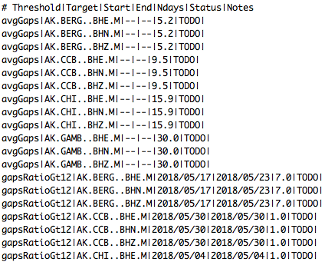
QA Reports – Finding Issues
Find Issues
issueFile.orig
Report Utilities
Preference
File
Find Issues
Thresholds
List of issues sorted by threshold
Pipe separated
Threshold|Target|Start|End|Ndays|Status|Notes
Issue List
These fields different for some thresholds, which are averages over the reporting period.
For example, avgGaps has no start or end associated, and reports the average value rather than the number of days.
This file isn’t very human readable, but is easily parsed by QuARG.py

Slide 13
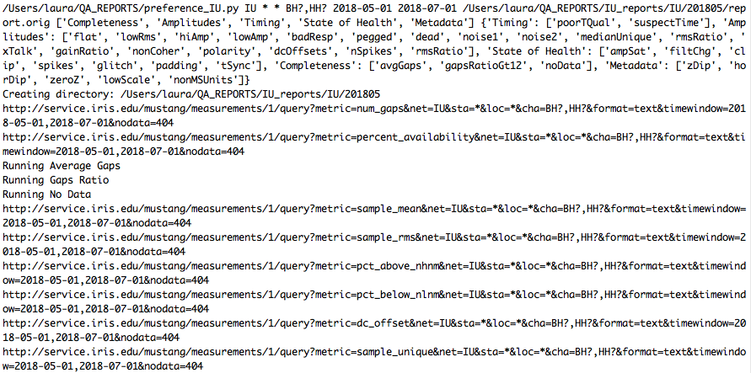
QA Reports – Finding Issues
Find Issues
findIssues.py
Report Utilities
Preference
File
Find Issues
Thresholds
When run, it will output progress to the console:
Issue List

Slide 14
QA Reports – Finding Issues
Recap
Use findIssues.py to highlight problem sncl-days using MUSTANG metrics
The preference file can be used to more easily refine searches or switch between searches, reduces the number of inputs
The threshold definitions can be viewed or changed in thresholds.py
reportUtils.py has the functions that grab and combine metrics, amongst other things
This produces a file (by default report.orig) that isn’t easily human readable but is used in the next step to examine issues.
You can use the GUI doQA.py to easily load in files and autofill from there
OR
You can run findIssues.py on the command line

