Slide 1
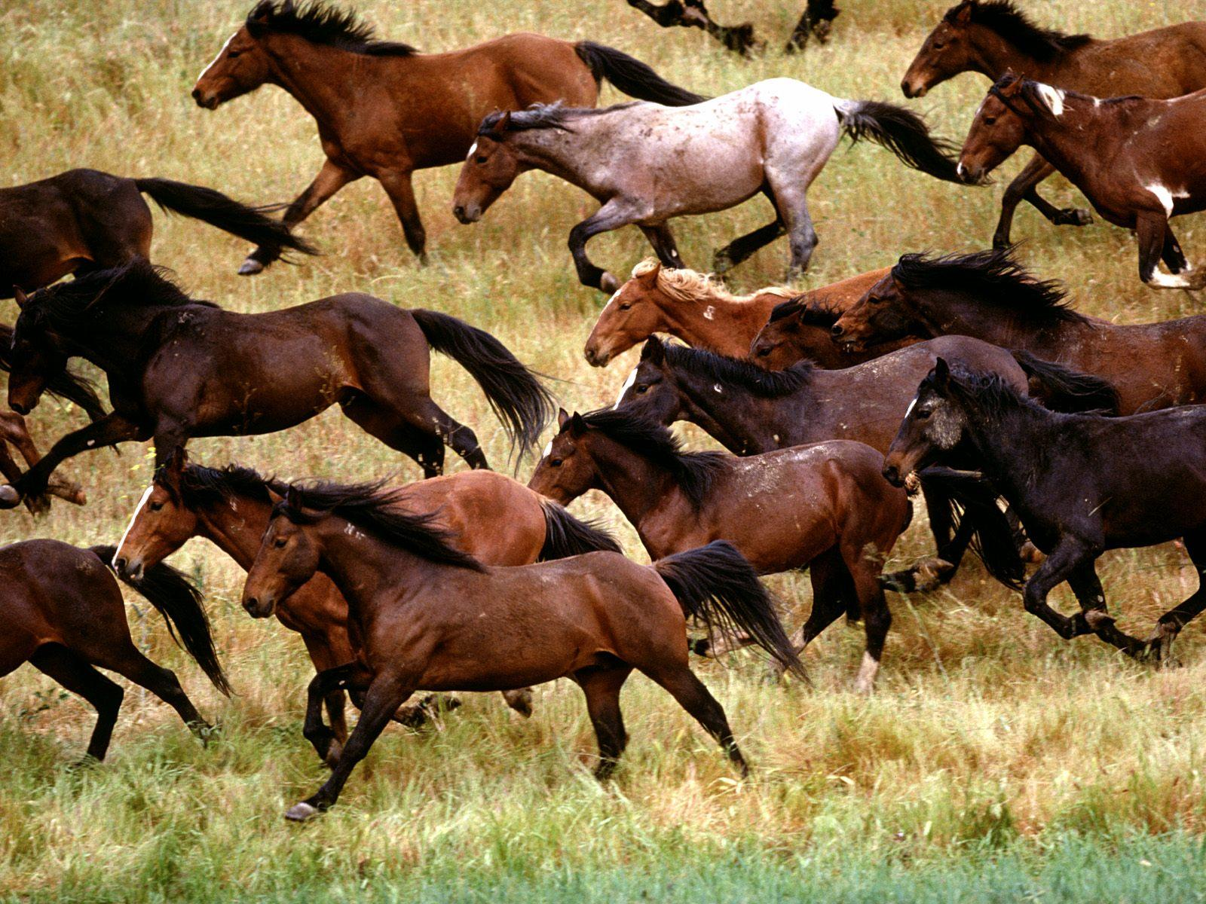
Introduction to MUSTANG
Robert Casey, IRIS Data Services
North American Seismic Network Training Workshop, Quality Assurance
August 1-2, 2018

Slide 2
What is MUSTANG?
An analytics database containing time series statistics for all stations in the IRIS archive.
A suite of web services providing quality assurance metrics on demand.
An ecosystem for rapid exploration of data quality and instrumentation state of health.
A collection of algorithms that continually process incoming waveform data and metadata.

Slide 3
Motivations for MUSTANG
Case histories have indicated the need for continual quality assurance procedures by network operators.
Station monitoring of data quality is insufficient for spotting long term trending of problems.
Data quality is (especially) relevant for old datasets.
Exploration and filtering of data quality outliers demands instant access to figures (not batched jobs).
Data constantly changes, requiring that metrics be updated.
UI tools are easy to use, but do not scale well and are not conducive to automation (hence web service APIs).

Slide 4
What Do I Get From MUSTANG?
In the most basic terms, columnar data points for station/channel/days
Target, start time, end time, load time
Measured value(s) for one metric/statistic
"Sample Mean Metric"
"value","target","start","end","lddate"
"467.1","HK.HKPS.00.BHE.M","2012/05/01 00:00:00","2012/05/01 23:59:59","2016/11/20 05:08:53" "257.1","HK.HKPS.00.BHN.M","2012/05/01 00:00:00","2012/05/01 23:59:59","2016/11/20 05:08:54" "474.2","HK.HKPS.00.BHZ.M","2012/05/01 00:00:00","2012/05/01 23:59:59","2016/11/20 05:08:55" "467.1","HK.HKPS..BHE.M","2012/05/01 00:00:00","2012/05/01 23:59:59","2016/11/20 05:08:56" "257.1","HK.HKPS..BHN.M","2012/05/01 00:00:00","2012/05/01 23:59:59","2016/11/20 05:08:57" "474.2","HK.HKPS..BHZ.M","2012/05/01 00:00:00","2012/05/01 23:59:59","2016/11/20 05:08:57" "467.2","HK.HKPS..HHE.M","2012/05/01 00:00:00","2012/05/01 23:59:59","2016/11/20 05:08:58" "257.2","HK.HKPS..HHN.M","2012/05/01 00:00:00","2012/05/01 23:59:59","2016/11/20 05:08:59" "474.3","HK.HKPS..HHZ.M","2012/05/01 00:00:00","2012/05/01 23:59:59","2016/11/20 05:08:59"
Not all metrics are created equal!

Slide 5
MUSTANG Architecture
There are many layers and many hosts.
System is always available and can serve many users.
Daily activities including new metric calculations.
MUSTANG is continually growing and evolving.

Slide 6
The MUSTANG Database
Master
Offsite standby
Disk
1
135 connections
NFS mounted NetApp
1 VM server instance
8 cores
24 GB RAM
UPSERT write txns
JDBC clients w/pool
Async hot standby
Job Queue
Postgres 9.5
10 TB in size
5.7 billon rows
~100 tables
2
Stations/Channels
2
PSD Spectrograms
Standard Metrics
1

Slide 7
MUSTANG Web Services
tomcat1
Load balanced tomcat servers
All code written in Java
Spring framework
JDBC connections to database
Clients perform HTTP calls
Response in various formats
‘measurements’ service
‘metrics’ service
‘targets’ service
Also a service to add new values
Special services for spectral noise
HTTP
queries
clients
tomcat2
MUSTANG DB
…
tomcatN

Slide 8
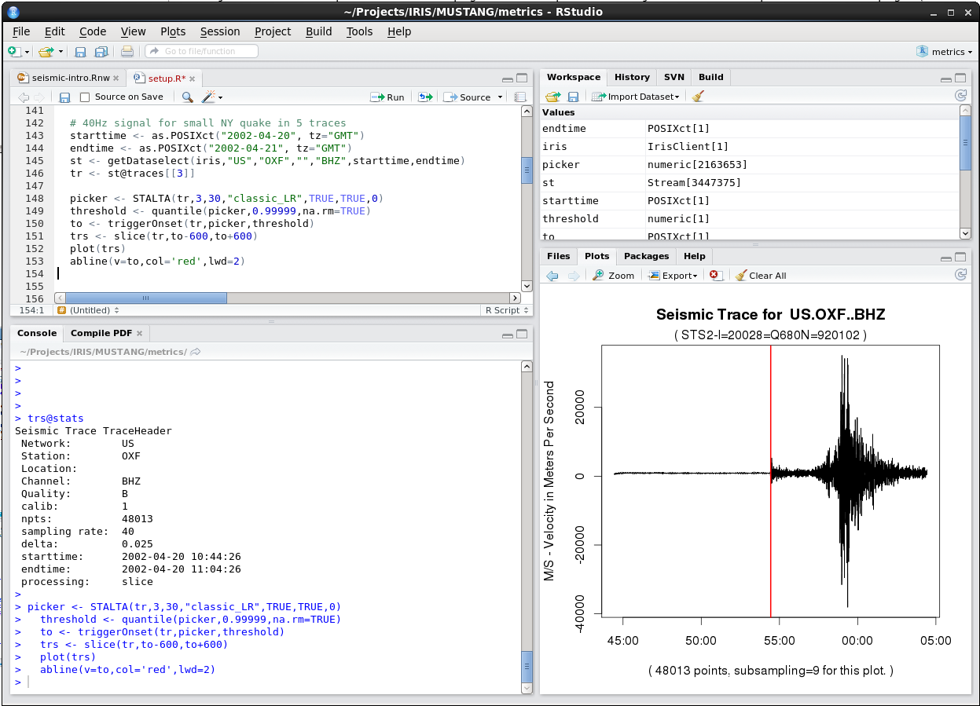
Metrics Algorithms
Metrics algorithms written in ‘R’
Metadata and archival miniseed data accessed via web services
libmseed reads miniseed into R objects
Extensive libraries make analysis algorithms easy to construct
R scripts process many channels as a batch job
https://www.r-project.org/

Slide 9
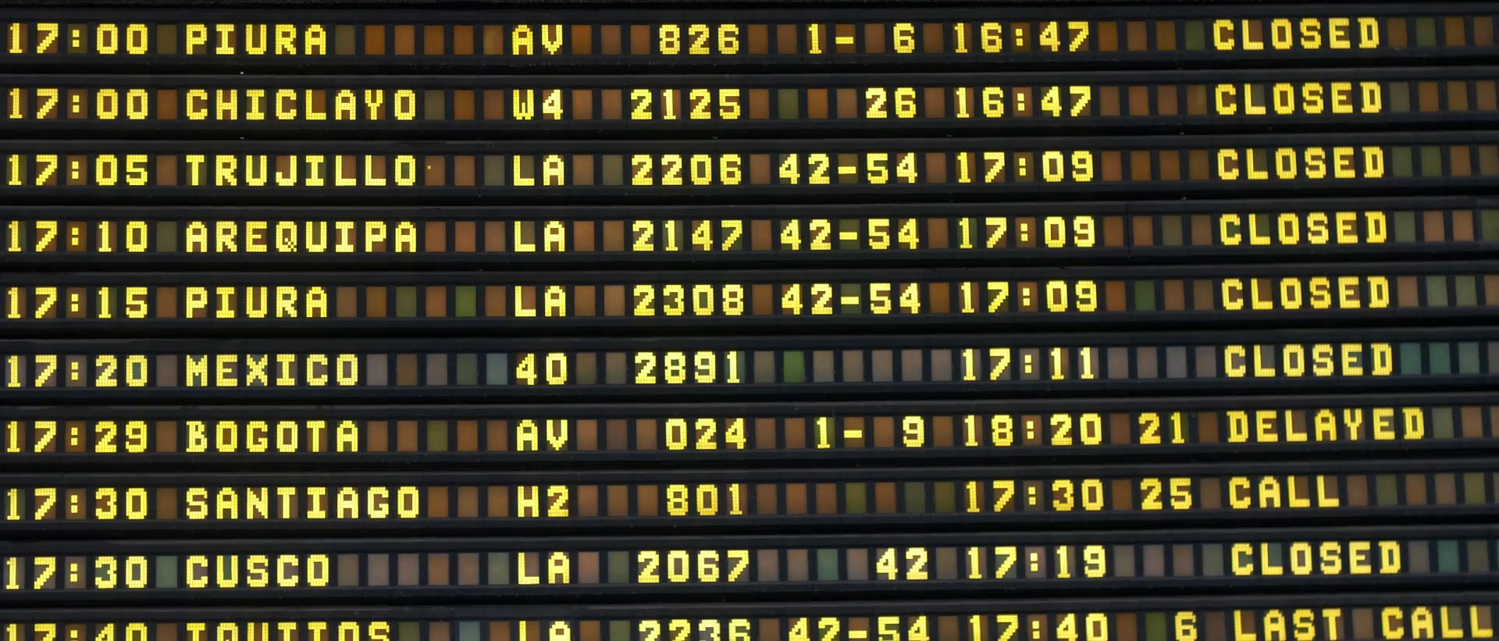
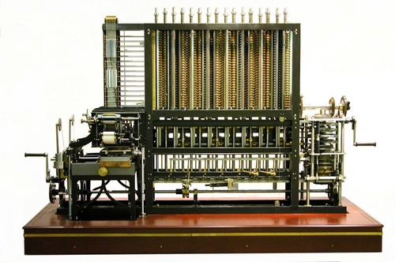
Master Control Runtime
Data Requests
Job Queue
Metrics Workflow
Job Manager
Assigned Resource

Slide 10
Distributed Metrics Processing
25 Virtual Machines between two locations
200 – 2000 jobs per hour

Slide 11
Metrics Collection after Calculation
tomcat1
tomcat2
…
MUSTANG DB
tomcatN

Slide 12
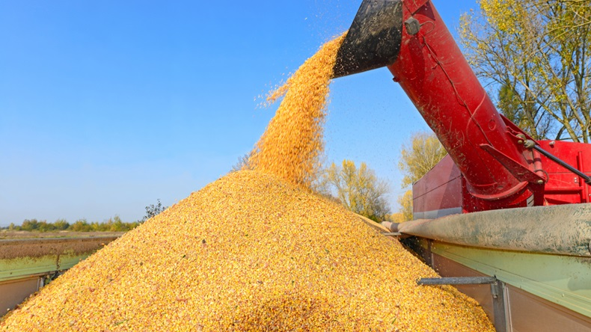
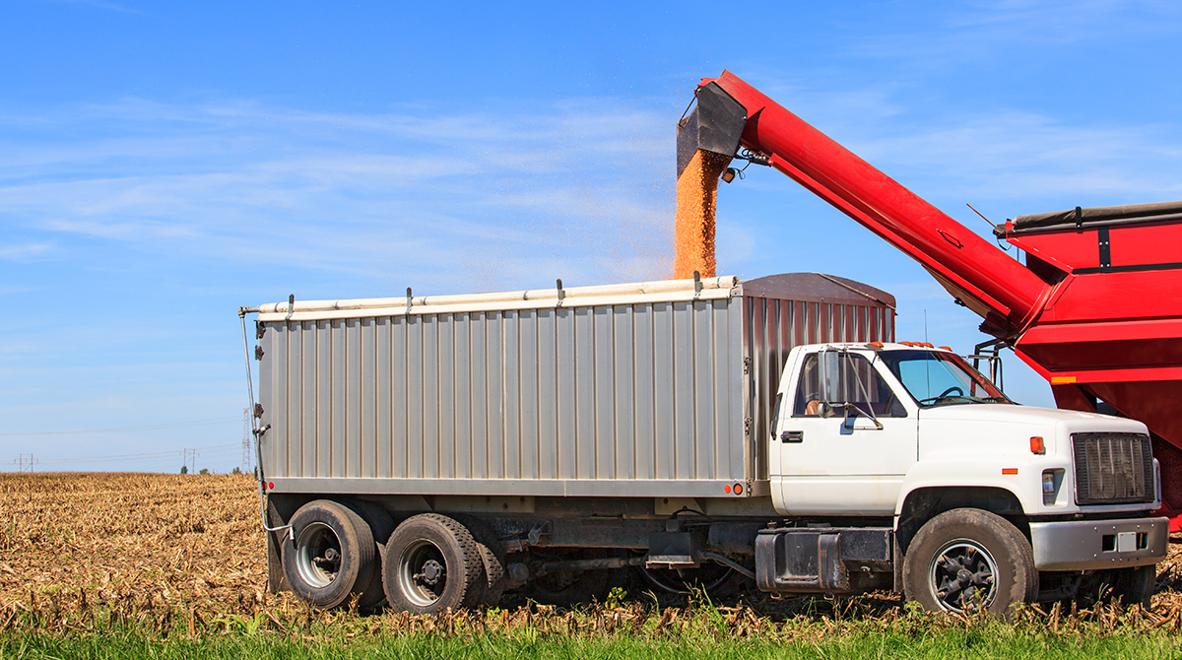
MustangMQ Metrics Collection
tomcat1
External metrics provider
MUSTANG DB
RabbitMQ holding area
Dequeue to Loader

Slide 13
Just-in-Time Metrics
Some metrics can be calculated on the fly from an external query source, especially one that is consistently up-to-date.
We are currently evaluating a class of ‘ts_’ (time series) metrics as replacements for the current gap metrics.
The MUSTANG database is largely bypassed with this operation.
client
Calculated gap metrics
tomcat1
irisws/
availability
Bulk results of available data
MUSTANG DB

Slide 14
PASTURE for metrics recalculation
Data archived at IRIS DMC is not static.
New data arrives constantly for current measurements
Older data arrives at any time and can undergo revisions
Metadata can change and undergo revisions
Data and metadata can be deleted
Compare and catalog data and metadata times vs metric times
States of metric entries in PASTURE
Metric for channel day is current to data
Metric for channel day is stale vs data
Metric for channel day is missing vs data
Metadata for channel day has changed
Metric for channel day has no data
PASTURE catalog is consulted regularly to automatically generate job workflows.

Slide 15
Secondary Data Center (ADC1)
Livermore data center location duplicates much of the hardware and software as Seattle.
Standby databases available for queries
Standby data archive can be accessed independently
Additional web service instances provided to balance load w/Seattle
MUSTANG web server instances provided
MUSTANG metrics processing interacts w/Seattle’s MCR job control
Many of the DMC operations can transfer to the ADC1 site as needed
DMC
client
ADC1

Slide 16
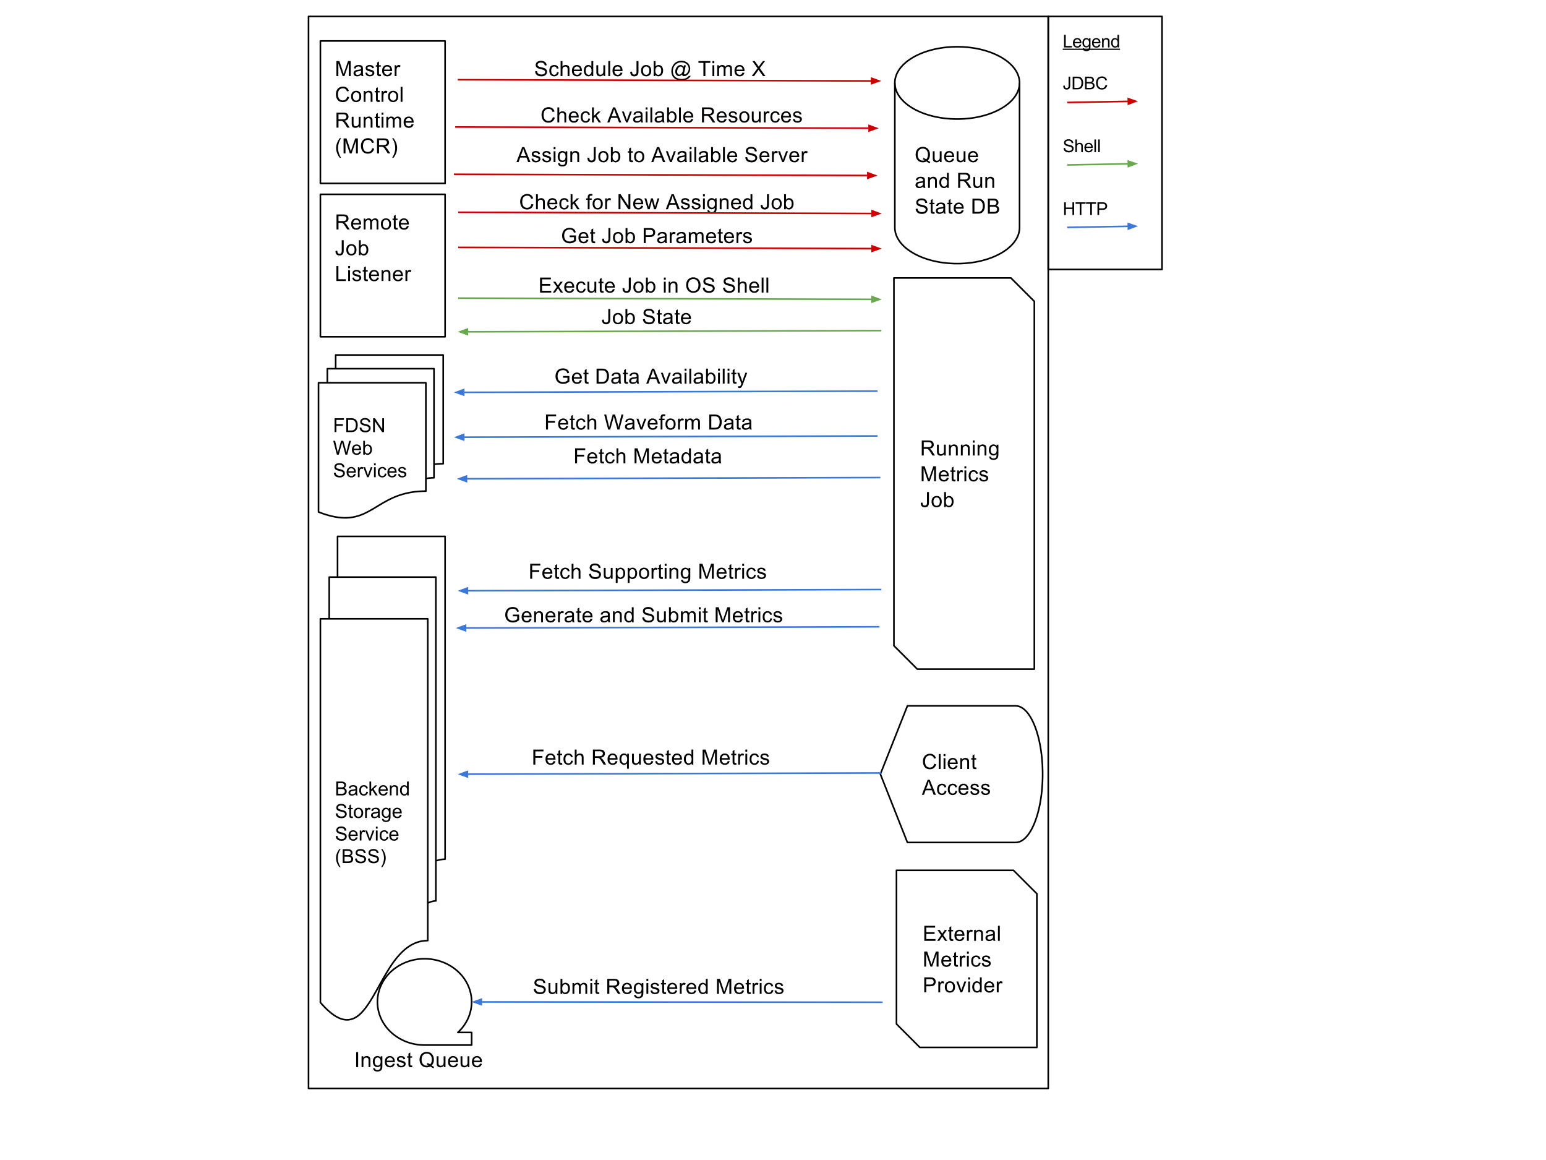
A Final Overview

